Slide 1
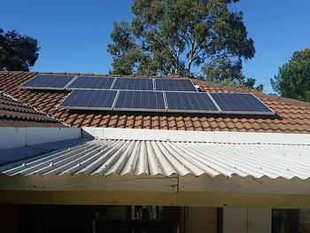


SOLAR POWERED BIO MEDICAL MANUFACTURING PLANT

Slide 2
01
Why Kenya
Contents
02
Investment Opportunity
03
Get Started

Slide 3

Why Kenya
Regional economic hub
Host to over 200 Multinational Corporations with regional & continent-wide HQs in Nairobi
Robust financial system
43 banking institutions
9 representative offices of foreign banks,
13 Microfinance Banks,
3 credit reference bureaus
19 Money Remittance Providers
73 forex bureaus
3rd largest
economy in sub-Saharan Africa.
US$ 110.35 Bn
7.5% growth
Dominant economy in EAC
≈46% of EAC’s GDP.
Africa’s UN HQs (UNON) which is one of four main UN secretariat duty stations globally.
Global headquarters of UNEP and UN-Habitat, together with a joint presence of 23 other UN Agencies.
Communications & Logistics hub of the region
Access to regional transport corridors.
4 international airports
2 sea ports and 2 ICDs
30-freight and 2-passenger rail services daily between Nairobi and Mombasa.
US$ 2,081.8
+75% growth since 2010
Growing middle-class with an increasing appetite for high-value goods and services.

Slide 4
The Investment Environment is Conducive
Guaranteed repatriation of capital and profits
Constitutional protection against expropriation
Investment guarantee against non-commercial risks: ICSID, MIGA and ATIA
1
Economic liberalization
One stop shop facilitation
Periodic Presidential roundtables with private sector
Digitization of government services
Facilitative Industrial zone programs - EPZs & SEZs
2
3
Political and macroeconomic stability.
High labour productivity: a large pool of youthful, trainable and literate workforce
Globally competitive:
56th in the Ease of Doing Business
1st for five years in a row in financial inclusion
1st globally in protection of minority investors
Nairobi – Africa’s leading business travel destination and hub for impact investors.
2nd in Africa in the logistics performance index
Investment attractiveness
Investment facilitation
Source: World Bank, UNCTAD, CBK, KNBS

Slide 5
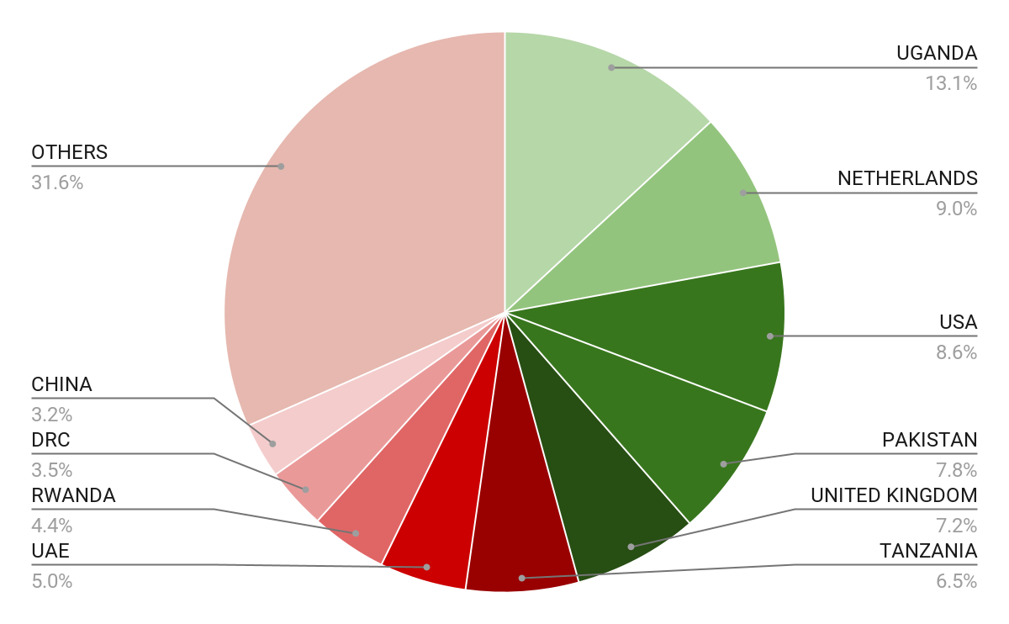





Wide Market Access & Good Trade Relations
US$ 17.43 Bn
Total Imports
US$ 6.09 Bn
Total Exports
Preferential Trade Agreements
1.7Bn
Population
~ US$ 40Tn
Market value
Kenya’s untapped export potential
~ US$ 4.1 Bn (ITC)

Slide 6
Existing Bilateral Trade Treaties with United Kingdom
Economic Partnership Agreement: In 2021, Kenya and the UK signed a trade agreement that seeks to deepen trade and investment ties between the two countries by providing a framework for the elimination of tariffs and non-tariff barriers.
Development Cooperation Agreement: In 2018, Kenya and the UK signed a development cooperation agreement, which aims to strengthen cooperation in areas such as health, education, governance, and security.
Double Taxation Agreement: In 1976, Kenya and the UK signed a double taxation agreement, which seeks to prevent double taxation of income earned by residents of the two countries.
Air Services Agreement: In 1967, Kenya and the UK signed an air services agreement, which allows airlines from the two countries to operate scheduled services between them.

Slide 7
Contents
01
Why Kenya
02
Investment Opportunity
03
Get Started

Slide 8
Executive Summary
Project Name: SOLAR POWERED BIO MEDICAL MANUFACTURING PLANT
County of operations: Nairobi
The Current status of project: Concept
Sector: Health
Proposed legal structure: PPP
Proposed investment structure
Type of investment: Equity / debt/donor
Type of investor needed: Debt/Equity Investor/donor
Expected Investments: Construction and operation of a biomedical manufacturing plant.
Investment Estimates: USD 30M
Phase 1: Construction of a Manufacturing plant that will be filling/sealing IV fluids at a nominal capacity of 1250 bags per hour (3.250.000 bags per year in 1 shift, 6.500.000 in 2 shifts, 9.750.000 in 3 shifts). The plant will have an estimated efficiency of 80% for phase one.
Phase 2: Installation of an additional line with a nominal capacity of 1250 bags per hour increasing our production capacity 2500 bags per hour (6.500.000 bags per year in 1 shift, 13.000.000 bags in 2 shifts, 19.500.000 in 3 shifts) and adding a line to produce 2500 empty bags in PP per hour starting from film.
Incorporate a solar energy system and medical Liquid gases plant. The solar system will generate enough power to run the biomedical manufacturing plant and supplement electricity thereby reducing energy costs.
Medical Liquid gases plant will provide affordable/Refilling of medical liquid Oxygen to big storage tanks, Cylinder Filling on Medical Oxygen Gases, Nitrogen, medical CO2 and Medical Nitrous Oxide to public, private, research and military health facilities in Kenya and beyond.

Slide 9
Problem Statement
There are only 2 identified biomedical plants manufacturing intravenous infusions in the continent. In East Africa, there is one manufacturing plant in Uganda – Abacus Parenteral Drugs Limited- dealing with parenteral fluids. The plant’s annual output is 20 million units of Large Volume Parenteral (LVP) solutions. They have a wide market base including Kenya through the Kenya Medical Supplies Authority, KEMSA.
In Ghana, there is Intravenous Infusions PLC which manufactures intravenous infusions and supplies neighboring countries in the region. The proposed biomedical plant is in a unique position to take advantage of the lack of local production of intravenous infusions and the country's total dependence on imports.
The imports business is facing several challenges with the Covid pandemic. Manufacturing countries are imposing exports restrictions leading to shortages of various consumables that rely on imports only.
The process of importing consumables is long and time consuming with frequent lag times resulting in periodic shortages. This impacts negatively to healthcare delivery. The proposed biomedical plant will fill this gap by ensuring timely and uninterrupted supply of affordable and quality consumables.

Slide 10
Opportunity and Value Proposition
Ready Market
Kenya has a population of 60M+ inhabitants, we estimate a yearly consumption of about 60 million IVF (intraVenous Fluids) of standard IVF + dialysis concentrate solutions mostly imported or locally manufactured. The prices are high (Kes 90/= per bag) allowing to estimate a Gross Operating Margin of over Kes 50/= per Bag).
Provide affordable treatment & therapy consumables to public, private, research and military health facilities in Kenya and beyond.
Lack of competition
There are only 2 identified biomedical plants manufacturing intravenous infusions in the continent. In East Africa, there is one manufacturing plant in Uganda – Abacus Parenteral Drugs Limited- dealing with parenteral fluids.

Slide 11
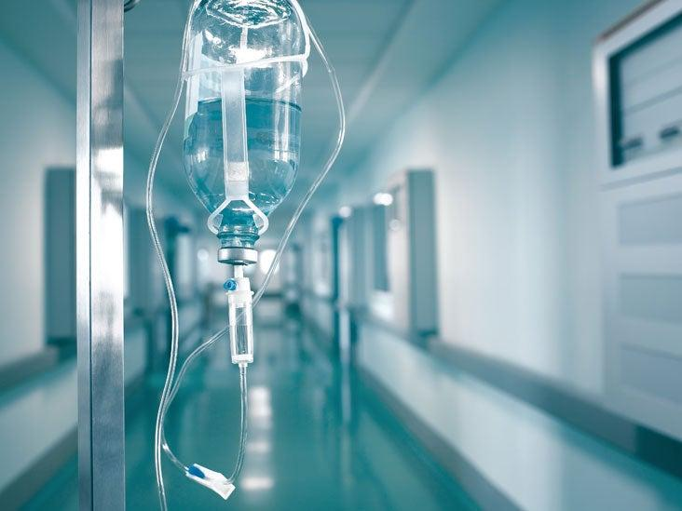
Solution / Product
Construction of a Bio-Medical Manufacturing plant encompassing the following functional elements:
The Main manufacturing plant block
Sterilization Department (CSSD)
Workshops (building, Electrical and Mechanical, Biomedical)
Holding Room (Quarantine)
Laboratories (Quality Control & Analysis)
Installation of Solar Energy component for energy provision
Water filtration system
Medical Liquid gases plant (Nitrogen, Medical CO2, Medical Nitrous Oxide Supply)
Manufacture of IV fluids, dialysis concentrate solutions, renal concentrates, and disinfectants
Manufacturing of Liquid Oxygen, Nitrogen, Medical CO2 and Medical Nitrous Oxide
Water filtration system
Solar Energy provision
Textile Embroidery

Slide 12
Financial Ask
Capital Cost (Ksh) to complete the Project ………….. US$ 30M
Investments | Cost (USD)
Land Acquisition costs | NO COST
Site Access, Preparation and Utility | NO COST
Construction | USD 10 M
Plant and Equipment | USD 20 M
Fixtures and Fittings | USD 5 M
Other Capital Costs (Solar) | USD 5 M
Notes:
Total investments – including inflation and 25% contingency – are estimated to amount to USD 210 M; total phase 1 investments are estimated to amount to USD 163 M.
Investments also include a small share of general port investments.

Slide 13
Social and Economic Impact
The hospital will cut costs as it will use the manufactured consumables
It will address the constant shortages brought on by challenges facing importation
It will be a source of income for the institution through sales made to hospitals and other consumers both locally and regionally.
It will provide employment opportunities.
It will contribute to the GDP of the country in the manufacturing sector. It will lower the cost of healthcare.

Slide 14
Contents
01
Why Kenya
02
Investment Opportunity
03
Get Started

Slide 15

Get started with KenInvest and KDC

Slide 16



