Slide 1
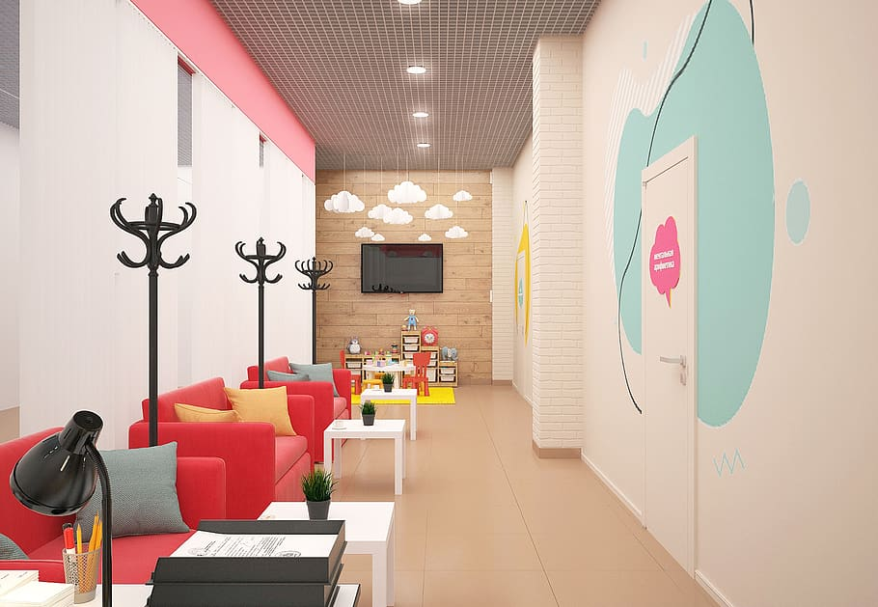


Proposed Children Hospital Project

Slide 2
01
Why Kenya
Contents
02
Investment Opportunity
03
Get Started

Slide 3

Why Kenya
Regional economic hub
Host to over 200 Multinational Corporations with regional & continent-wide HQs in Nairobi
Robust financial system
  43 banking institutions
  9 representative offices of foreign banks,
  13 Microfinance Banks,
  3 credit reference bureaus
  19 Money Remittance Providers
  73 forex bureaus
3rd largest
economy in sub-Saharan Africa.
US$ 110.35 Bn
7.5% growth
Dominant economy in EAC
≈46% of EAC’s GDP.
Africa’s UN HQs (UNON) which is one of four main UN secretariat duty stations globally.
Global headquarters of UNEP and UN-Habitat, together with a joint presence of 23 other UN Agencies.
Communications & Logistics hub of the region
Access to regional transport corridors.
  4 international airports
  2 sea ports and 2 ICDs
  30-freight and 2-passenger rail services daily between Nairobi and Mombasa.
US$ 2,081.8
+75% growth since 2010
Growing middle-class with an increasing appetite for high-value goods and services.

Slide 4
The Investment Environment is Conducive
Guaranteed repatriation of capital and profits
Constitutional protection against expropriation
Investment guarantee against non-commercial risks: ICSID, MIGA and ATIA
1
Economic liberalization
One stop shop facilitation
Periodic Presidential roundtables with private sector
Digitization of government services
Facilitative Industrial zone programs - EPZs & SEZs
2
3
Political and macroeconomic stability.
High labour productivity: a large pool of youthful, trainable and literate workforce
Globally competitive:
  56th in the Ease of Doing Business
  1st for five years in a row in financial inclusion
  1st globally in protection of minority investors
  Nairobi – Africa’s leading business travel destination and hub for impact investors.
  2nd in Africa in the logistics performance index
Investment attractiveness
Investment facilitation
Source: World Bank, UNCTAD, CBK, KNBS

Slide 5
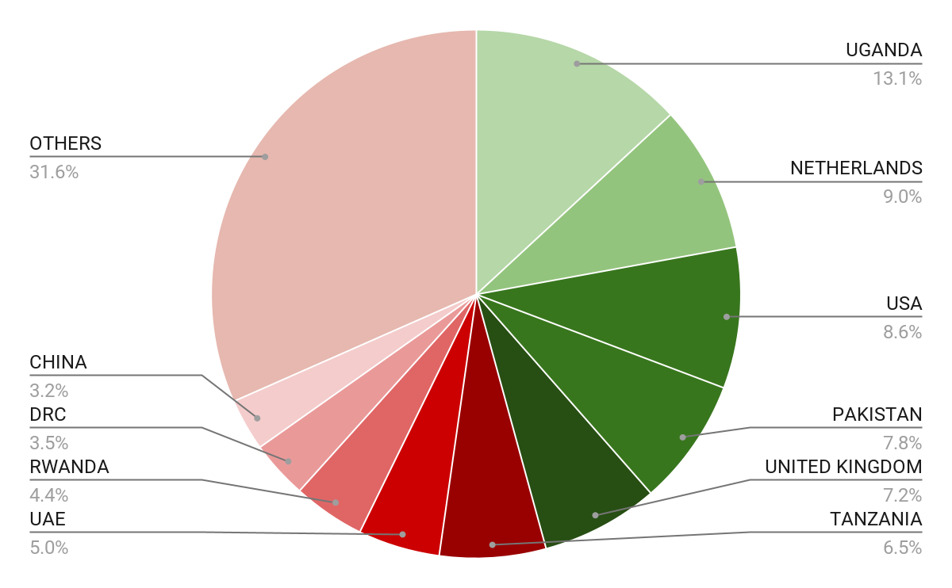





Wide Market Access & Good Trade Relations
US$ 17.43 Bn
Total Imports
US$ 6.09 Bn
Total Exports
Preferential Trade Agreements
1.7Bn
Population
~ US$ 40Tn
Market value
Kenya’s untapped export potential
~ US$ 4.1 Bn (ITC)

Slide 6
Existing Bilateral Trade Treaties with United Kingdom
Economic Partnership Agreement: In 2021, Kenya and the UK signed a trade agreement that seeks to deepen trade and investment ties between the two countries by providing a framework for the elimination of tariffs and non-tariff barriers.
Development Cooperation Agreement: In 2018, Kenya and the UK signed a development cooperation agreement, which aims to strengthen cooperation in areas such as health, education, governance, and security.
Double Taxation Agreement: In 1976, Kenya and the UK signed a double taxation agreement, which seeks to prevent double taxation of income earned by residents of the two countries.
Air Services Agreement: In 1967, Kenya and the UK signed an air services agreement, which allows airlines from the two countries to operate scheduled services between them.

Slide 7
Contents
01
Why Kenya
02
Investment Opportunity
03
Get Started

Slide 8
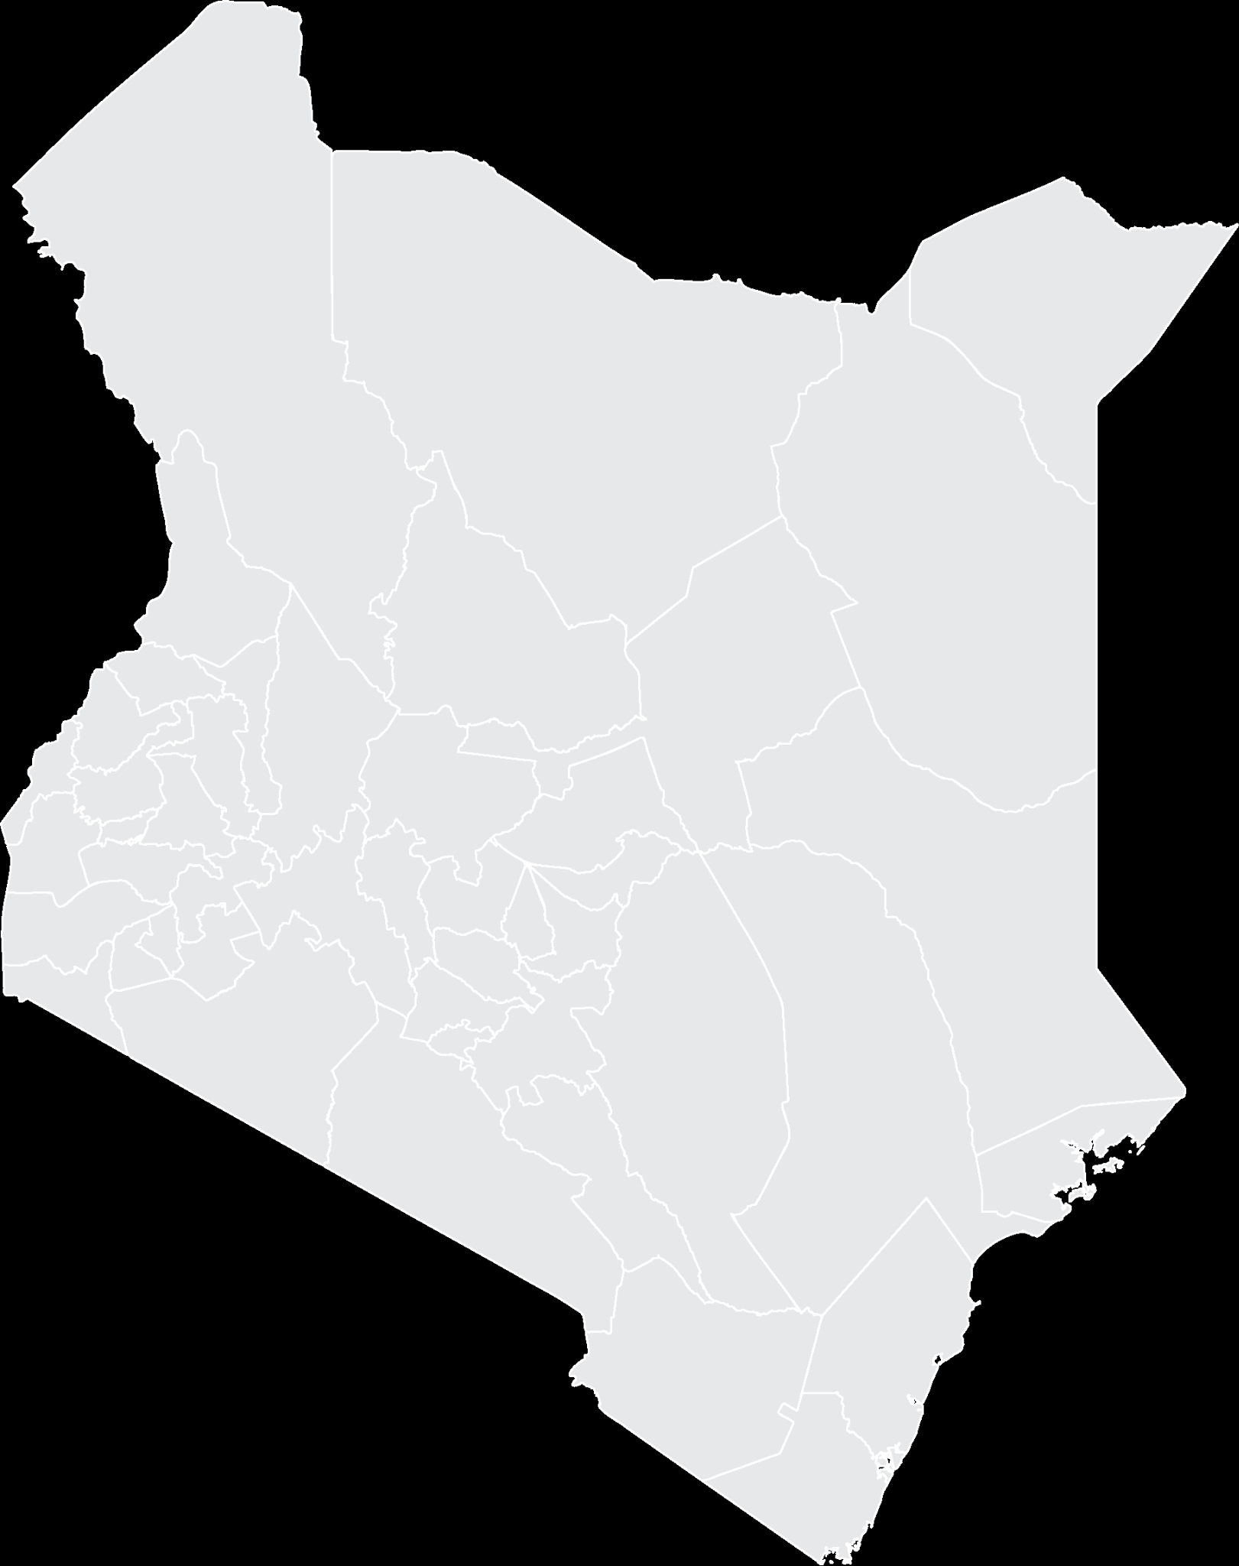



Executive Summary
Project Name: PROPOSED CHILDREN HOSPITAL PROJECT
IMPLEMENTING AGENCY: KENYATTA UNIVERSITY TEACHING, REFERRAL & RESEARCH HOSPITAL
ESTIMATED INVESTMENT COST: USD 60 Million
TARGET POPULATION: NAIROBI, MT. KENYA, EASTERN AND NORTHERN KENYA REGIONS (19.19 Million)
INVESTMENT ENGAGEMENT: PUBLIC PRIVATE PARTNERSHIP (PPP)
i
NAIROBI COUNTY

Slide 9
Problem Statement
Kenya lacks adequate Children Hospitals. Only 1 Public Children Hospital, Shoe4Africa (2015), under Moi Teaching & Referral Hospital serving North Rift and Western Regions serving a population of 47.5 Million
Africa equally suffers from a dire lack of dedicated public children hospitals. Only 3 against an approximate population of 1 billion people.
The three are: 1 in Kenya, 2 in South Africa
Children are treated in normal hospitals which are not designed with children in mind.
Children require dedicated healthcare facilities to cater for their unique needs.
The establishment of a child-centred hospital will therefore fill this gap in the country and give children and their caregivers a better experience while receiving quality health care in Kenya

Slide 10
Opportunity and Value Proposition
Salient Features
600 bed capacity Level 6 Hospital
Highly specialised Children Hospital with child friendly facilities
Paediatric Cancer Centre served by the Integrated Molecular Imaging Centre
Brief description of the opportunity that exists as a result of the problem.
Establishment of a Children Hospital would lead to improved health outcomes for children.
The Hospital will improve socio economic conditions
The Hospital will generate enough revenue to give ROI.
Brief description on the size of the market opportunity of the project. What proportion of this population will be served by the proposed project? (Market Share)
The area encompassing Nairobi, Mt. Kenya, Eastern and Northern Kenya Regions with a population of 19.19 Million does not have a single Children Hospital
The hospital will also serve patients from other countries in the region.
The Hospital will therefore have a huge catchment area.
What is the Value Proposition (in one simple statement) for the project? (Unique Selling Point)
The hospital will be serving a population that has not been served thereby creating enough volumes
Competitive advantage
It will be the only hospital in the region

Slide 11
Financial Ask
Description | Phase 1 (USD) | Phase (2 USD) | Totals (USD)
Infrastructure | 12,528,288 | 12,984,000 | 25,512,288
Personnel & Capacity Building | 3,592,050 | 3,953,682 | 7,545,732
Biomedical Equipment | 10,850,305 | 13,838,400 | 24,688,705
Design Preparation(2%) | 250,566 | 259,680 | 510,246
Contingency(2.5%) | 313,207 | 324,600 | 637,807
Totals | 27,534,416 | 31,360,362 | 58,894,778
Current implementation Status: at the foundation level
Available Financing: GoK has allocated USD 1.7M in the financial year 2022-23
Required Financing: USD 60 Million

Slide 12
Financial Projections
Projections for the duration to pay off both debt and equity injections
Year | Revenue USD | Cost USD | Net income USD
3 | 12,475,368 | 4,279,619 | 8,195,749
5 | 13,596,544 | 4,718,280 | 8,878,265
10 | 17,405,543 | 6,021,853 | 11,383,690
Risk | Likelihood/Probability | Risk Impact | Mitigation Strategy
Project Cost Variations | Likely to occur | Medium | Legally binding contacts Involvement of professionals in initial project costing
Change in government policy | Not Likely to occur | Medium | Lobby for political goodwill Alignment with long-term government policy.

Slide 13
Social and Economic Impact
Social Impact
Economic Impact
Improvement in paediatric health outcomes Improvement in quality of life
Reduction in child mortality rates
Reducing social exclusion of the vulnerable
Generation of jobs thus positively impacting the economy
Creation of opportunities for business through procurement of goods and services
A driver for implementation of local and national goals for sustainable development

Slide 14
Financial Projections
Project Returns and Outcomes
IRR
The IRR at 80%, 90% and 100% capacity utilization levels are 24%, 28.3% and 32.2% respectively.
NPV
The NPV, which is the difference between the present values of all cash inflows and the cash outflows for the twenty years, represents the net benefit over and above the compensation for time and risk.
The results of the cost-benefit analysis presented shows that the hospital project is viable up to about 32.2% discount rate at 100% capacity utilization, 28.3% discount rate at 90% capacity utilization and 24% discount rate at 80% level of capacity utilization.

Slide 15

Timelines
Project Team
Execution from start to completion.
3 YEARS
CEO - Overall responsible
Directorate of Planning, Development & Partnerships - incharge of all project and development initiatives
Projects and Facilities Manager
Project Consultants-to be determined
Contractor- to be determined.
Stage
1
Stage 2
Stage 3
Project definition plan
Master planning
Schematic design
Developed design
Construction documentation
Construction and commissioning
Post occupancy evaluation

Slide 16
Contents
01
Why Kenya
02
Investment Opportunity
03
Get Started

Slide 17

Get started with KenInvest and KDC

Slide 18



