Slide 1
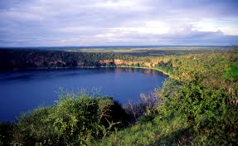


Lake Challa Water Resources Integrated Development Project

Slide 2
01
Why Kenya
Contents
02
Investment Opportunity
03
Get Started

Slide 3

Why Kenya
Regional economic hub
Host to over 200 Multinational Corporations with regional & continent-wide HQs in Nairobi
Robust financial system
  43 banking institutions
  9 representative offices of foreign banks,
  13 Microfinance Banks,
  3 credit reference bureaus
  19 Money Remittance Providers
  73 forex bureaus
3rd largest
economy in sub-Saharan Africa.
US$ 110.35 Bn
7.5% growth
Dominant economy in EAC
≈46% of EAC’s GDP.
Africa’s UN HQs (UNON) which is one of four main UN secretariat duty stations globally.
Global headquarters of UNEP and UN-Habitat, together with a joint presence of 23 other UN Agencies.
Communications & Logistics hub of the region
Access to regional transport corridors.
  4 international airports
  2 sea ports and 2 ICDs
  30-freight and 2-passenger rail services daily between Nairobi and Mombasa.
US$ 2,081.8
+75% growth since 2010
Growing middle-class with an increasing appetite for high-value goods and services.

Slide 4
The Investment Environment is Conducive
Guaranteed repatriation of capital and profits
Constitutional protection against expropriation
Investment guarantee against non-commercial risks: ICSID, MIGA and ATIA
1
Economic liberalization
One stop shop facilitation
Periodic Presidential roundtables with private sector
Digitization of government services
Facilitative Industrial zone programs - EPZs & SEZs
2
3
Political and macroeconomic stability.
High labour productivity: a large pool of youthful, trainable and literate workforce
Globally competitive:
  56th in the Ease of Doing Business
  1st for five years in a row in financial inclusion
  1st globally in protection of minority investors
  Nairobi – Africa’s leading business travel destination and hub for impact investors.
  2nd in Africa in the logistics performance index
Investment attractiveness
Investment facilitation
Source: World Bank, UNCTAD, CBK, KNBS

Slide 5
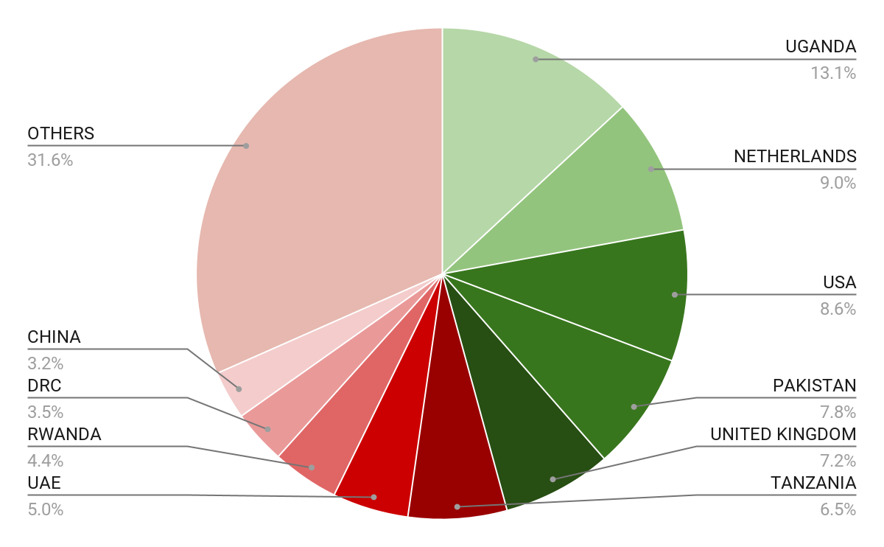





Wide Market Access & Good Trade Relations
US$ 17.43 Bn
Total Imports
US$ 6.09 Bn
Total Exports
Preferential Trade Agreements
1.7Bn
Population
~ US$ 40Tn
Market value
Kenya’s untapped export potential
~ US$ 4.1 Bn (ITC)

Slide 6
Existing Bilateral Trade Treaties with United Kingdom
Economic Partnership Agreement: In 2021, Kenya and the UK signed a trade agreement that seeks to deepen trade and investment ties between the two countries by providing a framework for the elimination of tariffs and non-tariff barriers.
Development Cooperation Agreement: In 2018, Kenya and the UK signed a development cooperation agreement, which aims to strengthen cooperation in areas such as health, education, governance, and security.
Double Taxation Agreement: In 1976, Kenya and the UK signed a double taxation agreement, which seeks to prevent double taxation of income earned by residents of the two countries.
Air Services Agreement: In 1967, Kenya and the UK signed an air services agreement, which allows airlines from the two countries to operate scheduled services between them.

Slide 7
Contents
01
Why Kenya
02
Investment Opportunity
03
Get Started

Slide 8
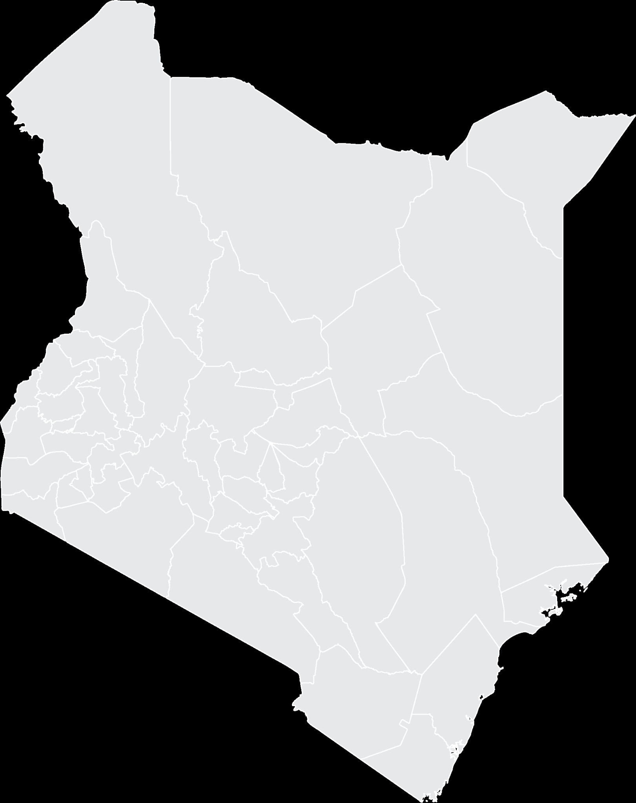


Executive Summary
Project Name: LAKE CHALA WATER RESOURCES INTEGRATED DEVELOPMENT PROJECT
i
IMPLEMENTING AGENCY: COAST DEVELOPMENT AUTHORITY
INVESTMENT VALUE: USD 118.2 Million
INVESTMENT STRUCTURE: PUBLIC PRIVATE PARTNERSHIP (PPP)
i
Taita Taveta County

Slide 9
Problem Statement
Low Rainfall
The project area is ASAL with inadequate portable water for domestic, livestock and irrigation.
Aquifer underutilization
Despite the existence of volcanic crater freshwater Lake that is recharged by underground aquifers from Mt. Kilimanjaro, the water resources are underutilized.
Water scarcity for domestic, livestock and irrigation use
Household survey confirmed that access to water for domestic and livestock use is a major challenge, particularly during the dry seasons with 77% of the respondents indicating that they purchase water.
81.1% of the population rely heavily on agriculture, i.e. subsistence farming and livestock production.

Slide 10
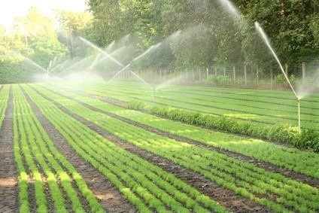
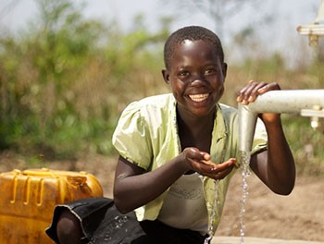
Opportunity and Value Proposition
Integrated Project
Commercialization of domestic water supply
Commercialization of water for livestock use
Irrigated Agriculture
Water Abstraction
Lake Challa 2,640,000 m³/year
3 Boreholes 7,920,000 m³/year
Water supply rate
557,365 m³ annually for domestic and livestock use
9.6 million m³/year provided for irrigation of over 2,020 ha of land
Water Demand of 11.68 million m³/year
Provision of potable water at a cost of $ 0.38 per m³compared to current $ 3.8 per m³
Unlock commercial cash crop farming from rainfed to Irrigated agriculture (2020 ha)

Slide 11
Financial Ask
Alternative | Description | Investment costs (USD) | O&M costs @ 3% USD
1a | Full project(Lake +Bore holes) including Mwaktau area | 118.2 M | 3.55 M
1b | Full project(Lake +Bore holes) excluding Mwaktau area | 84.31 M | 2.53 M
2a | Full project(Bore holes) including Mwaktau area | 117.45 M | 3,52 M
2b | Full project(Bore holes) excluding Mwaktau area | 83.36 M | 2.50 M
      Revenue
Domestic water supply revenues are expected to increase from $389,046 in year 1 to $865,219 in 20 years.
Crop farming is expected to grow from $561,227 from year 1, year 2 $11.67 Mn stabilize at $ 19.15 Mn by 3rd year of cropping.
      Cost
The total investment cost is USD 118.2 Million.
      Project Returns and Outcomes
Net Present Value- USD 56.59 Million
Internal Rate of Return- 7.48%
Benefit Cost Ratio-1.42

Slide 12
Risks and Mitigation
RISK CLASS | RISK | MITIGATION MEASURES
Engineering Design | Human Resource competency | Hire technical expertise
Construction | Resettlement of project affected persons | Compliance to project safeguards
Regulatory | Accidents occurring during construction Approvals Changes Taxation and Tariff regimes | Ensure attainment and compliance with all relevant approvals
Revenue inflows | Low revenue inflows at inception | Sensitization of target customers and securing available incentives on capital investments

Slide 13
Socio-Economic Impact
Increased irrigated area and change from subsistence to commercial agriculture by the farmers hence increase in crop yields per unit area.
Change from subsistence and commercial farming creates more business opportunities
Improved irrigation access significantly contributes to poverty reduction through improved employment from labor requirements.
Availability of piped water at household level create more time for other economic activities
Reduced outbreak of waterborne disease Setting up of a water supply system for fisheries and forestry.
Provision of water for wildlife within the park. Development of eco-tourism initiatives

Slide 14

Timelines
Project Team
Phase 1
  To cover Kilanga Pilot Irrigation Project, the existing Challa Irrigation Scheme, Fisheries and Forestry
The National Treasury - Projects development approvals
Coast Development Authority - Project management and coordination
Investor - Financier (100% financing from the investor)
County Government of Taita Taveta - Buyer
Phase 2
  To cover Nakuruto, Timbila and Jipe Irrigation schemes, provision of domestic water within the areas covered by the pipelines, Fisheries and Forestry
Phase 3
To cover Mwaktau Irrigation Schemes, provision of domestic and livestock water within the areas covered by the pipelines, Fisheries and Forestry

Slide 15
Contents
01
Why Kenya
02
Investment Opportunity
03
Get Started

Slide 16

Get started with KenInvest and KDC

Slide 17



