Slide 1
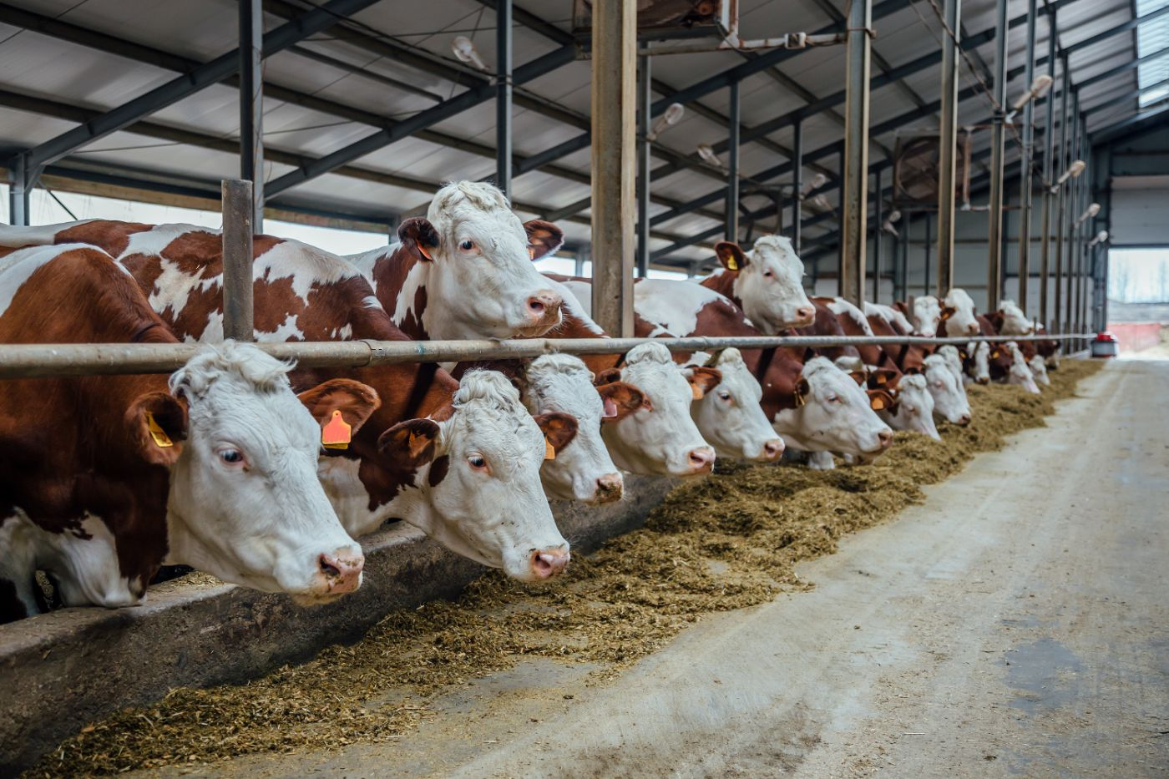

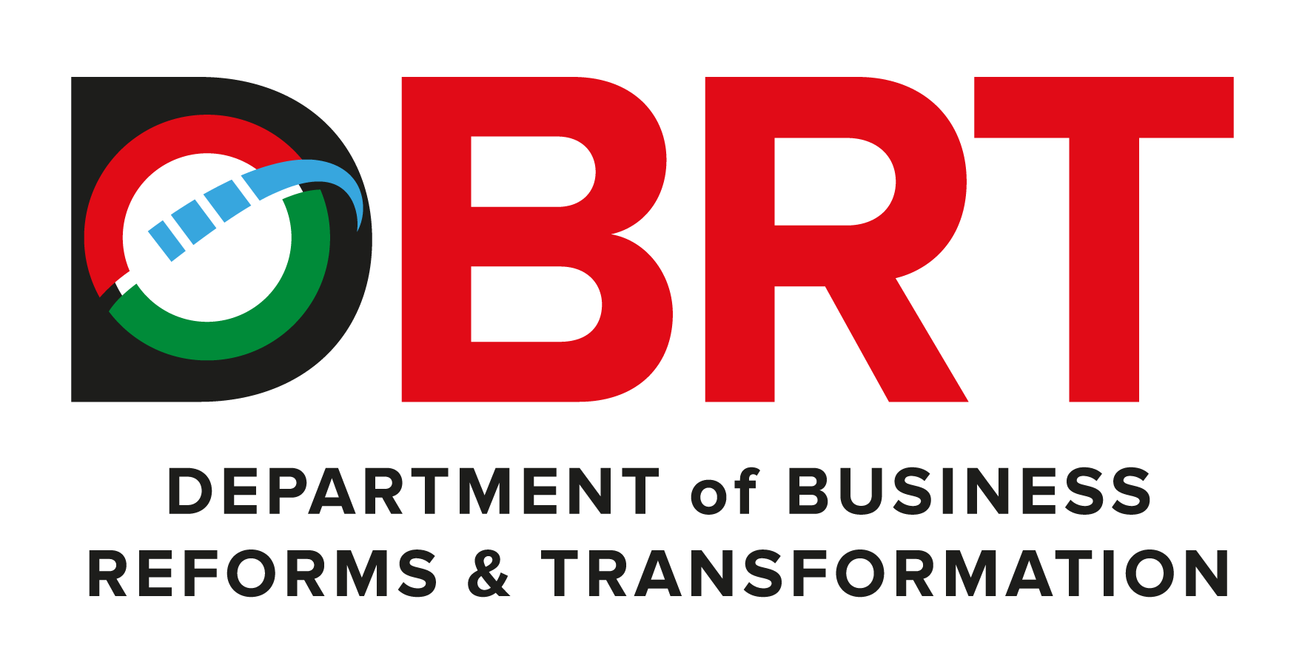
Livestock Integrated Project - Masinga

Slide 2
01
Why Kenya
Contents
02
Investment Opportunity
03
Get Started

Slide 3

Why Kenya
Regional economic hub
Host to over 200 Multinational Corporations with regional & continent-wide HQs in Nairobi
Robust financial system
43 banking institutions
9 representative offices of foreign banks,
13 Microfinance Banks,
3 credit reference bureaus
19 Money Remittance Providers
73 forex bureaus
3rd largest
economy in sub-Saharan Africa.
US$ 110.35 Bn
7.5% growth
Dominant economy in EAC
≈46% of EAC’s GDP.
Africa’s UN HQs (UNON) which is one of four main UN secretariat duty stations globally.
Global headquarters of UNEP and UN-Habitat, together with a joint presence of 23 other UN Agencies.
Communications & Logistics hub of the region
Access to regional transport corridors.
4 international airports
2 sea ports and 2 ICDs
30-freight and 2-passenger rail services daily between Nairobi and Mombasa.
US$ 2,081.8
+75% growth since 2010
Growing middle-class with an increasing appetite for high-value goods and services.

Slide 4
The Investment Environment is Conducive
Guaranteed repatriation of capital and profits
Constitutional protection against expropriation
Investment guarantee against non-commercial risks: ICSID, MIGA and ATIA
1
Economic liberalization
One stop shop facilitation
Periodic Presidential roundtables with private sector
Digitization of government services
Facilitative Industrial zone programs - EPZs & SEZs
2
3
Political and macroeconomic stability.
High labour productivity: a large pool of youthful, trainable and literate workforce
Globally competitive:
56th in the Ease of Doing Business
1st for five years in a row in financial inclusion
1st globally in protection of minority investors
Nairobi – Africa’s leading business travel destination and hub for impact investors.
2nd in Africa in the logistics performance index
Investment attractiveness
Investment facilitation
Source: World Bank, UNCTAD, CBK, KNBS

Slide 5
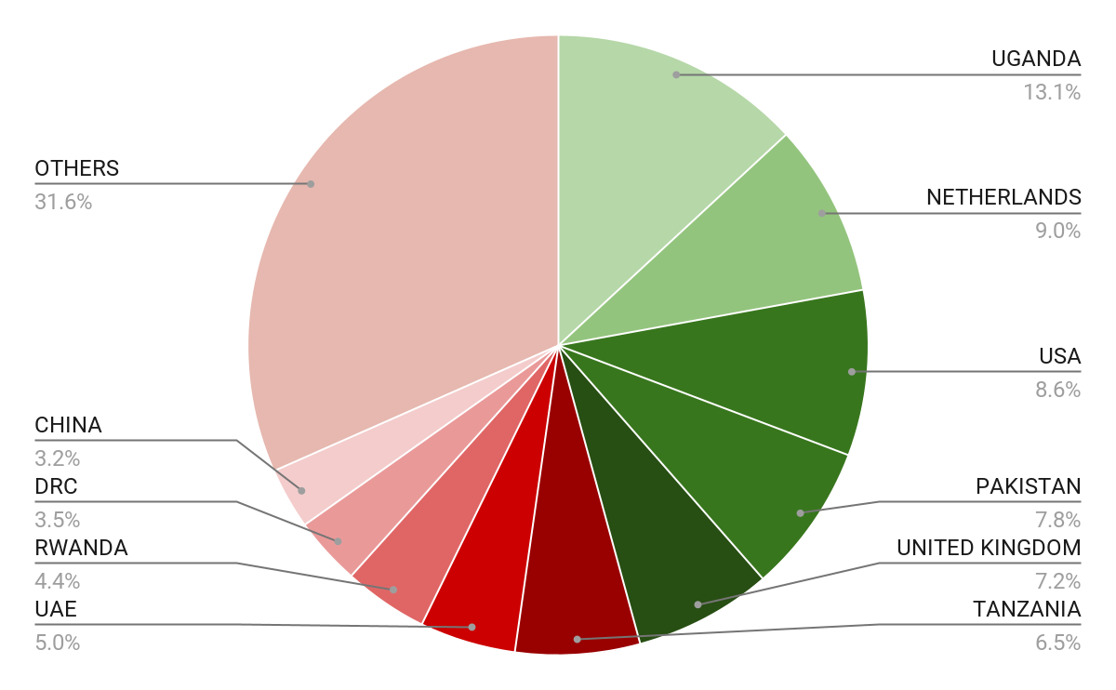





Wide Market Access & Good Trade Relations
US$ 17.43 Bn
Total Imports
US$ 6.09 Bn
Total Exports
Preferential Trade Agreements
1.7Bn
Population
~ US$ 40Tn
Market value
Kenya’s untapped export potential
~ US$ 4.1 Bn (ITC)

Slide 6
Existing Bilateral Trade Treaties with United Kingdom
Economic Partnership Agreement: In 2021, Kenya and the UK signed a trade agreement that seeks to deepen trade and investment ties between the two countries by providing a framework for the elimination of tariffs and non-tariff barriers.
Development Cooperation Agreement: In 2018, Kenya and the UK signed a development cooperation agreement, which aims to strengthen cooperation in areas such as health, education, governance, and security.
Double Taxation Agreement: In 1976, Kenya and the UK signed a double taxation agreement, which seeks to prevent double taxation of income earned by residents of the two countries.
Air Services Agreement: In 1967, Kenya and the UK signed an air services agreement, which allows airlines from the two countries to operate scheduled services between them.

Slide 7
Contents
01
Why Kenya
02
Investment Opportunity
03
Get Started

Slide 8
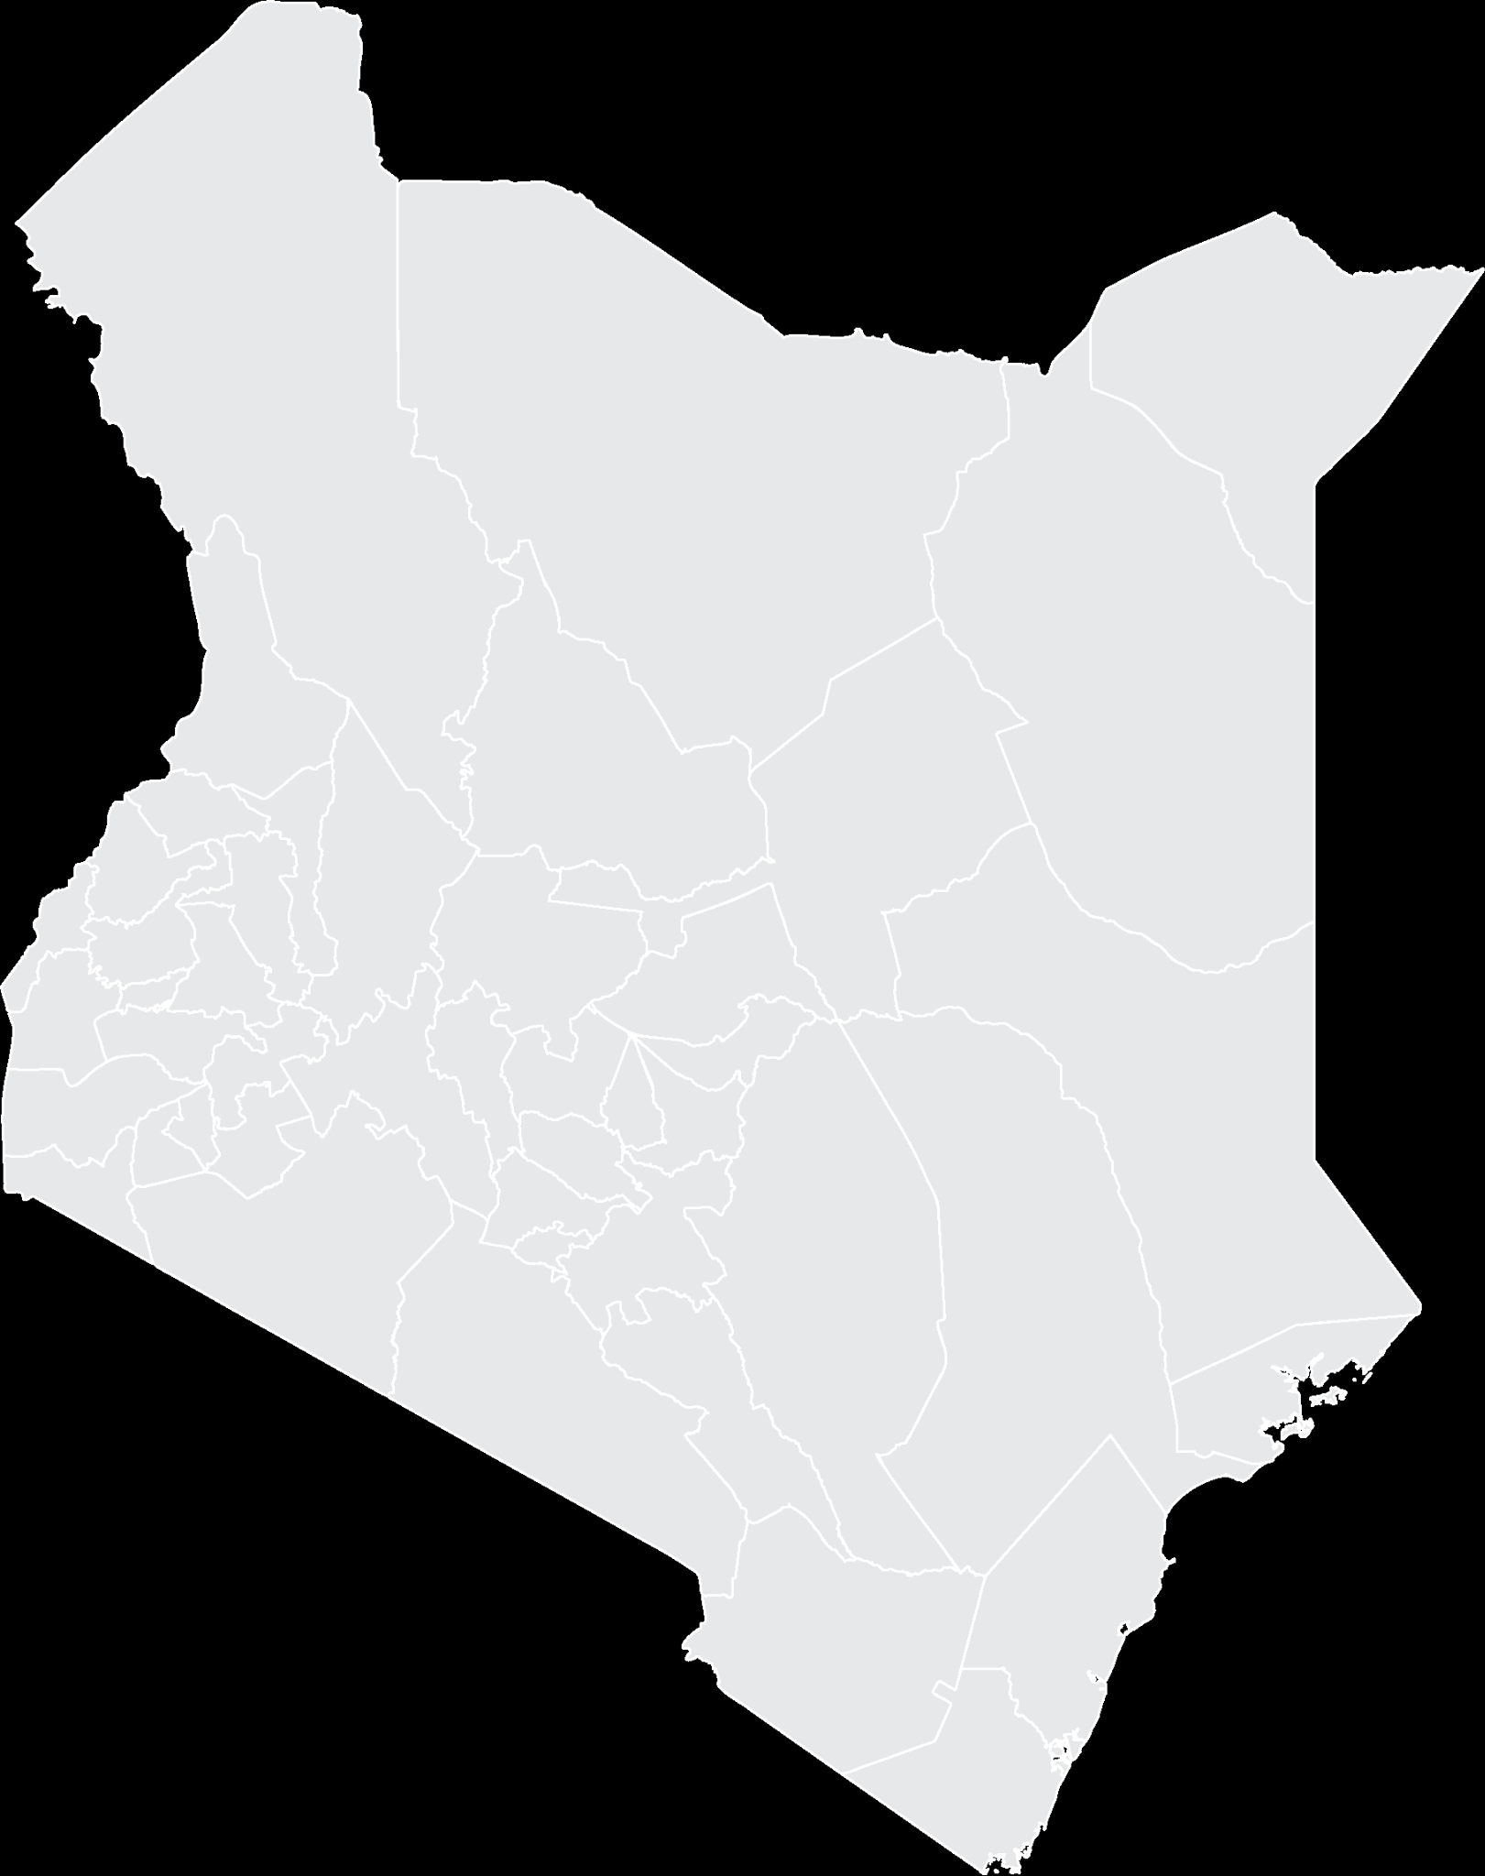



Executive Summary
Project Name: MASINGA LIVESTOCK INTEGRATED PROJECT
IMPLEMENTING AGENCY: TANA & ATHI RIVERS DEVELOPMENT AUTHORITY
ESTIMATED INVESTMENT COST: USD 17 Million
INVESTMENT ENGAGEMENT: PUBLIC PRIVATE PARTNERSHIP (PPP)
i
MACHAKOS COUNTY

Slide 9







Masinga site components offers the best access to the Nairobi market combined with low initial investment
Masinga Dam site
County:
Size of land:
Machakos
2,000 hectares
Overview of project
Phase 1
Phase 2
2000
hectares
Total land encircling the Masinga dam reservoir
1
Irrigation for fodder production
Key Financial Metrics
2
Watering points
Initial investment
Annual revenue
Annual EBITDA
Equity IRR¹
Payback period
~USD 17 Mn
~USD 7 Mn
~USD 2 Mn
~14%
<10 years
3
Grazing and grassland regeneration
151 Km
Distance to Nairobi, economic hub of Kenya
4
Feedlot for 1000 cattle
5
Breeding farm for 500 cows
6
Feed mill for 5 -10 t/day
2 phases
Initial focus on irrigation and breeding, then dairy processing
7
Milk collection buffer tank
Enablers:
Situated near Masinga Dam reservoir reservoir with ~5 Mn cubic meters of water
Close to Nairobi ~151km
Ready market for surplus fodder and breeding cattle
8
Dairy processing plant
9
Abattoir
1. Equity IRR only calculated for irrigation scheme
Source: TARDA feasibility study for integrated livestock

Slide 10
Problem Statement
The effects of climate change has caused significant drought in regions of Kiambere and Masinga region, which has led to loss of livestock due to dwindling pasture for animals.
This has resulted to the shift from rainfed to irrigated agriculture to bridge the demand gaps and thereby provided opportunities in livestock farming that include; Fodder production (silage lucerne hay & maize forage), breeding farms, Feedmill production and abattoir for the region.
Feed scarcity for livestock - Through Kenya and especially in the ASAL areas, Scarcity of feed is a major constraint for feed ,milk and small ruminant production,
Feed quality of feed quantity - Compound concentrates in feeds vary and farmers fail to distinguish good quality
Growing interest of maize silage supplemented by protein products.
Growing demand for milk and milk products and Meat and meat products.

Slide 11
Opportunity and Value Proposition
Kiambere Farm
Irrigation for fodder production
Grazing and grassland regeneration
Feedlots for 4000 cattle
Breeding farm for 500 cows
Feedmill for 5-10t/day
Abattoir for 100 cattle/day and 500 goats /sheep /day
Embu County

Slide 12
Opportunity & Value Proposition
Competitive advantage
No organizations offering what the project will offer in the region.
Ready Market
Variety under one roof under competitive prices
Land Ownership: - 3,000ha
Situated near Masinga Dam reservoir with ~5 Mn cubic meters of water.
Proximity to Nairobi ~151km
Ready market for surplus fodder and breeding cattle
What are the existing alternatives that prove the problem exists?
Feed scarcity of livestock - There’s a wide shortage currently being experienced due to effects of climate change and what's available cannot meet market demands only satisfy the small holder farmers.
Feed quality and quantity - No analysis for concentrates declared on bags so farmers cannot compare quality except on milk yield.
Growing demand for processed milk and meat products.
Who is suffering from the problem?
Livestock farmers , Pastoralists
Unique Selling Proposition
2,000 Ha land with titles , Skilled workforce, Available feasibility studies, Pilot farms with updated business plans, Water points(Proximity to Masinga Dam reservoir reservoir with ~5 Mn cubic meters of water), Ready market, Existing irrigation infrastructure , Large livestock population in the community ~67,000 cattle

Slide 13
Market Channels
Direct on-farm Sales
Direct supplies to retailers
Wholesale and distribution channels
E- commerce channels
Supplies to milk and meat processors ,
Export markets (Products exported are UHT Milk, Milk powder, butter and ice cream and meat products) - Tanzania ,Uganda, Rwanda , Southern Sudan, DR Congo, Malawi , Somalia.

Slide 14
Market Size
Kenya’s demand for meat and dairy
products is projected to rise quickly
Consumption of milk and meat in Kenya, 1000 tons
Local production is rising slowly
Local production of milk and meat in Kenya, 1000 tons
2020 2021E
2017
2018
2019
2020
2021
Market trends and growth expectations
Livestock remains a key sector of Kenya’s economy, contributing up to 12% of the country’s Gross Domestic Product (GDP) with the expected surge in demand projected to push further .
The nomad pastoralists, mainly found (ASALs), form 70% of the population in the country that keeps livestock
Growth in demand is driven by an expanding middle class with higher disposable income
6,000
5,500
5,000
4,500
4,000
3,500
3,000
2,500
2,000
1,500
1,000
500
0
4,500
4,000
3,500
3,000
2,500
2.000
1,500
1,000
500
0
Milk
Meat
Milk
Meat
CAGR
5.6%
6.9%
3.0%
-1.3%
Source: FAO

Slide 15
Financial Ask
Area set aside for implementation has been cleared in readiness for commencement.
Current Implementation status
Nil
How much financing is available at present
How much investment/capital the investor needs to inject into the project
USD 17M
ROI for Investor
Equity model to be determined
Notes:
During each phase of the construction period, only interest is paid on outstanding bank debt for that phase, after which payments begin on a declining balance.

Slide 16
Project Costs
Financial Projections
Projections for the duration to pay off both debt and equity injection
Investments | Cost (USD)
Dryland Cultivation | 0
Breeding farm | 2,608,923
Projects for communities | 49,000
Feedlots | 4,058,769
TOTAL | 11,626,385
1,354,884 USD
TOTAL SALES
580,340 USD
TOTAL COSTS
774,544 USD
ANNUAL GROSS PROFIT
57 %
PROFIT ON SALES (%)
6 YEARS
PAYBACK (YEARS)
Risks
Prevalence to Infectious diseases,
Adverse effects of climate change leading to receding dam levels
14 %
IRR (%)
Project Returns and Outcomes
NPV and IRR are bare minimum metrics
Notes:
Total investments – including inflation and 25% contingency – are estimated to amount to USD 210 M; total phase 1 investments are estimated to amount to USD 163 M.
Investments also include a small share of general port investments.

Slide 17
Financial Performance
Socio-economic Benefits
Key financial metrics
Key impact metrics (by 2025)
Kiambere
Masinga
Kiambere
Masinga
Annual output capacity¹
>500,000 tons
processed meat
>1,700 tons slaughtering weight of feedlot cattle
Job creation
960
2,250
~ USD 41 Mn
(~ KES 4.6 Bn)
~ USD 7 Mn
(~ KES 710 Mn)
Smallholder farmers reached
104,000
60,000
Annual revenue
Project results in farmers having increased access to:
More productive heifers
Cheap fodder for feeding cattle
Market to sell their cattle and milk
EBITDA
~ USD 15 Mn
(~ KES 1.6 Bn)
~ USD 2 Mn
(~ KES 234 Mn)
Equity IRR²
~ 35%
~ 14%
Weight of cattle output from slaughterhouse/feeding lot and breeding farm
Equity IRR only calculated for irrigation scheme
Source: TARDA feasibility study for integrated livestock

Slide 18
Risks
NO | TYPE OF RISK | RISK | MITIGATION
1. | Financial Risk (Upstream water abstraction) | Reduces the potential power generation Loss of expected revenue | Promotion of irrigation system downstream. Sensitization and awareness forum on project benefits
2 | Environmental | Climate change effects | Conservation activities around the region
3 | Legal | Human Rights and environmental activists | Sensitivity and stakeholder involvement Conflict management
4 | Economic Risks | Inflation | Minimize project time overruns.
5 | Political Risk | Change of Government policy | Political goodwill
6 | Technical Risk | Design Parameters | Design Review

Slide 19
Kiambere site offers 5,000 hectares for cattle grazing, breeding and meat and dairy processing which is 43% of priority TARDA sites
Kiambere Dam site
County:
Size of land:
West
2,000 hectares
East
3,000 hectares
Embu County
5,000 hectares
Overview of project
5000
hectares
Total land encircling the Kiambere dam reservoir
1
Irrigation for fodder production
Key Financial Metrics
2
Watering points
Initial investment
Annual revenue
Annual EBITDA
Equity IRR¹
Payback period
~USD 50 Mn
~USD 41 Mn
~USD 15 Mn
~35%
<6 years
3
Grazing and grassland regeneration
3000
hectares
East of dam targeted for irrigation
4
Feedlot for 4000 cattle
5
Breeding farm for 500 cows
6
Feed mill for 5 -10 t/day
2000
hectares
West of dam targeted for agro- processing units
7
Milk collection buffer tank
Enablers:
Proposed site encircles Kiambere Dam reservoir which has a capacity of 585 Mn cubic meters
Existing irrigation infrastructure
Large livestock population in the community ~67,000 cattle
8
Dairy processing plant
9
Abattoir for 100 cattle/day and 500 goats/sheep per day
1. Equity IRR only calculated for irrigation scheme
Source: TARDA feasibility study for integrated livestock

Slide 20
Social Impact
Small holders will have available fodder for feeding their herds especially in drought periods, which is vital for livestock survival
95 to 99% of the calves for each feedlot (3,800 to 15,800 heads, depending on the site), will come from the communities
Communities could sell between 4,000 and 20,000 cattle heads/year directly to each abattoir, without middlemen and at reasonable prices.
Milk production should be improved in several year times (each F1 heifer would yield 10 litres/day of milk instead of the present figures for Zebu
Watering points for their herds will be placed near their homes.
Employment during the 2-year construction timeline and long term occupations for agricultural activities, farms and industrial projects (150 – 200 jobs per site)
Small holders will have available fodder for feeding their herds during the whole year, especially in drought periods, which is vital for livestock survival
Milk production should be improved in several year times (each F1 heifer would yield 10 litres/day of milk instead of the present figures for Zebu.

Slide 21
Environmental Guidelines
Farms and feedlots will have manure pits and wastewater will be collected and retained for treatment in different phases.
Dairy plants and slaughterhouses will be provided with biological wastewater treatment plants.
Composting of the abattoir solid disposals will be feasible.
Management and storage of manure - Waste produced in bulking.
Spreading of manure management field – Consideration of nutrients to adjust the amounts applied manure management field plan
Management and treatment of effluents and waste water ( white water and skua content)
Spreading of manure management field – Consideration to adjust the amounts applied manure management field field plan.
Purification and Methanization – Trapping at source pre treatment, physicochemical process
Limiting water consumption in building - economic cleaning means , monitoring of flood sources and waste watering.
The farms and feedlots will have manure pits and wastewater will be collected and retained for treatment in different phases.
Slaughterhouses will be provided with biological wastewater treatment plants.
Composting of the abattoir disposals.

Slide 22

Timelines
Project Team
Investor - Funding and roles agreeable to the parties
TARDA team – Implementation and facilitation of smooth running of the project
Execution of deliverables from start to completion.
3 YEARS
*Implementation roles will be guided by feasibility study and engagement framework

Slide 23
Contents
01
Why Kenya
02
Investment Opportunity
03
Get Started

Slide 24
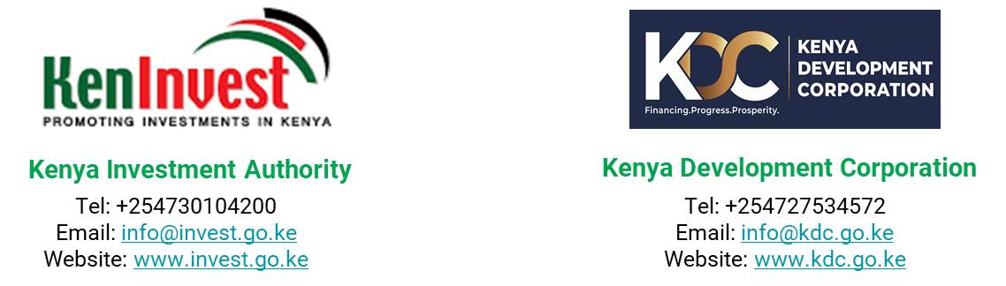
Get started with KenInvest and KDC

Slide 25
