Slide 1
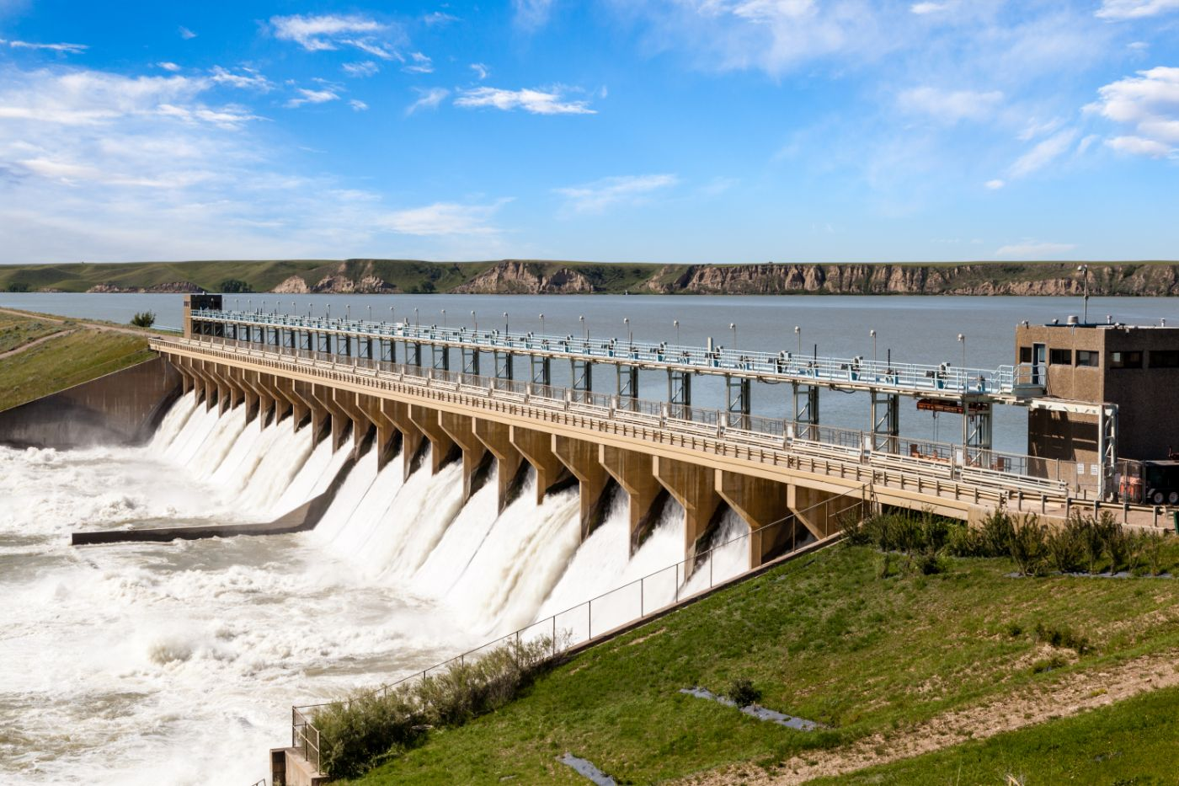

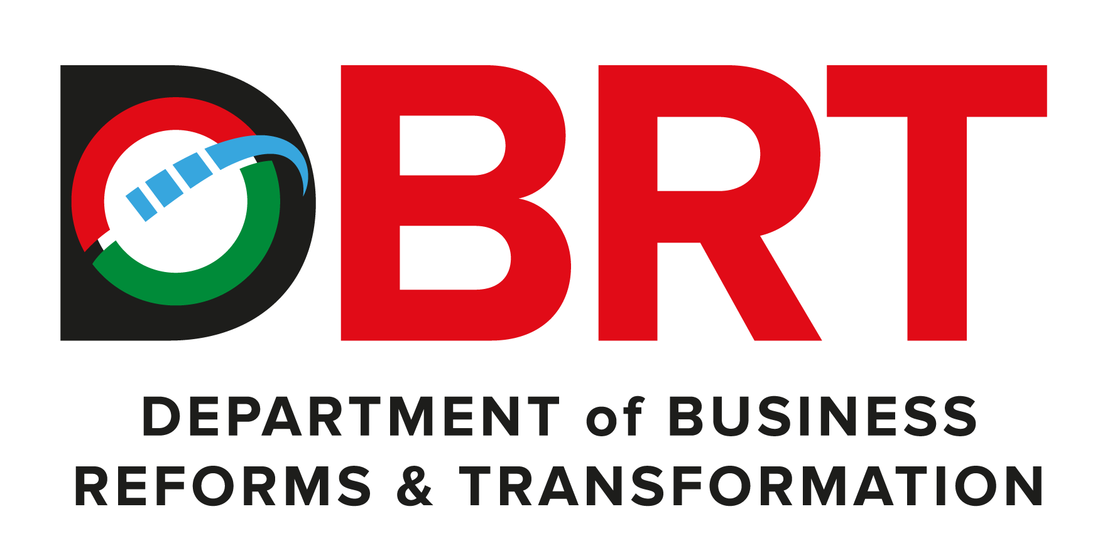
PROPOSED NYATIKE/GOGO DAM PROJECT

Slide 2
01
Why Kenya
Contents
02
Investment Opportunity
03
Get Started

Slide 3

Why Kenya
Regional economic hub
Host to over 200 Multinational Corporations with regional & continent-wide HQs in Nairobi
Robust financial system
43 banking institutions
9 representative offices of foreign banks,
13 Microfinance Banks,
3 credit reference bureaus
19 Money Remittance Providers
73 forex bureaus
3rd largest
economy in sub-Saharan Africa.
US$ 110.35 Bn
7.5% growth
Dominant economy in EAC
≈46% of EAC’s GDP.
Africa’s UN HQs (UNON) which is one of four main UN secretariat duty stations globally.
Global headquarters of UNEP and UN-Habitat, together with a joint presence of 23 other UN Agencies.
Communications & Logistics hub of the region
Access to regional transport corridors.
4 international airports
2 sea ports and 2 ICDs
30-freight and 2-passenger rail services daily between Nairobi and Mombasa.
US$ 2,081.8
+75% growth since 2010
Growing middle-class with an increasing appetite for high-value goods and services.

Slide 4
The Investment Environment is Conducive
Guaranteed repatriation of capital and profits
Constitutional protection against expropriation
Investment guarantee against non-commercial risks: ICSID, MIGA and ATIA
1
Economic liberalization
One stop shop facilitation
Periodic Presidential roundtables with private sector
Digitization of government services
Facilitative Industrial zone programs - EPZs & SEZs
2
3
Political and macroeconomic stability.
High labour productivity: a large pool of youthful, trainable and literate workforce
Globally competitive:
56th in the Ease of Doing Business
1st for five years in a row in financial inclusion
1st globally in protection of minority investors
Nairobi – Africa’s leading business travel destination and hub for impact investors.
2nd in Africa in the logistics performance index
Investment attractiveness
Investment facilitation
Source: World Bank, UNCTAD, CBK, KNBS

Slide 5
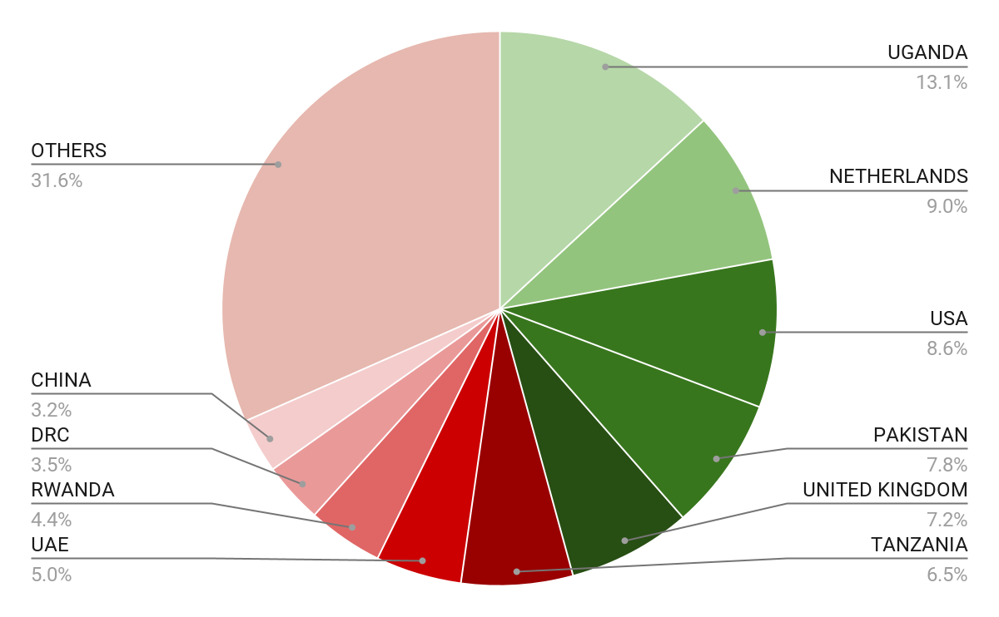





Wide Market Access & Good Trade Relations
US$ 17.43 Bn
Total Imports
US$ 6.09 Bn
Total Exports
Preferential Trade Agreements
1.7Bn
Population
~ US$ 40Tn
Market value
Kenya’s untapped export potential
~ US$ 4.1 Bn (ITC)

Slide 6
Existing Bilateral Trade Treaties with United Kingdom
Economic Partnership Agreement: In 2021, Kenya and the UK signed a trade agreement that seeks to deepen trade and investment ties between the two countries by providing a framework for the elimination of tariffs and non-tariff barriers.
Development Cooperation Agreement: In 2018, Kenya and the UK signed a development cooperation agreement, which aims to strengthen cooperation in areas such as health, education, governance, and security.
Double Taxation Agreement: In 1976, Kenya and the UK signed a double taxation agreement, which seeks to prevent double taxation of income earned by residents of the two countries.
Air Services Agreement: In 1967, Kenya and the UK signed an air services agreement, which allows airlines from the two countries to operate scheduled services between them.

Slide 7
Contents
01
Why Kenya
02
Investment Opportunity
03
Get Started

Slide 8
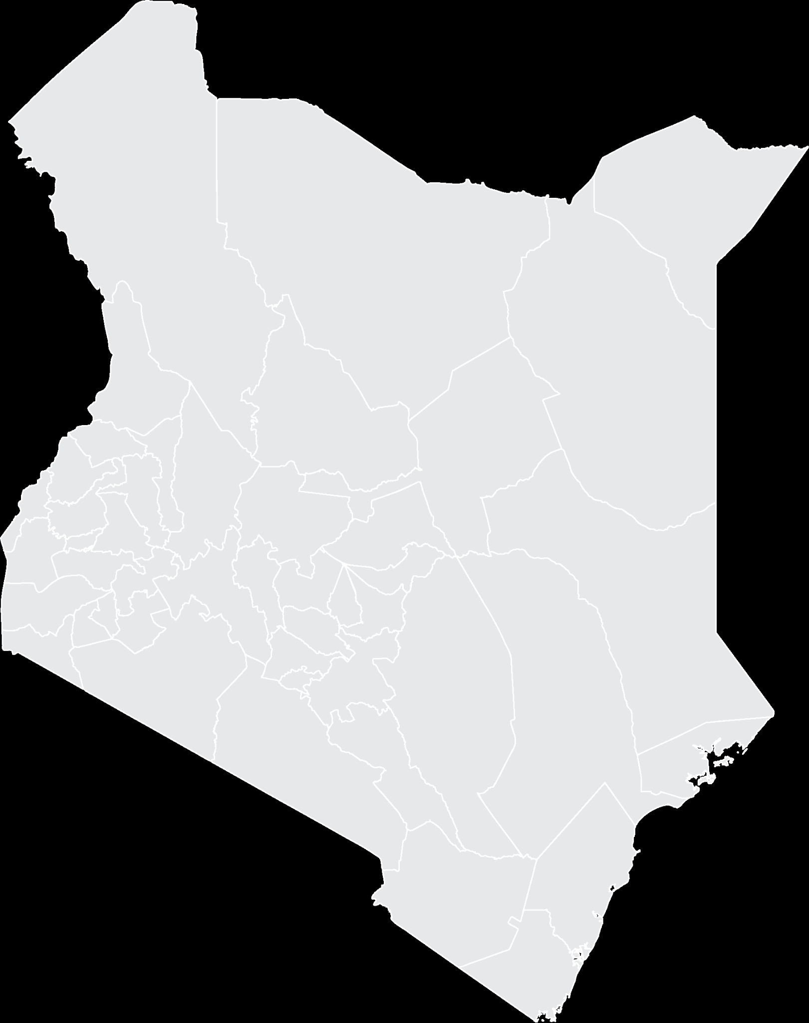


Executive Summary
Project Name: PROPOSED NYATIKE/GOGO DAM PROJECT
i
IMPLEMENTING AGENCY: NATIONAL IRRIGATION AUTHORITY
INVESTMENT VALUE: USD 232 Million
INVESTMENT STRUCTURE: PUBLIC PRIVATE PARTNERSHIP (PPP)
MIGORI COUNTY
i

Slide 9
Problem Statement
The proposed Nyatike Dam in Migori aims to address the water shortage in the area, which affects both domestic and agricultural needs. The current water sources are insufficient to meet the growing demand, especially during dry seasons, leading to frequent water rationing and crop failure.
The reliance on rainwater harvesting and expensive borehole drilling is unsustainable, and the current water sources are also drying up due to prolonged droughts and climate change.
Migori residents, including farmers, traders, and households, are heavily impacted by the water shortage, affecting their livelihoods, health, and well-being.

Slide 10
Opportunity and Value Proposition
The proposed Nyatike Dam project will be used for domestic and irrigation.
The overage population that the dam will serve is more than 107,000 in addition to the Agricultural lands.
The Lower Kuja Irrigation Scheme has an existing approximately 17,000 Acres being served by Gogo Falls Dam.
Nyatike Dam will lead to expansion of Lower Kuja Irrigation Scheme by over 66,000 Acres and production of 16.25MW hydropower.
The total proposed irrigable area is 27,000 Ha. Out of this, 2,000 Ha is to be upland crop irrigation in Uriri and Ndhiwa District while the balance is to be largely on Nyatike and part of Migori District.
The dam will facilitate opening up the entire Lower Kuja Basin for irrigation. The peak demand is estimated at 49.945 cubic metres per second

Slide 11
Financials
Financial Ask
Asking for USD 232 MILLION
If all the above initiatives are implemented, the payback period will be 7 years and the project IRR 12.53%
2) Financial Projections
The project is marginally viable with a payback of 20 years, with an IRR 4.62%. We have considered the following viability initiatives to improve bankability:
The Bulk NRW assumed to be 7% and Tariff for raw water as Kshs 7/m3 (irrigation water demand is 79.77 Mm3 per month) hence the revenues per year will be approximately USD 60 Million per year on average from sale of Irrigation Water if there will be 100% utilisation of irrigable land.
The Sale of hydropower to Kenya Power (16.25 MW).
The sale of water for domestic water 50,000 m3/day with an estimated tariff of USD 0.23/m3
Notes:
During each phase of the construction period, only interest is paid on outstanding bank debt for that phase, after which payments begin on a declining balance.

Slide 12
Financial Risk
Gogo Dam is a replica project to many carried out worldwide under PPP. The model has been designed such that water from the dam will be acquired and sold to an entity responsible for irrigation in the area. The entity will collect fees to be used in recovery of construction cost.
From the existing market sounding, the project has a revenue to cost ratio of 1.68, making it a good project for investments.

Slide 13

Project Team
The National Treasury; PPP Directorate – facilitate the development of the PPP project and structuring of the deal.
State Department of Roads, Ministry of Roads and Transport, - Parent Ministry, for Oversight and Monitoring
Kenya National Highways Authority - The Contracting Authority

Slide 14
Contents
01
Why Kenya
02
Investment Opportunity
03
Get Started

Slide 15
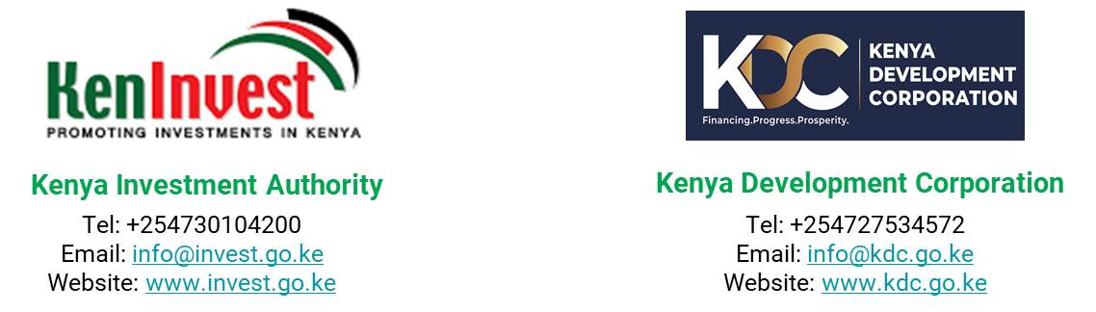
Get started with KenInvest and KDC

Slide 16



