Slide 1
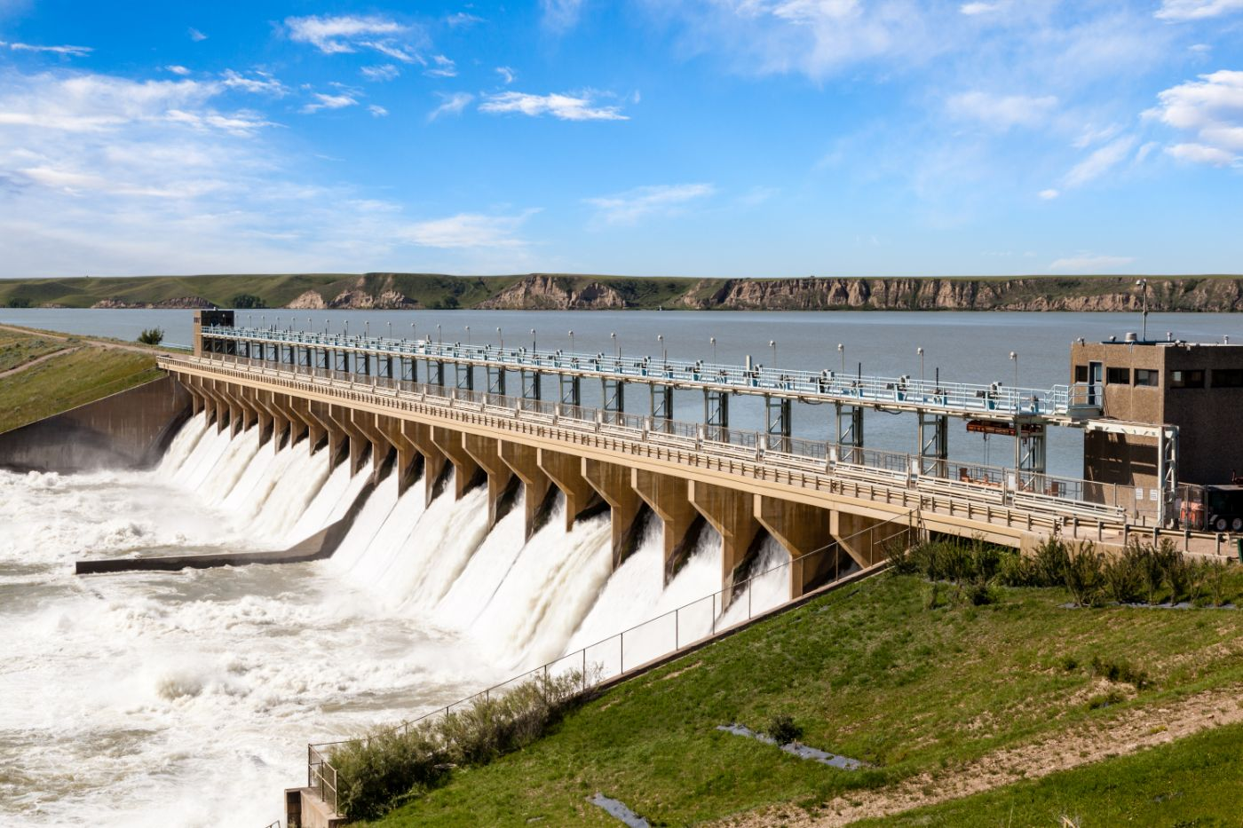




PROPOSED OLENKIRENITO DAM PROJECT

Slide 2
01
Why Kenya
Contents
02
Investment Opportunity
03
Get Started

Slide 3

Why Kenya
Regional economic hub
Host to over 200 Multinational Corporations with regional & continent-wide HQs in Nairobi
Robust financial system
  43 banking institutions
  9 representative offices of foreign banks,
  13 Microfinance Banks,
  3 credit reference bureaus
  19 Money Remittance Providers
  73 forex bureaus
3rd largest
economy in sub-Saharan Africa.
US$ 110.35 Bn
7.5% growth
Dominant economy in EAC
≈46% of EAC’s GDP.
Africa’s UN HQs (UNON) which is one of four main UN secretariat duty stations globally.
Global headquarters of UNEP and UN-Habitat, together with a joint presence of 23 other UN Agencies.
Communications & Logistics hub of the region
Access to regional transport corridors.
  4 international airports
  2 sea ports and 2 ICDs
  30-freight and 2-passenger rail services daily between Nairobi and Mombasa.
US$ 2,081.8
+75% growth since 2010
Growing middle-class with an increasing appetite for high-value goods and services.

Slide 4
The Investment Environment is Conducive
Guaranteed repatriation of capital and profits
Constitutional protection against expropriation
Investment guarantee against non-commercial risks: ICSID, MIGA and ATIA
1
Economic liberalization
One stop shop facilitation
Periodic Presidential roundtables with private sector
Digitization of government services
Facilitative Industrial zone programs - EPZs & SEZs
2
3
Political and macroeconomic stability.
High labour productivity: a large pool of youthful, trainable and literate workforce
Globally competitive:
  56th in the Ease of Doing Business
  1st for five years in a row in financial inclusion
  1st globally in protection of minority investors
  Nairobi – Africa’s leading business travel destination and hub for impact investors.
  2nd in Africa in the logistics performance index
Investment attractiveness
Investment facilitation
Source: World Bank, UNCTAD, CBK, KNBS

Slide 5
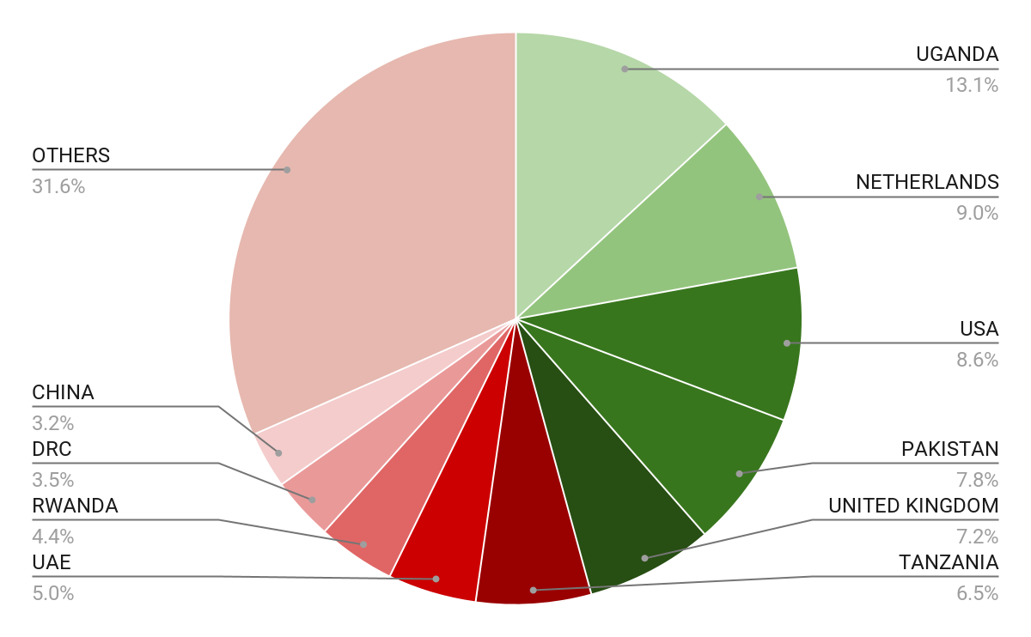





Wide Market Access & Good Trade Relations
US$ 17.43 Bn
Total Imports
US$ 6.09 Bn
Total Exports
Preferential Trade Agreements
1.7Bn
Population
~ US$ 40Tn
Market value
Kenya’s untapped export potential
~ US$ 4.1 Bn (ITC)

Slide 6
Existing Bilateral Trade Treaties with United Kingdom
Economic Partnership Agreement: In 2021, Kenya and the UK signed a trade agreement that seeks to deepen trade and investment ties between the two countries by providing a framework for the elimination of tariffs and non-tariff barriers.
Development Cooperation Agreement: In 2018, Kenya and the UK signed a development cooperation agreement, which aims to strengthen cooperation in areas such as health, education, governance, and security.
Double Taxation Agreement: In 1976, Kenya and the UK signed a double taxation agreement, which seeks to prevent double taxation of income earned by residents of the two countries.
Air Services Agreement: In 1967, Kenya and the UK signed an air services agreement, which allows airlines from the two countries to operate scheduled services between them.

Slide 7
Contents
01
Why Kenya
02
Investment Opportunity
03
Get Started

Slide 8
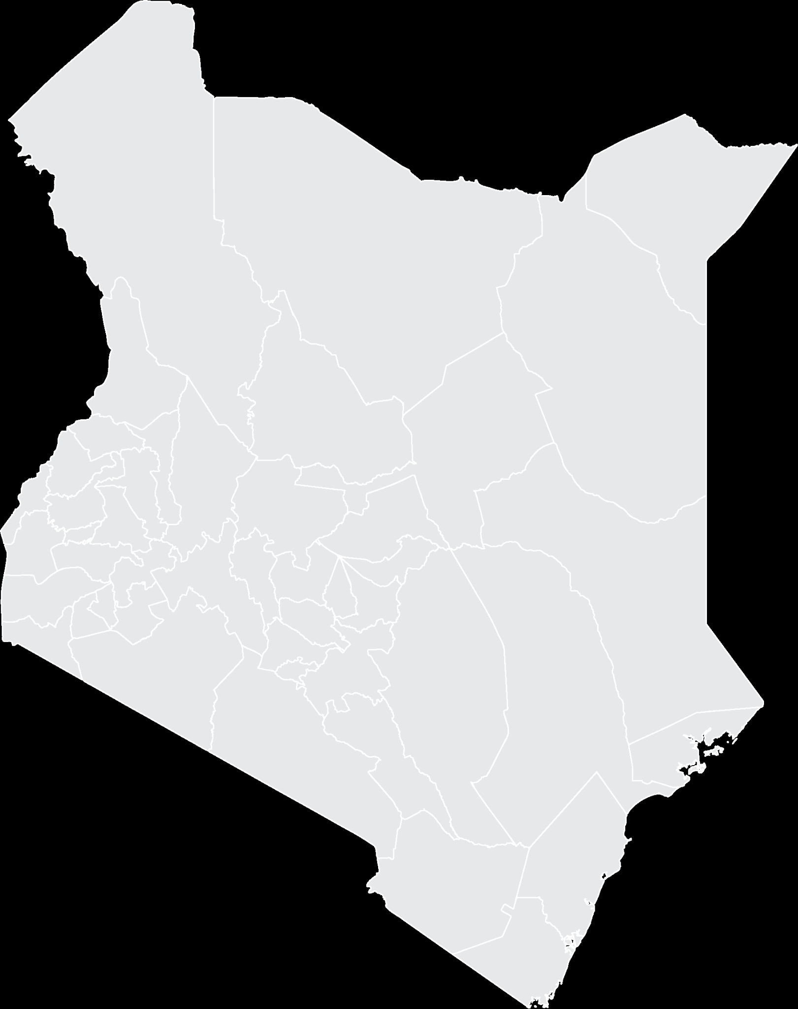


Executive Summary
Project Name: PROPOSED OLENKIRENITO DAM PROJECT
i
IMPLEMENTING AGENCY: NATIONAL IRRIGATION AUTHORITY
INVESTMENT VALUE: USD 57.7 Million
INVESTMENT STRUCTURE: PUBLIC PRIVATE PARTNERSHIP (PPP)
NAROK COUNTY
i

Slide 9
Problem Statement
Narok County has been classified as an Arid and Semi-Arid Land (ASAL), characterized by warm to hot, with temperatures ranging between 24 to 40 degrees Celsius. Rainfall is erratic (averaging 300mm to 400m) and unpredictable both in timing and distribution.
Agro-pastrolism, which is the main source of livelihood for the residents activity of the residents is mainly rainfed, and with the vagarity of climate change, marked by erratic and less rainfall being received in the area,agro-pastrolism has become an unattractive venture to both the residents and potential investors, despite the county having large tracks of arable land, as both crops and livestock are lost due to drought and floods in the county. This has led to widespread food insecurity and poverty in the area.

Slide 10
Opportunity and Value Proposition
The project is a replica project to many carried out worldwide under PPP. The model has been designed such that water from the dam will be acquired and sold to an entity responsible for irrigation in the area. The entity will collect fees to be used in recovery of construction cost. From the existing market sounding, the project has a revenue to cost ratio of 0.27, making it a good project for investment.
The project seeks to deliver water for irrigation of of 18,350 acres. High value crops such as green grams, water melons and cowpeas will be introduced as additional crops. Agricultural productivity is also expected to improve as farmers adopt more modern farming methods
Water supply: The water supply is planned to cover Ntuka and Elang’ata Enterit locations. The target population for water supply is approximately 14,900 people and 375,965 livestock and 70 Non-individual users. The population is projected to increase to 50,196 and approximately 500,000 livestock by 2070.

Slide 11
Financial Ask
The project’s design has been done
Current Implementation status
Nil
How much financing is available at present
How much investment/capital the investor needs to inject into the project
USD 40.39 Million (as debt)
2.77% IRR
ROI for the Investor
Notes:
During each phase of the construction period, only interest is paid on outstanding bank debt for that phase, after which payments begin on a declining balance.

Slide 12
Financial Projections
From 2030 to 2058
The project is projected to generate approximately USD 20.7 Million
The total Operations and Maintenance Costs for the project is USD 18.5 Million.
The total Depreciation Cost is approximately USD 15.6 Million
2) Project Returns and Outcomes
The Project's IRR is 2.77% with a payback period of 25years.
Notes:
During each phase of the construction period, only interest is paid on outstanding bank debt for that phase, after which payments begin on a declining balance.

Slide 13

Timelines
Project Team
The project concession will stretch across 27 years as detailed below:
The National Treasury; PPP Directorate – facilitate the development of the PPP project and structuring of the deal.
State Department of Irrigation, Ministry of Water, Sanitation and Irrigation
National Irrigation Authority - The Contracting Authority
Construction Period
5 YEARS
Operation and Maintenance period
22 YEARS

Slide 14
Contents
01
Why Kenya
02
Investment Opportunity
03
Get Started

Slide 15

Get started with KenInvest and KDC

Slide 16



