Slide 1
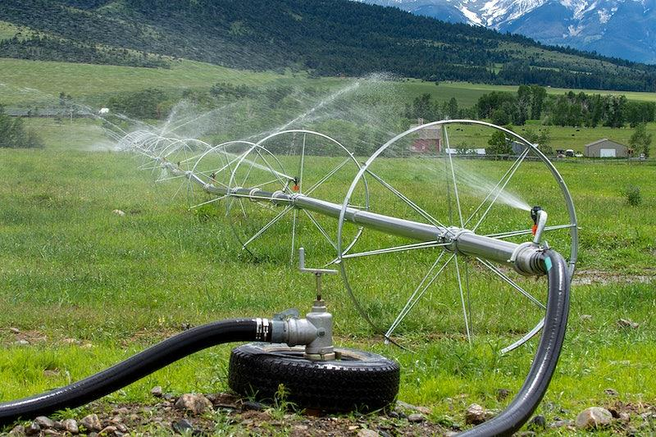
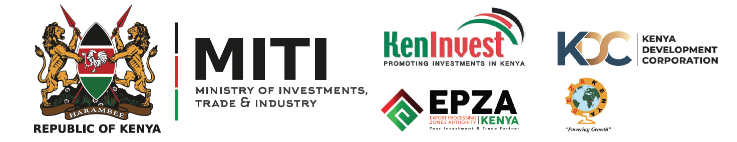
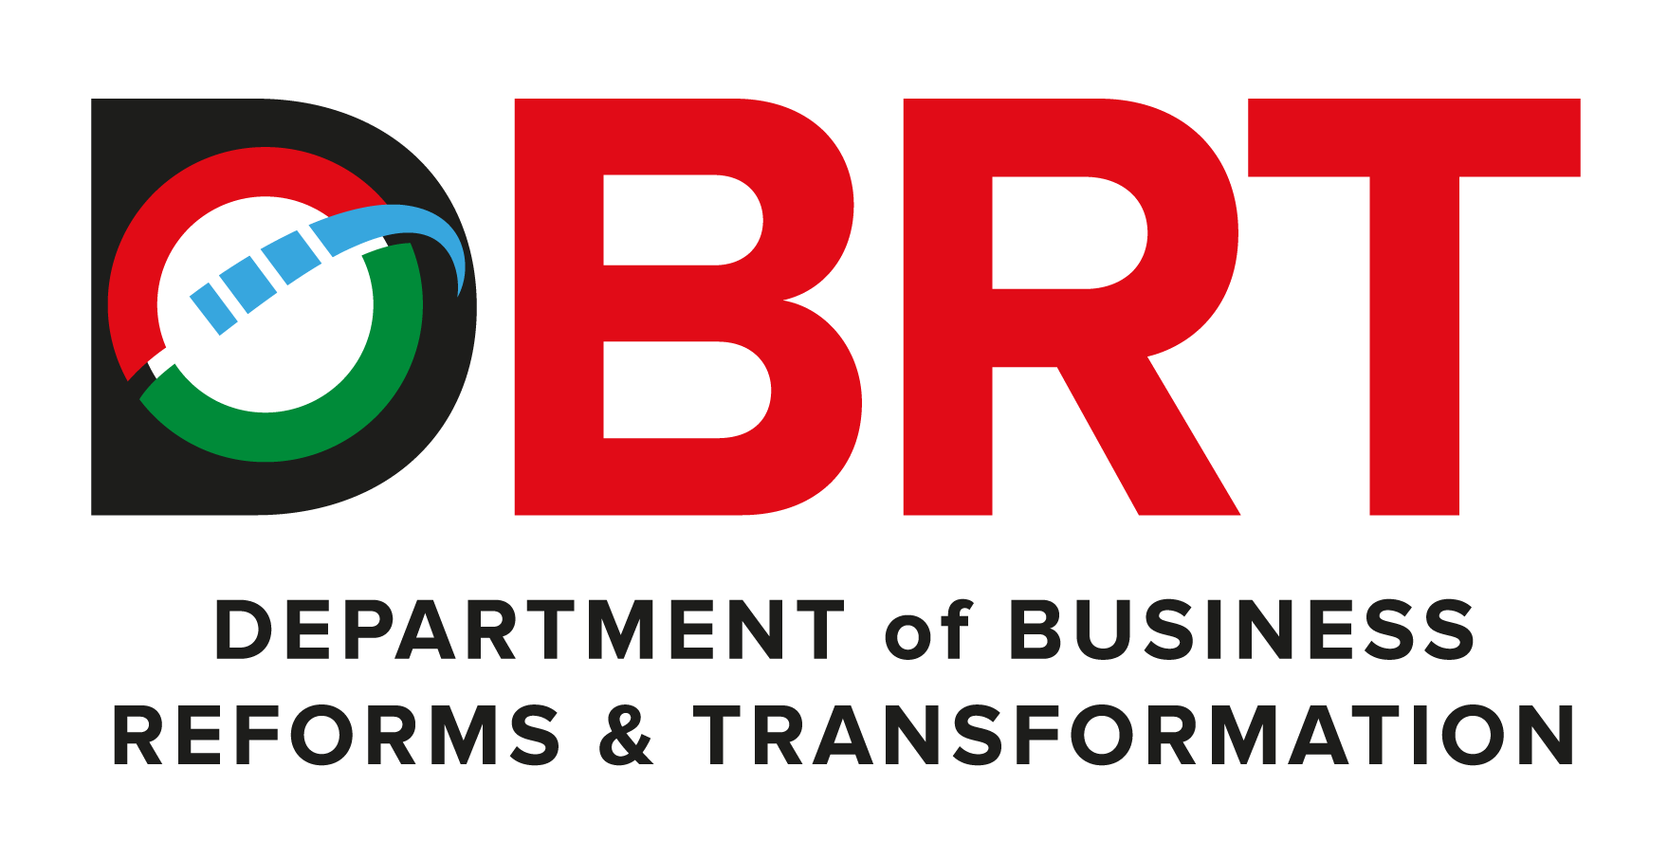
Rwabura Irrigation Development Project

Slide 2
01
Why Kenya
Contents
02
Investment Opportunity
03
Get Started

Slide 3

Why Kenya
Regional economic hub
Host to over 200 Multinational Corporations with regional & continent-wide HQs in Nairobi
Robust financial system
  43 banking institutions
  9 representative offices of foreign banks,
  13 Microfinance Banks,
  3 credit reference bureaus
  19 Money Remittance Providers
  73 forex bureaus
3rd largest
economy in sub-Saharan Africa.
US$ 110.35 Bn
7.5% growth
Dominant economy in EAC
≈46% of EAC’s GDP.
Africa’s UN HQs (UNON) which is one of four main UN secretariat duty stations globally.
Global headquarters of UNEP and UN-Habitat, together with a joint presence of 23 other UN Agencies.
Communications & Logistics hub of the region
Access to regional transport corridors.
  4 international airports
  2 sea ports and 2 ICDs
  30-freight and 2-passenger rail services daily between Nairobi and Mombasa.
US$ 2,081.8
+75% growth since 2010
Growing middle-class with an increasing appetite for high-value goods and services.

Slide 4
The Investment Environment is Conducive
Guaranteed repatriation of capital and profits
Constitutional protection against expropriation
Investment guarantee against non-commercial risks: ICSID, MIGA and ATIA
1
Economic liberalization
One stop shop facilitation
Periodic Presidential roundtables with private sector
Digitization of government services
Facilitative Industrial zone programs - EPZs & SEZs
2
3
Political and macroeconomic stability.
High labour productivity: a large pool of youthful, trainable and literate workforce
Globally competitive:
  56th in the Ease of Doing Business
  1st for five years in a row in financial inclusion
  1st globally in protection of minority investors
  Nairobi – Africa’s leading business travel destination and hub for impact investors.
  2nd in Africa in the logistics performance index
Investment attractiveness
Investment facilitation
Source: World Bank, UNCTAD, CBK, KNBS

Slide 5
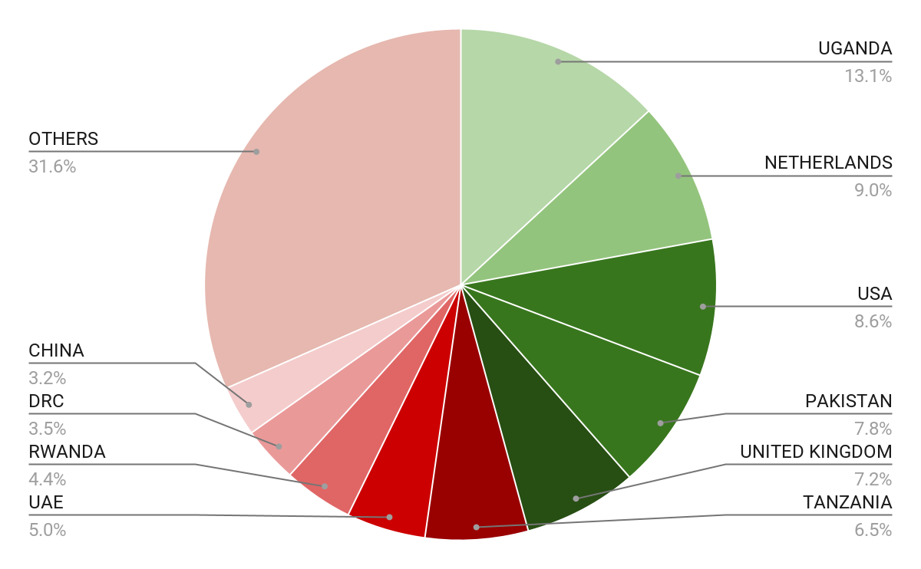





Wide Market Access & Good Trade Relations
US$ 17.43 Bn
Total Imports
US$ 6.09 Bn
Total Exports
Preferential Trade Agreements
1.7Bn
Population
~ US$ 40Tn
Market value
Kenya’s untapped export potential
~ US$ 4.1 Bn (ITC)

Slide 6
Existing Bilateral Trade Treaties with United Kingdom
Economic Partnership Agreement: In 2021, Kenya and the UK signed a trade agreement that seeks to deepen trade and investment ties between the two countries by providing a framework for the elimination of tariffs and non-tariff barriers.
Development Cooperation Agreement: In 2018, Kenya and the UK signed a development cooperation agreement, which aims to strengthen cooperation in areas such as health, education, governance, and security.
Double Taxation Agreement: In 1976, Kenya and the UK signed a double taxation agreement, which seeks to prevent double taxation of income earned by residents of the two countries.
Air Services Agreement: In 1967, Kenya and the UK signed an air services agreement, which allows airlines from the two countries to operate scheduled services between them.

Slide 7
Contents
01
Why Kenya
02
Investment Opportunity
03
Get Started

Slide 8
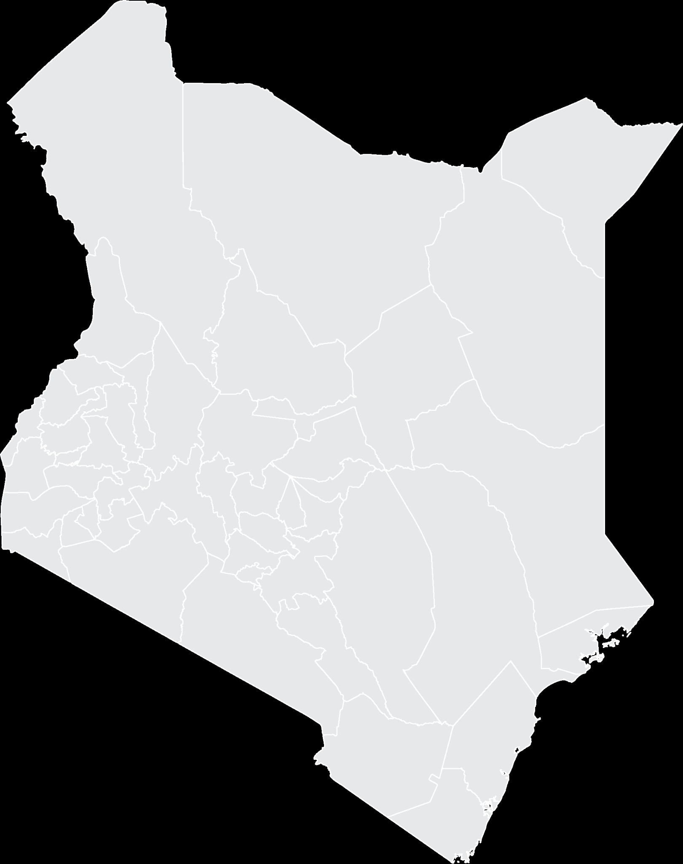



Executive Summary
Project Name: RWABURA IRRIGATION DEVELOPMENT PROJECT
IMPLEMENTING AGENCY: NATIONAL IRRIGATION AUTHORITY
ESTIMATED INVESTMENT COST: USD 5.631 Million
INVESTMENT ENGAGEMENT: PUBLIC PRIVATE PARTNERSHIP (PPP)
i
KIAMBU COUNTY

Slide 9
Problem Statement
Low erratic rainfall pattern due to climate change has resulted to low crop production in Rwabura and Thiririka regions of Gatundu South area.
There is need to construct dams in this region to store water for irrigation purpose especially during the dry season.
Local residents of Gatundu South District need water for domestic and irrigation purpose.

Slide 10
Opportunity and Value Proposition
The project seeks US$ 5.631 Million (debt), with government providing the land.
Rwabura dam will be used to store and distribute water for irrigation purposes, improving agricultural productivity and enabling farmers to grow crops more efficiently.
The dam will also provide a reliable source of drinking water to Gatundu South Residents
The dam will be constructed in two phases.
  Phase I – 1,500acres
  Phase II – 3,500acres
It is expected that the project will generate a total net income of approximately USD 6.5 Million per year from phase I

Slide 11
Financial Projections
Financial Projections
Projections for the duration to pay off both debt and equity injection
Parameters | Estimated Value
Dryland Cultivation | 0
Breeding farm | 2,608,923
Projects for communities | 49,000
Feedlots | 4,058,769
TOTAL | 11,626,385
1,354,884 USD
TOTAL SALES
580,340 USD
TOTAL COSTS
774,544 USD
ANNUAL GROSS PROFIT
57 %
PROFIT ON SALES (%)
6 YEARS
PAYBACK (YEARS)
      Risks
Prevalence to Infectious diseases,
Adverse effects of climate change leading to receding dam levels
14 %
IRR (%)
Project Returns and Outcomes
NPV and IRR are bare minimum metrics
Notes:
Total investments – including inflation and 25% contingency – are estimated to amount to USD 210 M; total phase 1 investments are estimated to amount to USD 163 M.
Investments also include a small share of general port investments.

Slide 12
Financial Projections
Parameters | Estimated Value
Dams | 1.7 Billion
Head works | 37 Million
Conveyance | 110 Million
Mainlines | 80 Million
Sub mains | 150 Million
Distribution network | 296 Million
Others (fittings, structures, Preliminaries | 200 Million
Subtotal | 873 Million
TOTAL | 2.573 Billion
The results of the financial analysis confirm that the project is financially, socially and economically viable.
NPV @ 18%: USD 5.3 Million
IRR: 37%
Benefit/Cost Ratio: 4 with the dams

Slide 13
Financial Analysis of the Project Net Worth Using Conventional NPV and IRR
Year | Capital Costs | Operations & Maintenance | Net Benefits from Crops | Total Project Benefits
1 | 2,573,000,000 | 43,650,000 | 205,418,478.85 | -2411231521.15
2 |  | 43,650,000 | 410,836,957.70 | 367186957.70
3 |  | 43,650,000 | 657,339,132.31 | 613689132.31
4 |  | 43,650,000 | 739,506,523.85 | 695856523.85
5 |  | 43,650,000 | 821,673,915.39 | 778023915.39
6 |  | 43,650,000 | 821,673,915.39 | 778023915.39
7 |  | 43,650,000 | 821,673,915.39 | 778023915.39
8 |  | 43,650,000 | 821,673,915.39 | 778023915.39
9 |  | 43,650,000 | 821,673,915.39 | 778023915.39
10 |  | 43,650,000 | 821,673,915.39 | 778023915.39
11 |  | 43,650,000 | 821,673,915.39 | 778023915.39
12 |  | 43,650,000 | 821,673,915.39 | 778023915.39
13 |  | 43,650,000 | 821,673,915.39 | 778023915.39
14 |  | 43,650,000 | 821,673,915.39 | 778023915.39
15 |  | 43,650,000 | 821,673,915.39 | 778023915.39
16 |  | 43,650,000 | 821,673,915.39 | 778023915.39
17 |  | 43,650,000 | 821,673,915.39 | 778023915.39
18 |  | 43,650,000 | 821,673,915.39 | 778023915.39
19 |  | 43,650,000 | 821,673,915.39 | 778023915.39
20 |  | 43,650,000 | 821,673,915.39 | 778023915.39
 | NPV |  |  | KShs 1,024,348,988.19
 | IRR |  |  | 27%

Slide 14
Summary of sensitivity analysis
Increase in cost of production by 20 percent | 152 million | 18%
Increase in capital cost by 20 percent | 588 million | 22%
Increase in operation & maintenance costs by 20 percent | 977 million | 26%
Decrease net benefits from crops by 20 percent | 819 million | 27%

Slide 15

Timelines
Project Team
National Irrigation Authority – Implementation and facilitation of smooth running of the project
The period for construction is
5 YEARS

Slide 16
Contents
01
Why Kenya
02
Investment Opportunity
03
Get Started

Slide 17
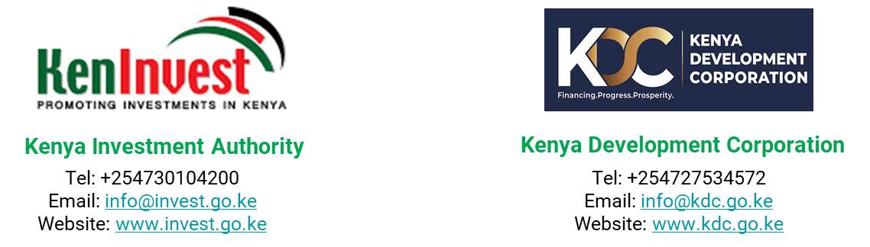
Get started with KenInvest and KDC

Slide 18
