Slide 1
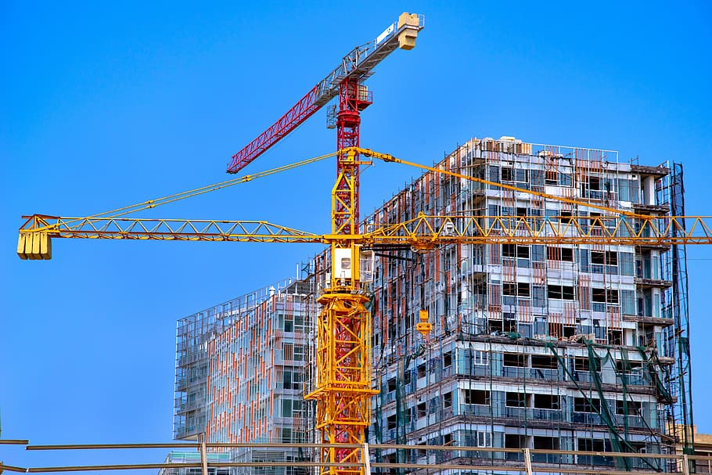


Tarda Upper Hill Proposed Development

Slide 2
01
Why Kenya
Contents
02
Investment Opportunity
03
Get Started

Slide 3

Why Kenya
Regional economic hub
Host to over 200 Multinational Corporations with regional & continent-wide HQs in Nairobi
Robust financial system
  43 banking institutions
  9 representative offices of foreign banks,
  13 Microfinance Banks,
  3 credit reference bureaus
  19 Money Remittance Providers
  73 forex bureaus
3rd largest
economy in sub-Saharan Africa.
US$ 110.35 Bn
7.5% growth
Dominant economy in EAC
≈46% of EAC’s GDP.
Africa’s UN HQs (UNON) which is one of four main UN secretariat duty stations globally.
Global headquarters of UNEP and UN-Habitat, together with a joint presence of 23 other UN Agencies.
Communications & Logistics hub of the region
Access to regional transport corridors.
  4 international airports
  2 sea ports and 2 ICDs
  30-freight and 2-passenger rail services daily between Nairobi and Mombasa.
US$ 2,081.8
+75% growth since 2010
Growing middle-class with an increasing appetite for high-value goods and services.

Slide 4
The Investment Environment is Conducive
Guaranteed repatriation of capital and profits
Constitutional protection against expropriation
Investment guarantee against non-commercial risks: ICSID, MIGA and ATIA
1
Economic liberalization
One stop shop facilitation
Periodic Presidential roundtables with private sector
Digitization of government services
Facilitative Industrial zone programs - EPZs & SEZs
2
3
Political and macroeconomic stability.
High labour productivity: a large pool of youthful, trainable and literate workforce
Globally competitive:
  56th in the Ease of Doing Business
  1st for five years in a row in financial inclusion
  1st globally in protection of minority investors
  Nairobi – Africa’s leading business travel destination and hub for impact investors.
  2nd in Africa in the logistics performance index
Investment attractiveness
Investment facilitation
Source: World Bank, UNCTAD, CBK, KNBS

Slide 5
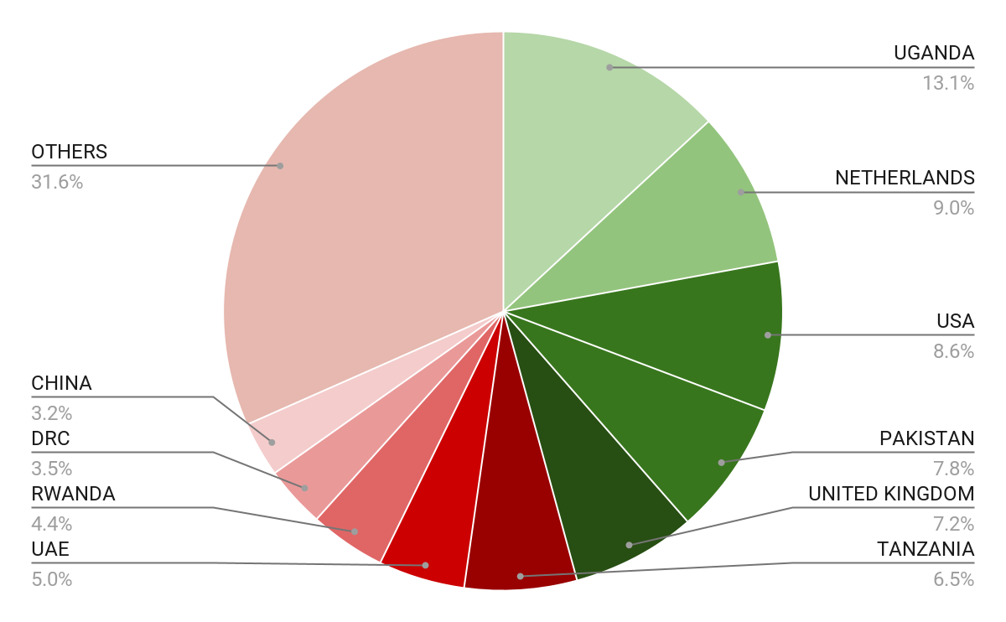





Wide Market Access & Good Trade Relations
US$ 17.43 Bn
Total Imports
US$ 6.09 Bn
Total Exports
Preferential Trade Agreements
1.7Bn
Population
~ US$ 40Tn
Market value
Kenya’s untapped export potential
~ US$ 4.1 Bn (ITC)

Slide 6
Existing Bilateral Trade Treaties with United Kingdom
Economic Partnership Agreement: In 2021, Kenya and the UK signed a trade agreement that seeks to deepen trade and investment ties between the two countries by providing a framework for the elimination of tariffs and non-tariff barriers.
Development Cooperation Agreement: In 2018, Kenya and the UK signed a development cooperation agreement, which aims to strengthen cooperation in areas such as health, education, governance, and security.
Double Taxation Agreement: In 1976, Kenya and the UK signed a double taxation agreement, which seeks to prevent double taxation of income earned by residents of the two countries.
Air Services Agreement: In 1967, Kenya and the UK signed an air services agreement, which allows airlines from the two countries to operate scheduled services between them.

Slide 7
Contents
01
Why Kenya
02
Investment Opportunity
03
Get Started

Slide 8
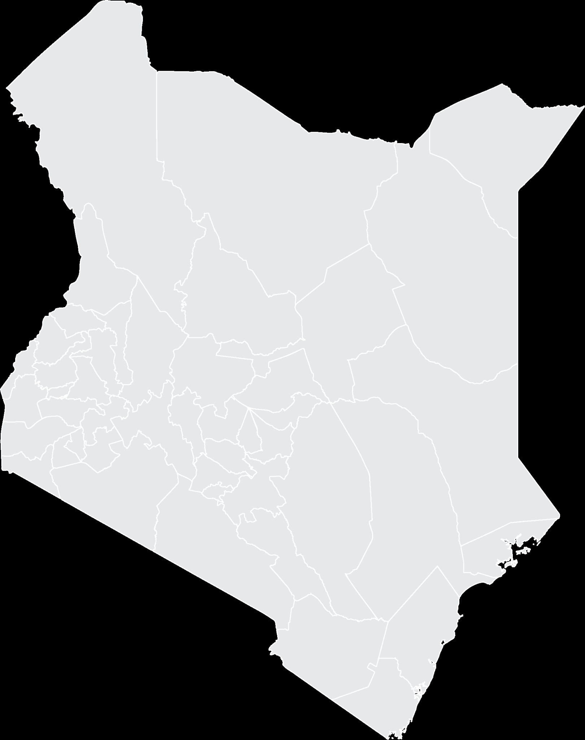



Executive Summary
Project Name: TARDA UPPER HILL PROPOSED DEVELOPMENT
IMPLEMENTING AGENCY: TANA & ATHI RIVERS DEVELOPMENT AUTHORITY
ESTIMATED INVESTMENT COST: USD 35.8 Million
INVESTMENT ENGAGEMENT: PUBLIC PRIVATE PARTNERSHIP (PPP)
i
Nairobi County

Slide 9
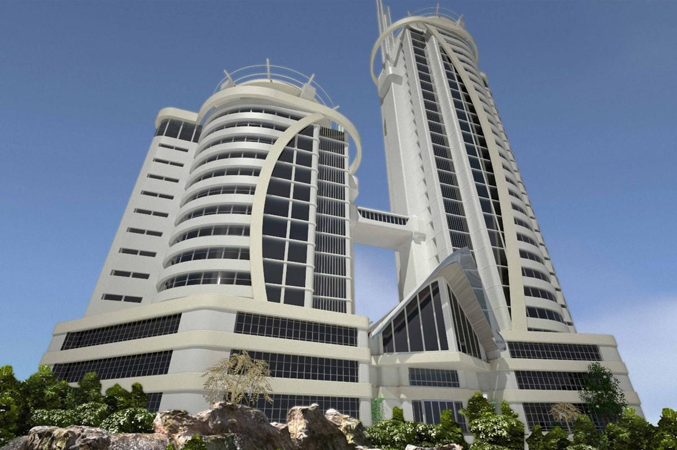
Problem Statement
Construct a complex to house TARDA’s offices that is currently housed on expensive rented premises at the City Centre.

Slide 10
Opportunity & Value Proposition
Key/salient features of the project:
Construct a High rise office building, Conference facility, Hotels, Parking facility & Mixed use.
Competitive Advantage:
Land ownership(1.7acres);
Developed plots;
Connected amenities such as city sewer, electricity & water; recreation facilities, hospitals among others.
Market Opportunity
The Complex will offer a one-stop for regions’ integrated development plans, international conference facilities and stakeholders’ forum for coordinated planning and development. Focal point for both local and international liaison in integrated river basin management.
Current market rent rates within the area range between;
Retail Space: USD 1.8-1.43 per sq ft per month (Plus VAT).
Office Space: USD 0.73-0.86 per sq ft per month (Plus VAT).
Parking: USD 81 per parking per month.
Escalation Rate: 7.5% per annum on Rent & Parking
The Estimated Service Charge USD 0.25 per sq ft

Slide 11
Financial Ask
UNDEVELOPED
Current Implementation status
Nil
How much financing is available at present
How much investment/capital the investor needs to inject into the project
USD 35.8 M
Notes:
During each phase of the construction period, only interest is paid on outstanding bank debt for that phase, after which payments begin on a declining balance.

Slide 12
Risks
NO | TYPE OF RISK | RISK | MITIGATION
1. | Financial Risk (Upstream water abstraction) | Reduces the potential power generation Loss of expected revenue | Promotion of irrigation system downstream. Sensitization and awareness forum on project benefits
2 | Environmental | Climate change effects Siltation | Conservation activities around the dam
3 | Legal | Conflicts with PAPs Human Rights and environmental activists. | Sensitization and stakeholder involvement. Conflict management
4 | Economic Risks | Inflation | Minimize project time overruns.
5 | Political Risk | Change of Government policy | Political goodwill
6 | Technical Risk | Design Parameters | Design Review

Slide 13
Contents
01
Why Kenya
02
Investment Opportunity
03
Get Started

Slide 14

Get started with KenInvest and KDC

Slide 15



