Slide 1
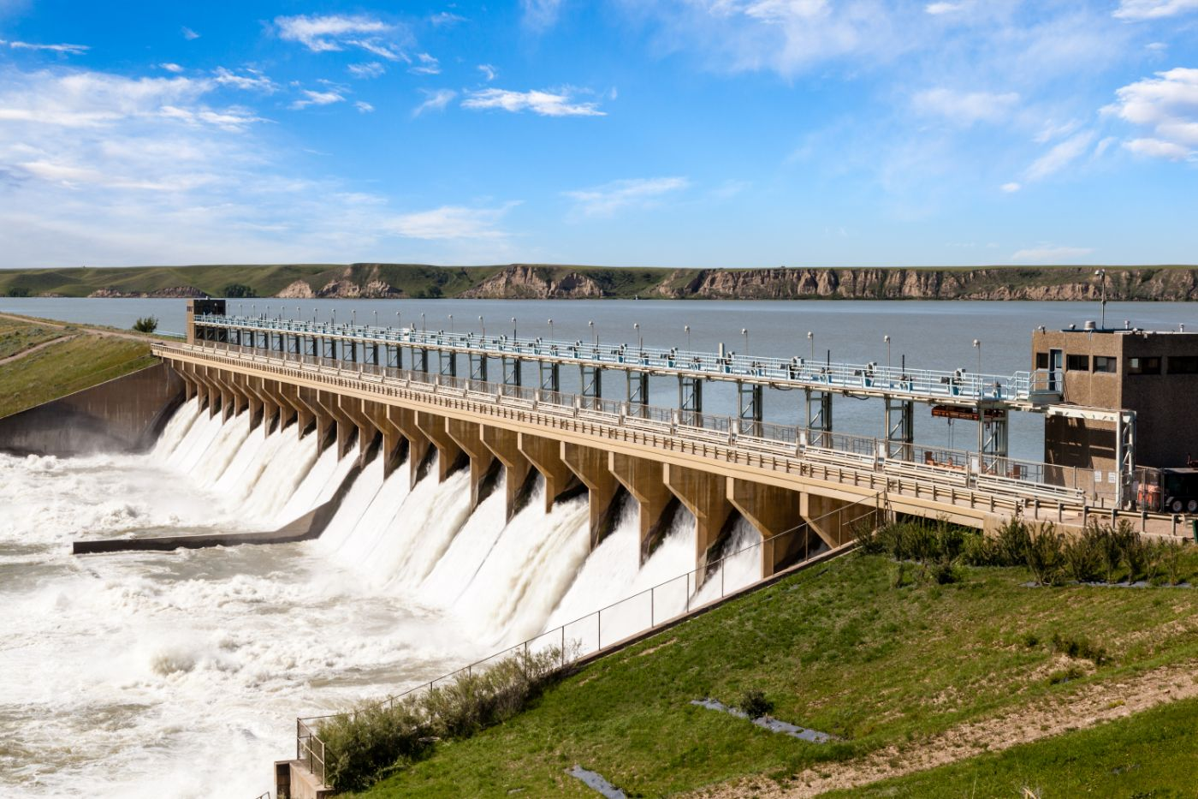


PROPOSED THUCI DAM PROJECT

Slide 2
01
Why Kenya
Contents
02
Investment Opportunity
03
Get Started

Slide 3

Why Kenya
Regional economic hub
Host to over 200 Multinational Corporations with regional & continent-wide HQs in Nairobi
Robust financial system
43 banking institutions
9 representative offices of foreign banks,
13 Microfinance Banks,
3 credit reference bureaus
19 Money Remittance Providers
73 forex bureaus
3rd largest
economy in sub-Saharan Africa.
US$ 110.35 Bn
7.5% growth
Dominant economy in EAC
≈46% of EAC’s GDP.
Africa’s UN HQs (UNON) which is one of four main UN secretariat duty stations globally.
Global headquarters of UNEP and UN-Habitat, together with a joint presence of 23 other UN Agencies.
Communications & Logistics hub of the region
Access to regional transport corridors.
4 international airports
2 sea ports and 2 ICDs
30-freight and 2-passenger rail services daily between Nairobi and Mombasa.
US$ 2,081.8
+75% growth since 2010
Growing middle-class with an increasing appetite for high-value goods and services.

Slide 4
The Investment Environment is Conducive
Guaranteed repatriation of capital and profits
Constitutional protection against expropriation
Investment guarantee against non-commercial risks: ICSID, MIGA and ATIA
1
Economic liberalization
One stop shop facilitation
Periodic Presidential roundtables with private sector
Digitization of government services
Facilitative Industrial zone programs - EPZs & SEZs
2
3
Political and macroeconomic stability.
High labour productivity: a large pool of youthful, trainable and literate workforce
Globally competitive:
56th in the Ease of Doing Business
1st for five years in a row in financial inclusion
1st globally in protection of minority investors
Nairobi – Africa’s leading business travel destination and hub for impact investors.
2nd in Africa in the logistics performance index
Investment attractiveness
Investment facilitation
Source: World Bank, UNCTAD, CBK, KNBS

Slide 5
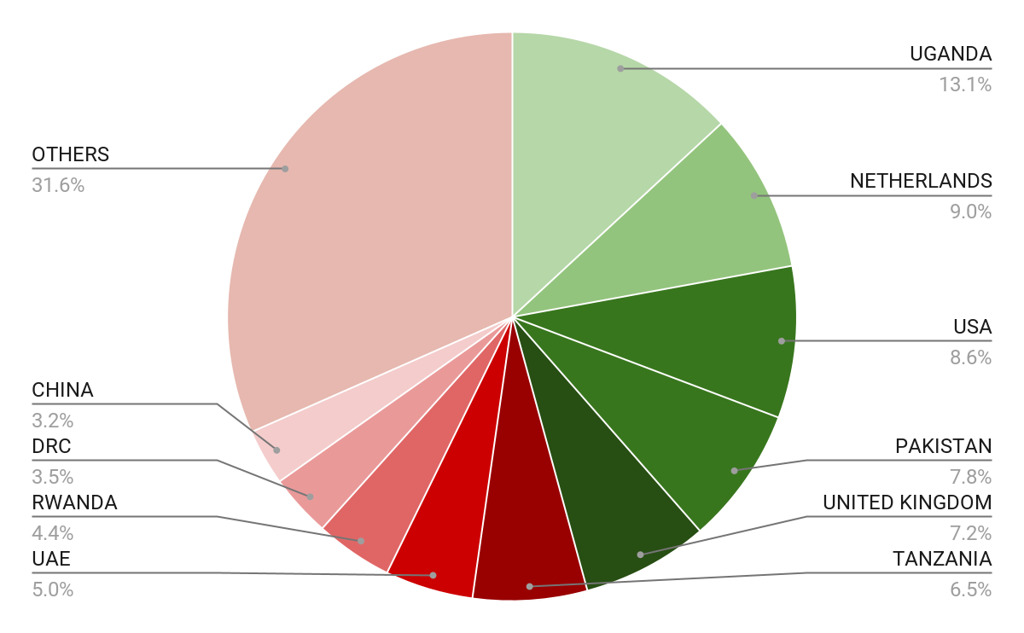





Wide Market Access & Good Trade Relations
US$ 17.43 Bn
Total Imports
US$ 6.09 Bn
Total Exports
Preferential Trade Agreements
1.7Bn
Population
~ US$ 40Tn
Market value
Kenya’s untapped export potential
~ US$ 4.1 Bn (ITC)

Slide 6
Existing Bilateral Trade Treaties with United Kingdom
Economic Partnership Agreement: In 2021, Kenya and the UK signed a trade agreement that seeks to deepen trade and investment ties between the two countries by providing a framework for the elimination of tariffs and non-tariff barriers.
Development Cooperation Agreement: In 2018, Kenya and the UK signed a development cooperation agreement, which aims to strengthen cooperation in areas such as health, education, governance, and security.
Double Taxation Agreement: In 1976, Kenya and the UK signed a double taxation agreement, which seeks to prevent double taxation of income earned by residents of the two countries.
Air Services Agreement: In 1967, Kenya and the UK signed an air services agreement, which allows airlines from the two countries to operate scheduled services between them.

Slide 7
Contents
01
Why Kenya
02
Investment Opportunity
03
Get Started

Slide 8
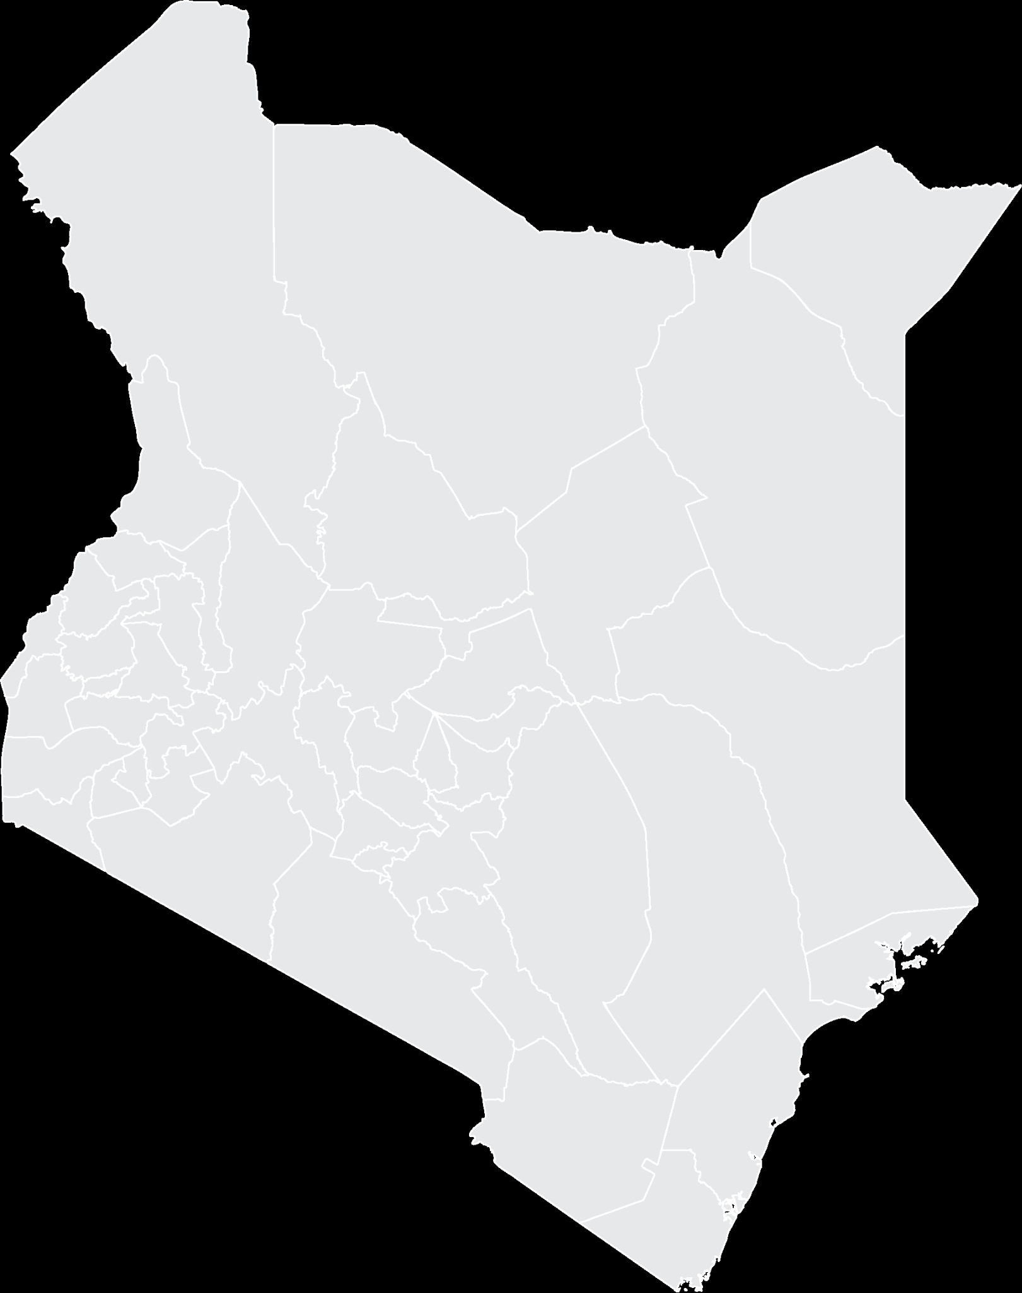


Executive Summary
Project Name: PROPOSED THUCI DAM PROJECT
i
IMPLEMENTING AGENCY: NATIONAL IRRIGATION AUTHORITY
INVESTMENT VALUE: USD 5.455 Million
INVESTMENT STRUCTURE: PUBLIC PRIVATE PARTNERSHIP (PPP)
EMBU COUNTY
i

Slide 9
Problem Statement
Runyenjes and Manyatta sub counties in Embu County are currently served by Embu Water and Sanitation Company (EWASCO).
The population of the two sub counties has grown over the years with current estimate at 106,000.
This has resulted in an increased demand for water for irrigation and domestic use that far exceeds the production capacity of the existing water supply system.
As a result, there is a pressing need to upgrade the water supply infrastructure in area to ensure that the growing population has access to clean and reliable water supply.

Slide 10
Opportunity and Value Proposition
With the growing population, the total demand for water in Runyenjes and Manyatta areas is likely to grow in the next 30 years, driven by:
Increased irrigation and population.
The current weather patterns is unpredictable with prolonged drought that has led to drying of some rivers. This has put a lot of pressure on the remaining water sources within the region hence need for the dam.

Slide 11
Opportunity
The project is economically viable in that it will greatly contribute toward food security in the Country, and the income of benefitting small scale farmers are expected to increase considerably.
The Government will therefore be able to tackle poverty and hunger.
The project is also financially viable in that the private party will be able to generate enough cash flow to operate and repay its debt in the long run. This is because the NPV of the project is greater than zero.

Slide 12
Financial Projections
The project is marginally viable with a payback of 24 years, with an IRR 2.72%.
Bulk Water Tariff Kshs/m³ | 25.00
Irrigation water tariff Kshs/m³ | 7.00
Hydropower Tariff Kshs/Kwh | 12.00
NRW | 7%
Item | Values
Estimated Expenditures
Personnel Cost (Kshs) | 17,559,832.56
Training (Kshs) | 2,659,455.427
Admin. Cost (Kshs) | 8,110,874.077
other operational cost(Kshs) | 53,484,279.78
Maintenance (Kshs) | 6,226,183.215
Regulatory Levy (Kshs) | 0
Debt Repayment 1 year at 3.7% (Principal + Interest) (kshs) | 50,1680,294.8
Total Costs | 589,720,919.8
Financial Risk
The project is a replica project to many carried out worldwide under PPP. The model has been designed such that water from the dam will be acquired and sold to an entity responsible for irrigation in the area. The entity will collect fees to be used in recovery of construction cost. Based on evaluated data the indicative revenue cost ratio is 0.78 for a payback period of 25 years.

Slide 13
Financial Projections
The following table provides projections for the next few years, including revenues, and expenses
Revenues
Domestic Water
People | 70,000.00
Volume m³ | 1,648,387.10
Revenue (kshs) | 41,209,677.42
Irrigation
Acres | 5,000.00
Volume m³ | 19,200,000.00
Revenue (kshs) | 134,400,000.00
Hydropower
Power MW | 5.00
Revenue (kshs) | 481,800,000.00
Total annual Revenue | 657,409,677.42
Revenue to cost ratio | 1.11

Slide 14
Social and Economic Impact
The major benefits that will accrue to farmers when the project is implemented include increased yields from irrigated crops due to higher cropping intensity, additional production of crops that are currently not produced and improved Gross Margins and net farm incomes.
Other major benefits that farmers will get include;
Additional irrigation area from the current 900ha to 6600ha
Domestic water supply for the communities living nearby
Tourism attraction
Fishing
Water sporting

Slide 15

Timelines
Project Team
The National Treasury; PPP Directorate – facilitate the development of the PPP project and structuring of the deal.
State Department of Irrigation, Ministry of Water, Sanitation and Irrigation
National Irrigation Authority - The Contracting Authority
Construction Period
5 YEARS
Operation and Maintenance Period
25 YEARS

Slide 16
Contents
01
Why Kenya
02
Investment Opportunity
03
Get Started

Slide 17

Get started with KenInvest and KDC

Slide 18



