Slide 1
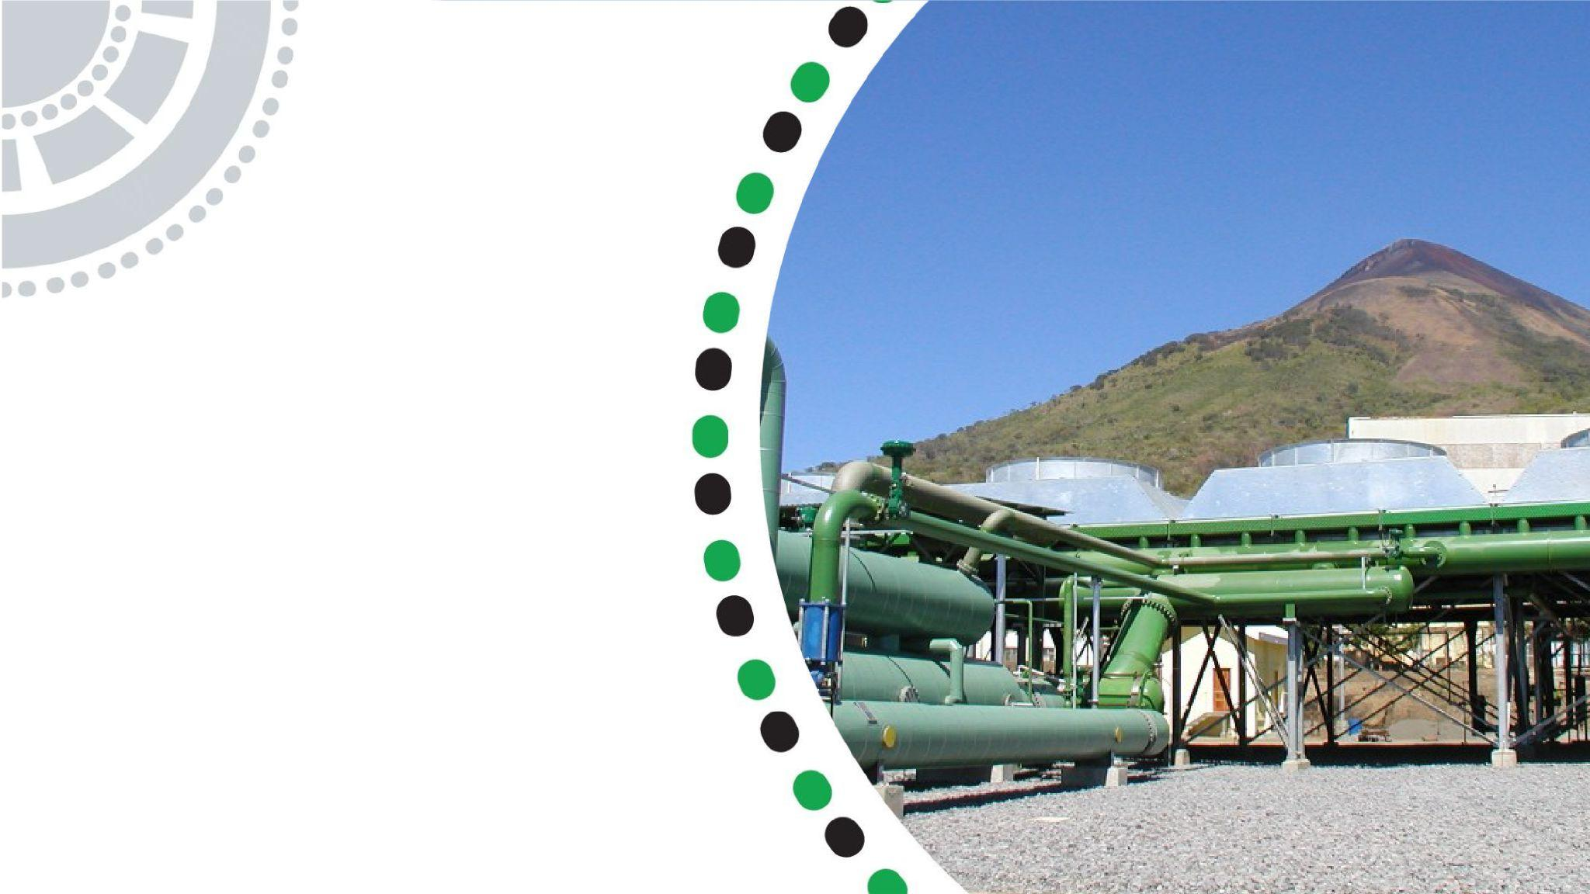


Dongo Kundu Fuel Logistics

Slide 2
01
Why Kenya
Contents
02
Investment Opportunity
03
Get Started

Slide 3

Why Kenya
Regional economic hub
Host to over 200 Multinational Corporations with regional & continent-wide HQs in Nairobi
Robust financial system
  43 banking institutions
  9 representative offices of foreign banks,
  13 Microfinance Banks,
  3 credit reference bureaus
  19 Money Remittance Providers
  73 forex bureaus
3rd largest
economy in sub-Saharan Africa.
US$ 110.35 Bn
7.5% growth
Dominant economy in EAC
≈46% of EAC’s GDP.
Africa’s UN HQs (UNON) which is one of four main UN secretariat duty stations globally.
Global headquarters of UNEP and UN-Habitat, together with a joint presence of 23 other UN Agencies.
Communications & Logistics hub of the region
Access to regional transport corridors.
  4 international airports
  2 sea ports and 2 ICDs
  30-freight and 2-passenger rail services daily between Nairobi and Mombasa.
US$ 2,081.8
+75% growth since 2010
Growing middle-class with an increasing appetite for high-value goods and services.

Slide 4
The Investment Environment is Conducive
Guaranteed repatriation of capital and profits
Constitutional protection against expropriation
Investment guarantee against non-commercial risks: ICSID, MIGA and ATIA
1
Economic liberalization
One stop shop facilitation
Periodic Presidential roundtables with private sector
Digitization of government services
Facilitative Industrial zone programs - EPZs & SEZs
2
3
Political and macroeconomic stability.
High labour productivity: a large pool of youthful, trainable and literate workforce
Globally competitive:
  56th in the Ease of Doing Business
  1st for five years in a row in financial inclusion
  1st globally in protection of minority investors
  Nairobi – Africa’s leading business travel destination and hub for impact investors.
  2nd in Africa in the logistics performance index
Investment attractiveness
Investment facilitation
Source: World Bank, UNCTAD, CBK, KNBS

Slide 5
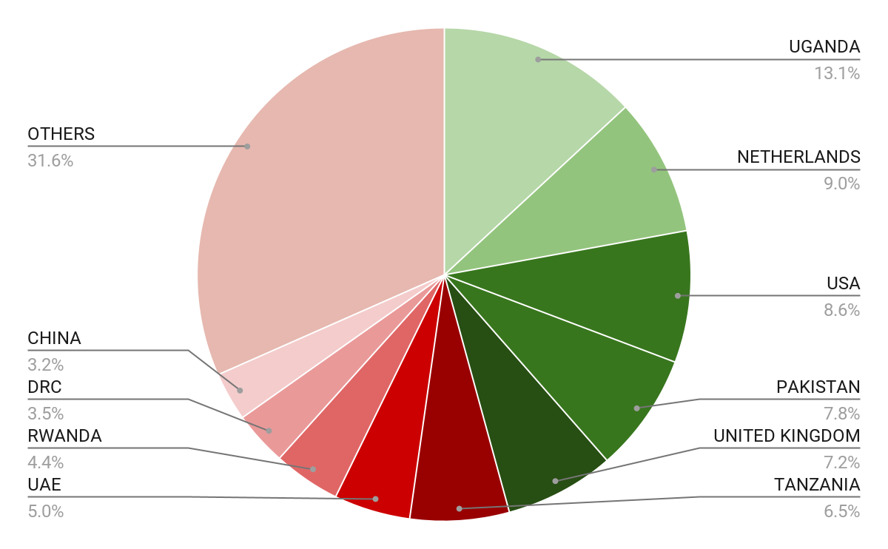





Wide Market Access & Good Trade Relations
US$ 17.43 Bn
Total Imports
US$ 6.09 Bn
Total Exports
Preferential Trade Agreements
1.7Bn
Population
~ US$ 40Tn
Market value
Kenya’s untapped export potential
~ US$ 4.1 Bn (ITC)

Slide 6
Existing Bilateral Trade Treaties with United Kingdom
Economic Partnership Agreement: In 2021, Kenya and the UK signed a trade agreement that seeks to deepen trade and investment ties between the two countries by providing a framework for the elimination of tariffs and non-tariff barriers.
Development Cooperation Agreement: In 2018, Kenya and the UK signed a development cooperation agreement, which aims to strengthen cooperation in areas such as health, education, governance, and security.
Double Taxation Agreement: In 1976, Kenya and the UK signed a double taxation agreement, which seeks to prevent double taxation of income earned by residents of the two countries.
Air Services Agreement: In 1967, Kenya and the UK signed an air services agreement, which allows airlines from the two countries to operate scheduled services between them.

Slide 7
Contents
01
Why Kenya
02
Investment Opportunity
03
Get Started

Slide 8
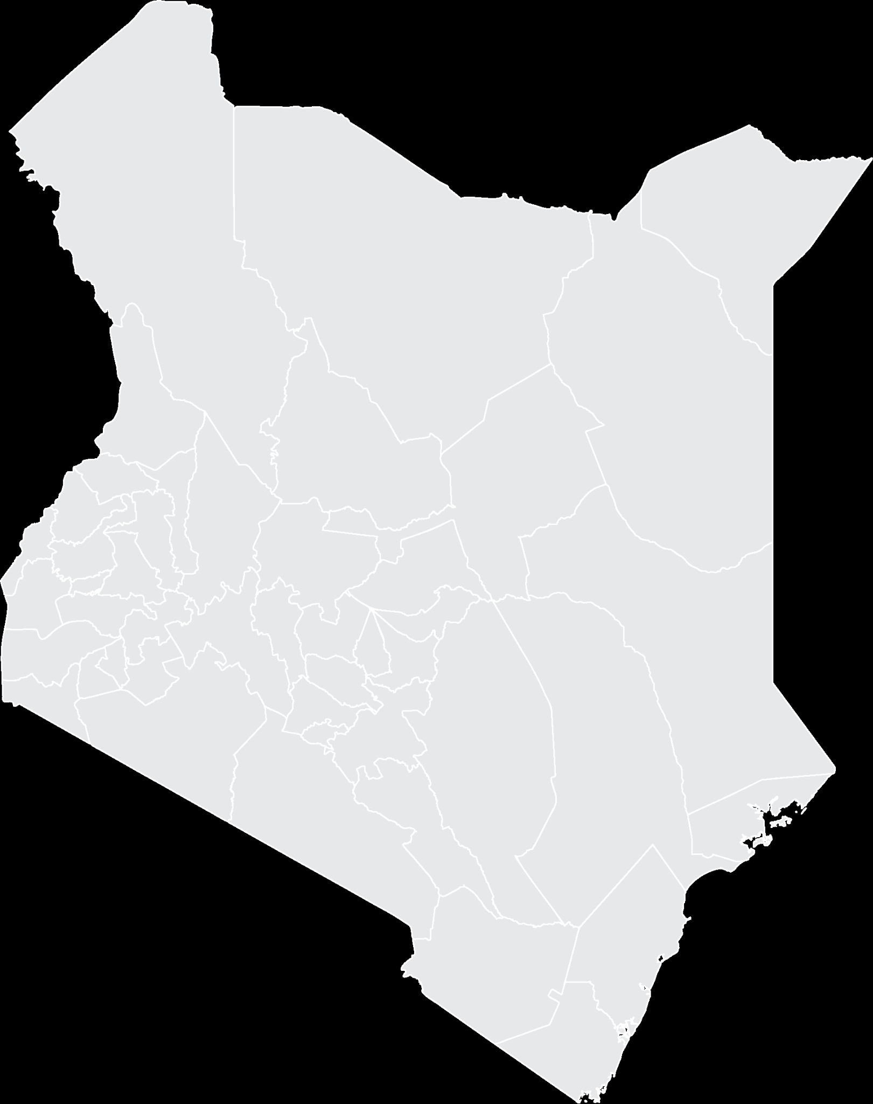



Executive Summary
Project Name: DONGO KUNDU FUEL LOGISTICS
IMPLEMENTING AGENCY: SPECIAL ECONOMIC ZONE AUTHORITY (SEZA)
ESTIMATED INVESTMENT COST: USD 6 Million
INVESTMENT ENGAGEMENT: PUBLIC PRIVATE PARTNERSHIP (PPP)
INVESTMENT FACILITATOR: KENYA INVESTMENT AUTHORITY.
ANCHOR INVESTOR: KENYA DEVELOPMENT CORPORATION.
i
Kwale County

Slide 9
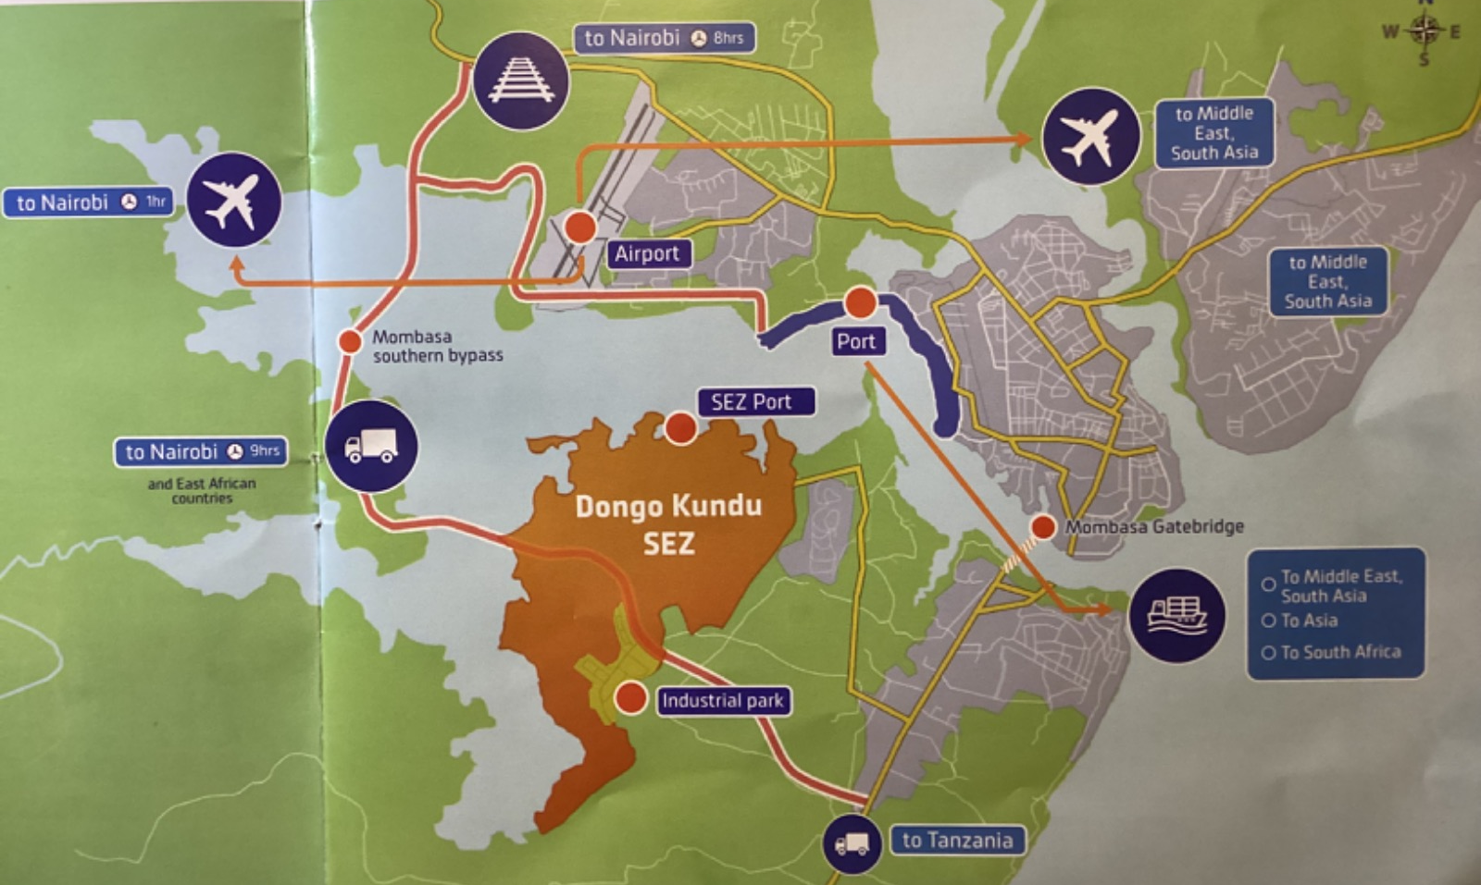
Dongo Kundu SEZ
This is a public special economic zone enjoying preferential customs rules and reduced taxation
Location: Mombasa, along the East African coastline, occupying approx. 1,200 hectares (3,000 acres). Adjacent to Mombasa Port Southern Bypass Road, Standard Gauge Railway and the Moi International Airport.
Served by: The Southern Bypass Road, a 10,000m3/day water reservoir, a dedicated 220KV power substation, a state-of-the-art fiber-optic connection, a dedicated SEZ port & free trade zone.
The SEZ features:
Industrial Park
Port
Free Port/Free Trade Zone
Residential and Commercial Areas
MICE (Meetings, Incentives, Conferences and Exhibition) facilities

Slide 10






Government Support to SEZs
Incentives Policy for SEZs
Exemptions and zero-rating of taxes to SEZ Enterprises
Developing Infrastructure
Connectivity via rail, road, and air. Efficient travel and cargo handling.
Supporting MSMEs
Demand-driven support through capacity buildings
Repatriation of Profits
Full repatriation of foreign investors
Wide Market Access
Access to regional & international markets; EAC, COMESA, AGOA, AFCFTA, EPA, TIFA & GPS, and bilateral trade agreements.
ICT Industry
Cutting edge connectivity hardware across the country, supported by a growing information technology business platform.

Slide 11







Fiscal Incentives for Investors in Dongo Kundu SEZ
Imported Goods (Fully Exempt)
Value Added Tax
Excise Duty
Import Duty
Import Declaration
Withholding Tax
Interest – 5%
Management – 5%
Royalty – 5%
Local Supplies
Zero Rated
Value Added Tax
Stamp Duty
Exempt
Corporate Tax (Preferential Rates)
First 10 Years – 10%
Next 10 Years – 15%
Subsequent Years – 30%
Investment Deduction Allowance
100% allowance on capital expenditure on building and machinery.
Local Government Fees Exemptions
Advertisement fees
Business Service permit fees

Slide 12
Opportunity
Market
There are over seventy-one (71) registered oil-marketing companies in Kenya. These entities market, sell and distribute oil products such as diesel, kerosene, gasoline (petrol), lubricants, and liquefied petroleum gas (LPG).
01
Dongo Kundu is located along the coastline of East Africa and acts as a gateway and exit port for a vast hinterland in East Africa that includes Kenya, Uganda, South Sudan, The Democratic Republic of Congo, Rwanda, Burundi, and Northern Tanzania.
02
In the year 2021, Kenya imported 6.4 million tonnes of petroleum products, growing at a CAGR of 0.4% out of which 0.6 million tonnes was re-exported.
03
The value of petroleum Exports to the East African Market averages USD 15 Million annually, growing at a CAGR of 9%.
Kwale County

Slide 13
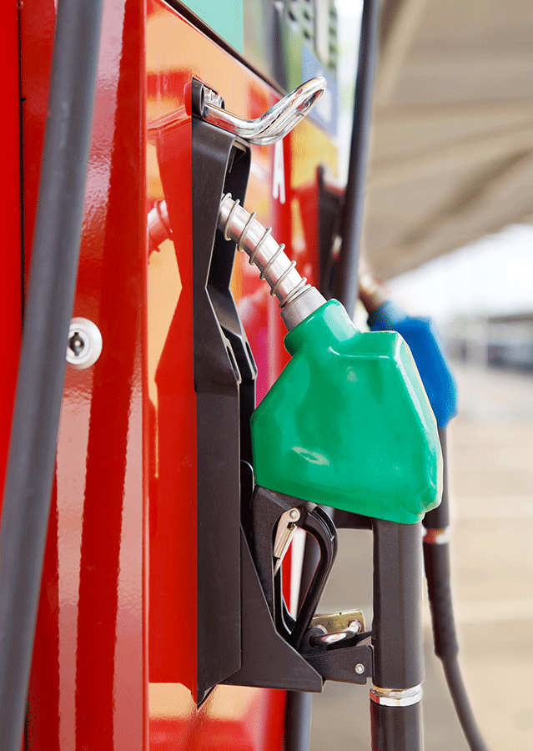
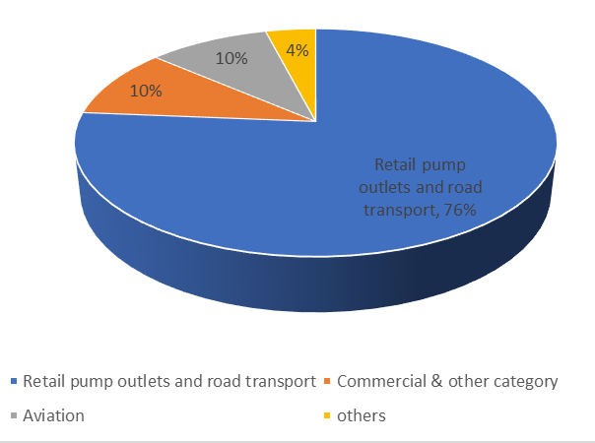
Consumers of Petroleum Fuels
Petroleum Fuels Consumption by Sector:

Slide 14
Contents
01
Why Kenya
02
Investment Opportunity
03
Get Started

Slide 15
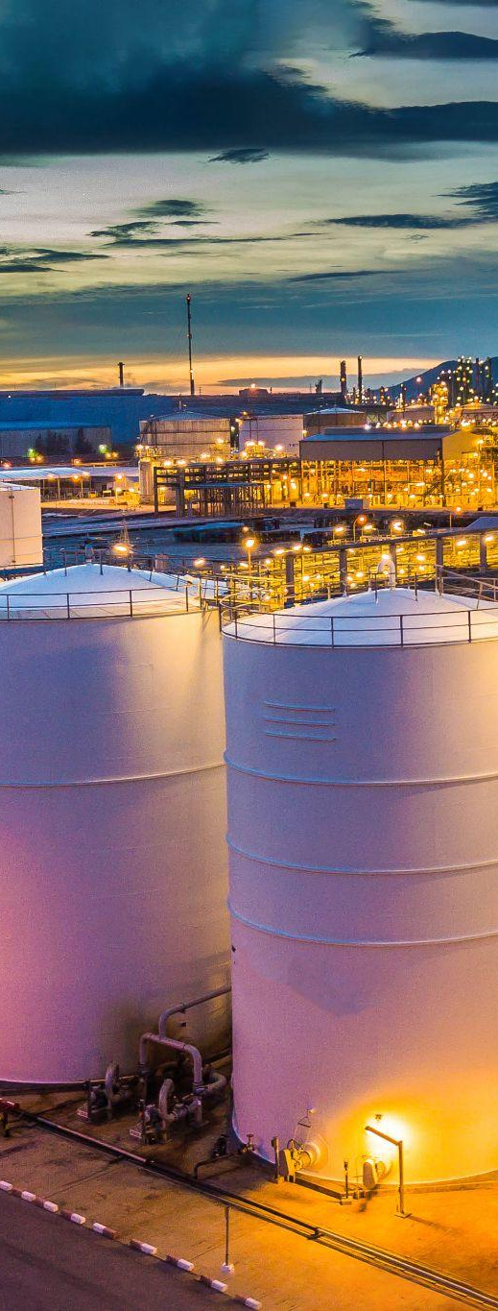
Value Proposition of the Dongo Kundu Fuel Logistics
Strategic Location
Proximate to a vibrant transport ecosystem; Sea Port, Airport, Rail, & Road network for ease of transporting refined products to various part of the countries and ship it to other countries.
✓
Products to various part of the countries and ship it to other countries.
✓
Ample Industrial space available for leasing.
✓
Availability of affordable skilled labour.
✓
A dedicated power substation is available on site.
✓
Other amenities like water, Sewage treatment plant and fibre optic connection are there in the park
✓
A dedicated SEZ port and free trade zone also support the custom-controlled functionality of the entire zone
The ASK: Investment in a warehouse at the Dongo Kundu SEZ to deal in transshipment of refined products in Kenya, East and Central Africa.

Slide 16
Contents
01
Why Kenya
02
Investment Opportunity
03
Get Started

Slide 17

Get started with KenInvest and KDC

Slide 18



