Slide 1



Digital Economy Investment Opportunities

Slide 2

Why Kenya
Regional economic hub
Host to over 200 Multinational Corporations with regional & continent-wide HQs in Nairobi
Robust financial system
43 banking institutions
9 representative offices of foreign banks,
13 Microfinance Banks,
3 credit reference bureaus
19 Money Remittance Providers
73 forex bureaus
3rd largest
economy in sub-Saharan Africa.
US$ 110.35 Bn
7.5% growth
Dominant economy in EAC
≈46% of EAC’s GDP.
Africa’s UN HQs (UNON) which is one of four main UN secretariat duty stations globally.
Global headquarters of UNEP and UN-Habitat, together with a joint presence of 23 other UN Agencies.
Communications & Logistics hub of the region
Access to regional transport corridors.
4 international airports
2 sea ports and 2 ICDs
30-freight and 2-passenger rail services daily between Nairobi and Mombasa.
US$ 2,081.8
+75% growth since 2010
Growing middle-class with an increasing appetite for high-value goods and services.

Slide 3
The Investment Environment is Conducive
Guaranteed repatriation of capital and profits
Constitutional protection against expropriation
Investment guarantee against non-commercial risks: ICSID, MIGA and ATIA
1
Economic liberalization
One stop shop facilitation
Periodic Presidential roundtables with private sector
Digitization of government services
Facilitative Industrial zone programs - EPZs & SEZs
2
3
Political and macroeconomic stability.
High labour productivity: a large pool of youthful, trainable and literate workforce
Globally competitive:
56th in the Ease of Doing Business
1st for five years in a row in financial inclusion
1st globally in protection of minority investors
Nairobi – Africa’s leading business travel destination and hub for impact investors.
2nd in Africa in the logistics performance index
Investment attractiveness
Investment facilitation
Source: World Bank, UNCTAD, CBK, KNBS

Slide 4
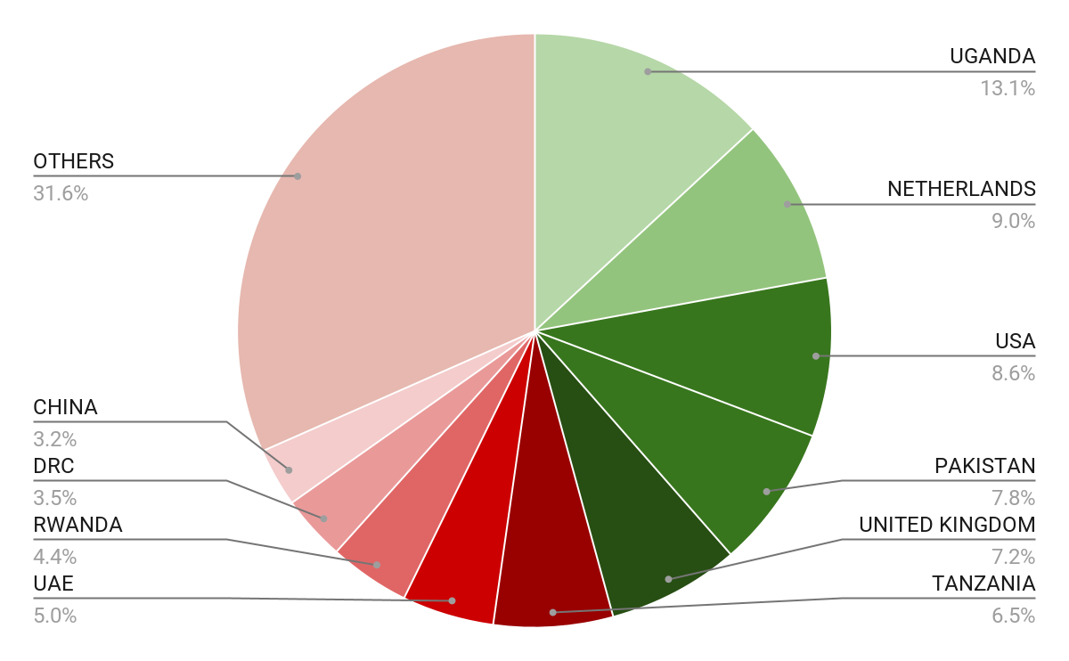





Wide Market Access & Good Trade Relations
US$ 17.43 Bn
Total Imports
US$ 6.09 Bn
Total Exports
Preferential Trade Agreements
1.7Bn
Population
~ US$ 40Tn
Market value
Kenya’s untapped export potential
~ US$ 4.1 Bn (ITC)

Slide 5
Existing Bilateral Trade Treaties with United Kingdom
Economic Partnership Agreement: In 2021, Kenya and the UK signed a trade agreement that seeks to deepen trade and investment ties between the two countries by providing a framework for the elimination of tariffs and non-tariff barriers.
Development Cooperation Agreement: In 2018, Kenya and the UK signed a development cooperation agreement, which aims to strengthen cooperation in areas such as health, education, governance, and security.
Double Taxation Agreement: In 1976, Kenya and the UK signed a double taxation agreement, which seeks to prevent double taxation of income earned by residents of the two countries.
Air Services Agreement: In 1967, Kenya and the UK signed an air services agreement, which allows airlines from the two countries to operate scheduled services between them.

Slide 6
Contents
01
Why Kenya
02
Investment Opportunity
03
Get Started

Slide 7

Preamble: Digitalization
Kenya is one of the world leaders in driving financial inclusion through the use of digital finance solutions.
The adoption of such innovations is facilitating transactions and spurring trade for corporations, small and medium enterprises (SME’s) and individuals. This in turn translates to improved and efficient business environments, increased accessibility, connectedness and better standards of living.
In the same token, the Kenyan Government has adopted technology that is leading to faster and efficient services to the people. Kenya however, has much more to offer and gain from the digital economy.
To harness these benefits, we have to build ecosystems that facilitate digital transactions nationally, regionally and globally. Towards this end, Kenya has identified investment opportunities for digitalization.

Slide 8



Executive Summary
Project Name: E-GOVERNMENT PLATFORM AND TECH START-UP
INVESTMENT FACILITATOR : KENYA INVESTMENT AUTHORITY (KENINVEST)
ANCHOR INVESTOR : KENYA DEVELOPMENT CORPORATION (KDC)
ESTIMATED INVESTMENT COST: USD 10 Million
INVESTMENT ENGAGEMENT: PUBLIC PRIVATE PARTNERSHIP (PPP)
i
Nairobi County
i

Slide 9
Kenya National Digital Master Plan 2022-2032
Pillar | Flagship Programmes | Actors
Digital Infrastructure | 1. Installation of 100,000km of high speed fiber optic infrastructure to provide internet to all Schools, government institutions/offices, Metro-cities, health facilities, rural businesses, homes and public spaces | MOICT IYA, ICTA., CA,KONZA, KURA, KeNHA, KeRRA, NMS, MOH, NT,MED, CoG, Development partners and Private Sector
 | 2. Establishment of 25,000 internet-hotspots across the country to provide internet services to innovators, youth and entrepreneurs | MOICT IYA, NT,CoG, ICTA, Private Sector
 | 3. Establishment of Cloud Services for government and private sector | MOICT IYA, ICTA.,NT, KONZA,ODP Private Sector
 | 4. Establishment of 1450 Village digital hubs for citizen digital literacy training, film production and public access to government services | MOICT IYA, ICTA., MOICT IYA, ICTA.NT, KFC,KFCB, MEDIA, ODP, CoG, Private Sector
 | 5. National Physical Addressing System to accelerate e-commerce initiative | MOICT IYA, ICTA.,PCK, ODP, CA,CoG,MOI,MOL, private sector, NT
 | 6. National Spatial Data Infrastructure to provide trusted geospatial data for businesses and government | MOICT IYA, ICTA., MOL,CoG, ODP,NT, MOL, ODP,Private Sector, Development partners, NT
 | 7. Regional Submarine Cable Maintenance Depot to ensure effective maintenance support for submarine cables serving the Africa Region | MOICT IYA, ICTA.,EAC,Private sector,NT, Development Partners, MOT
 | 8. Regional Smart ICT Hub to provide faster IP exchange and data storage for the Africa Region. | MOICT IYA, ICTA.,Private Sector, EAC, Konza, ODP
 | 9. Kenya eWaste Programme to manage e-waste electronic products in the country | MOICT IYA, ICTA., NEMA, KONZA, County Government, CoG, MCDAs, NT,Private Sector, Development Partners, ODP, KONZA
The Kenya National Digital Master Plan 2022 - 2032; The Kenya Digital Economy BluePrint

Slide 10
Kenya National Digital Master Plan 2022-2032
Pillar | Flagship Programmes | Actors
Digital Services, Products and Data Management | 10. Digital one-stop-shop for all Government common services through automation of all government core processes and digitization of manual records, interoperability and unified communication platforms. | MOICT IYA, ICTA., KONZA, MCDAs, NT, CoG, Private Sector, Development Partners
 | 11. National Public Key Infrastructure for digital signatures | MOICT IYA, ICTA., CA, MCDAs, Private Sector, NT, ODP
Digital Skills | 12. Digital Literacy Capacity Building for 20 million citizens 10,000 ICT professionals on high-end skills, 300,000 public servants and 350,000 teachers to given them necessary IT proficiency to be able to deliver services effectively to the citizen to be able to utilize technology in their businesses and access to government e-services | MOICT IYA, ICTA., MCDAs, CoG, MOI,MODEV,MOED, TSC,
 | 13. Smart ID card to provide person unique identifier. | MOICT IYA, ICTA., MOI, Dept Civil Reg, Private Sector, NT
 | 14. Digital Literacy Programme to accelerate integration of technology in teaching and learning in all learning institutions | MOICT IYA, ICTA.,, MOED, TSC, KNEC,KICD, Private Sector, Development partners, NT
The Kenya National Digital Master Plan 2022 - 2032; The Kenya Digital Economy BluePrint

Slide 11
Kenya National Digital Master Plan 2022-2032
Pillar | Flagship Programmes | Actors
Digital Enterprises, Innovation and Businesses | 15. Kenya Software and Electronic Industry establishment of 2 software manufacturing industries and two electronic manufacturing plants with 10,000 software engineers and production of over 1.2 million electronic devices | MOICT IYA, ICTA.,MOIED,CoG, Private Sector, Development Partners
 | 16. Annual International ICT Expo to showcase on existing products and services for entrepreneurs and businesses | MOICT IYA, ICTA., KENIA, KEPSA, Private Sector, MOFA
Policy, Legal and Regulatory | 17. Harmonization/enactment of policies, legislations to enable ease of doing ICT businesses in the country. | AG, MOICT IYA, ICTA, Parliament, NT
 | 18. Enactment of e-government legislation to support resource mobilization to fund the Masterplan Programmes. | MOICT IYA, ICTA., MOI, Dept Civil Reg, Private Sector, NT
 | 19. Enactment of Critical Infrastructure protection legislations to protect all critical infrastructure installations across the country | MOICT IYA, ICTA.,, MOED, TSC, KNEC,KICD, Private Sector, Development partners, NT
The Kenya National Digital Master Plan 2022 - 2032; The Kenya Digital Economy BluePrint

Slide 12


Opportunities for Digitalization in Kenya
01
Digital Government (e-government)
Digital Government (e-government) Sector Management Information Systems (Education, Agriculture, Health, among others.
Online provision of government services; centralized government portal, open data portal, secure reliable government network.
02
Provision of Cyber security solutions.
Provision of digital transformation technologies; Artificial Intelligence (AI), Robotics, Block Chain, Drones, Internet of Things (IoT), Big data, and Software-enabled industrial platforms.
Digital Business (e-business)
03
Connectivity - addition/ expansion of fibre infrastructure lines in collaboration with internet service providers.
Data Centres – establishment of secondary Data centres.
Setting up Nodes on existing infrastructure for Cloud computing.
Infrastructure
04
Establishment of a Fund, managed by KDC, to provide financing to start-up SME firms engaging in provision of digital technology
Tech Start-up Fund
The Kenya National Digital Master Plan 2022 - 2032; The Kenya Digital Economy BluePrint

Slide 13
Digitalization
i
Benefits of Digitalization
Increased efficiency
Increased productivity & agility
Lower operational costs
Improved customer experience
Improved communication
Increased transparency
Improved competitive advantage, and faster decision making
Opportunity
Private Investment in the identified opportunities for Digitalization in Kenya; e-government, e-business, infrastructure, and Tech funding.
The Kenya National Digital Master Plan 2022 - 2032; The Kenya Digital Economy BluePrint

Slide 14
Contents
01
Why Kenya
02
Investment Opportunity
03
Get Started

Slide 15

Get started with KenInvest and KDC

Slide 16



