Slide 1





Invest in Kenya’s Affordable Housing Projects

Slide 2
01
Why Kenya
Contents
02
Investment Opportunity
03
Get Started

Slide 3

Why Kenya
Regional economic hub
Host to over 200 Multinational Corporations with regional & continent-wide HQs in Nairobi
Robust financial system
  43 banking institutions
  9 representative offices of foreign banks,
  13 Microfinance Banks,
  3 credit reference bureaus
  19 Money Remittance Providers
  73 forex bureaus
3rd largest
economy in sub-Saharan Africa.
US$ 110.35 Bn
7.5% growth
Dominant economy in EAC
≈46% of EAC’s GDP.
Africa’s UN HQs (UNON) which is one of four main UN secretariat duty stations globally.
Global headquarters of UNEP and UN-Habitat, together with a joint presence of 23 other UN Agencies.
Communications & Logistics hub of the region
Access to regional transport corridors.
  4 international airports
  2 sea ports and 2 ICDs
  30-freight and 2-passenger rail services daily between Nairobi and Mombasa.
US$ 2,081.8
+75% growth since 2010
Growing middle-class with an increasing appetite for high-value goods and services.

Slide 4
The Investment Environment is Conducive
Guaranteed repatriation of capital and profits
Constitutional protection against expropriation
Investment guarantee against non-commercial risks: ICSID, MIGA and ATIA
1
Economic liberalization
One stop shop facilitation
Periodic Presidential roundtables with private sector
Digitization of government services
Facilitative Industrial zone programs - EPZs & SEZs
2
3
Political and macroeconomic stability.
High labour productivity: a large pool of youthful, trainable and literate workforce
Globally competitive:
  56th in the Ease of Doing Business
  1st for five years in a row in financial inclusion
  1st globally in protection of minority investors
  Nairobi – Africa’s leading business travel destination and hub for impact investors.
  2nd in Africa in the logistics performance index
Investment attractiveness
Investment facilitation
Source: World Bank, UNCTAD, CBK, KNBS

Slide 5
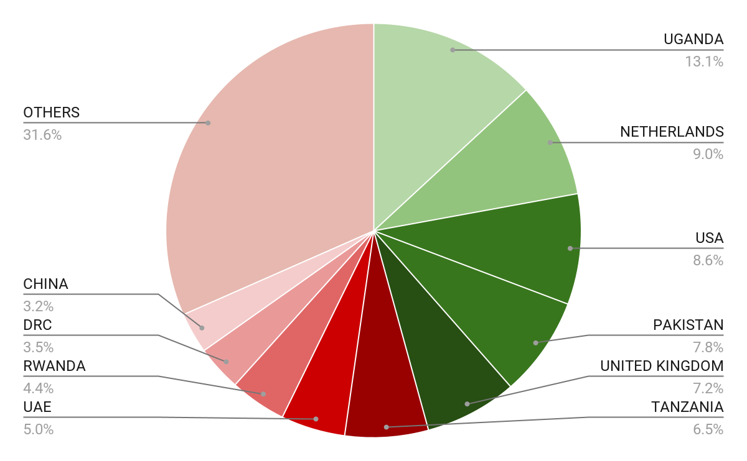





Wide Market Access & Good Trade Relations
US$ 17.43 Bn
Total Imports
US$ 6.09 Bn
Total Exports
Preferential Trade Agreements
1.7Bn
Population
~ US$ 40Tn
Market value
Kenya’s untapped export potential
~ US$ 4.1 Bn (ITC)

Slide 6
Existing Bilateral Trade Treaties with United Kingdom
Economic Partnership Agreement: In 2021, Kenya and the UK signed a trade agreement that seeks to deepen trade and investment ties between the two countries by providing a framework for the elimination of tariffs and non-tariff barriers.
Development Cooperation Agreement: In 2018, Kenya and the UK signed a development cooperation agreement, which aims to strengthen cooperation in areas such as health, education, governance, and security.
Double Taxation Agreement: In 1976, Kenya and the UK signed a double taxation agreement, which seeks to prevent double taxation of income earned by residents of the two countries.
Air Services Agreement: In 1967, Kenya and the UK signed an air services agreement, which allows airlines from the two countries to operate scheduled services between them.

Slide 7
Contents
01
Why Kenya
02
Investment Opportunity
03
Get Started

Slide 8
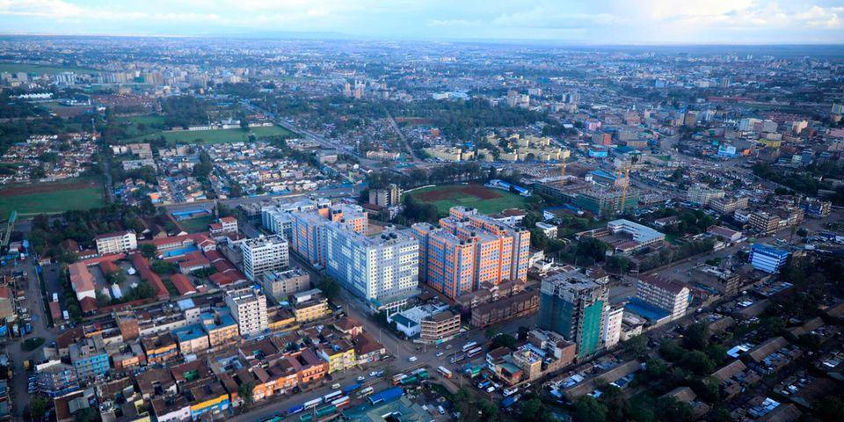
Kenya’s Housing Market
Kenya’s Real Estate Industry is growing at an average rate of 6.7% per annum with current population size of 56.2 Million (2022). Annual population growth rate is 2.3% with Urban population size of 14.7 Million.
The current housing deficit stands at 2 million houses which continues to rise due to fundamental constraints on both the demand and supply side and is exacerbated by an urbanization rate of 4.2%, equivalent to 0.5 million new city dwellers every year.
Currently, almost 61% of urban households live in informal settlements and the number is constantly rising due to the rising urbanization.
These informal settlements are characterized by poor or non-existent infrastructure and dilapidated structures that are unfit for human dwelling.

Slide 9
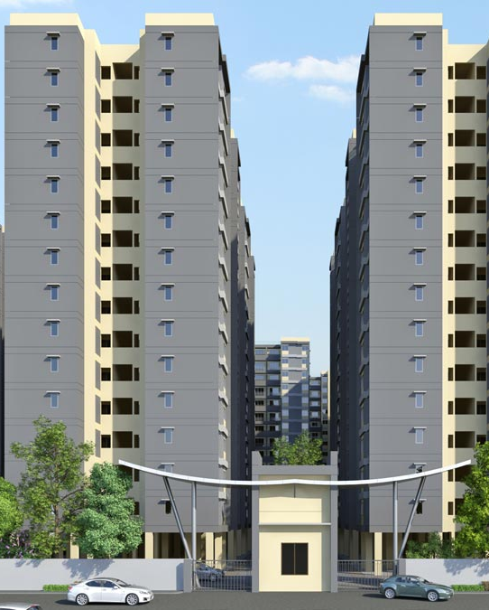
The Demand
With this level of growth, Kenya requires approximately 200,000 new housing units annually to meet demand, yet only 50,000 homes are built, leaving the housing deficit growing by 150,000 units per year.
A strategic approach to both the demand and the supply side of the housing sector has been implemented which include;
  Developing Innovative housing solutions
  Enhancing value Efficiency
  Creating Accessible financing solution
  Establishing institutional partnership

Slide 10
Market Potential
01
Increasing trends in studio and student housing in urban areas
02
Low home ownership in Urban areas, at 21.3%
03
Housing portal i.e. Boma Yangu to assist in identifying end buyer
04
Government’s priority Program on affordable housing
05
Provision of land and bulk infrastructure by the Government
06
New Housing demand of 250,000 per year against a supply of 50,000 annual housing deficit.
05
Increased entry of Multinational corporations and retailers into the country puts a demand on commercial and industrial warehouses
06
Infrastructure improvements has positioned Kenya as a regional hub hence the need for more residential, commercial and industrial warehouses

Slide 11














Targeted Income Segment
Affordable housing is targeting 3 income segments;
Middle to High Income
Income Range:
KES 150,000 +
Mortgage Gap
Income Range:
KES 50,000
–
KES 149,999
Low cost
Income Range:
KES
20
,000
–
KES 49,999
Social
Income Range:
KES 0
–
KES
1
9,999

Slide 12



Invest in the Development of Residential Estate at the Athi River EPZ
Estimated Investment Cost: US$ 22 Million
Development of Athi River housing estate complex.
The EPZ Programme has employed 66,053 people countrywide and out of which 23,558 people were employed at Athi River EPZ By 2022, the number of employees increased to 25,000 people.
Studio Apartments: 746 units
2-Bedroom Apartments: 2,328 units
3-Bedroom Apartments: 6,934 units.
i
Site Location | Proximity to the Kenya’s Capital City Nairobi (32 kms)
Ready market | The proposed development falls within the Nairobi Metropolitan Region
Utilities | Supplemented by a power substation. It is also well served by a water pipeline and a sewer system within the vicinity
Soil and Drainage | Minimal excavation for the substructures of buildings on the proposed site.
Accessibility | Accessibility is by road, an express highway and rail.

Slide 13
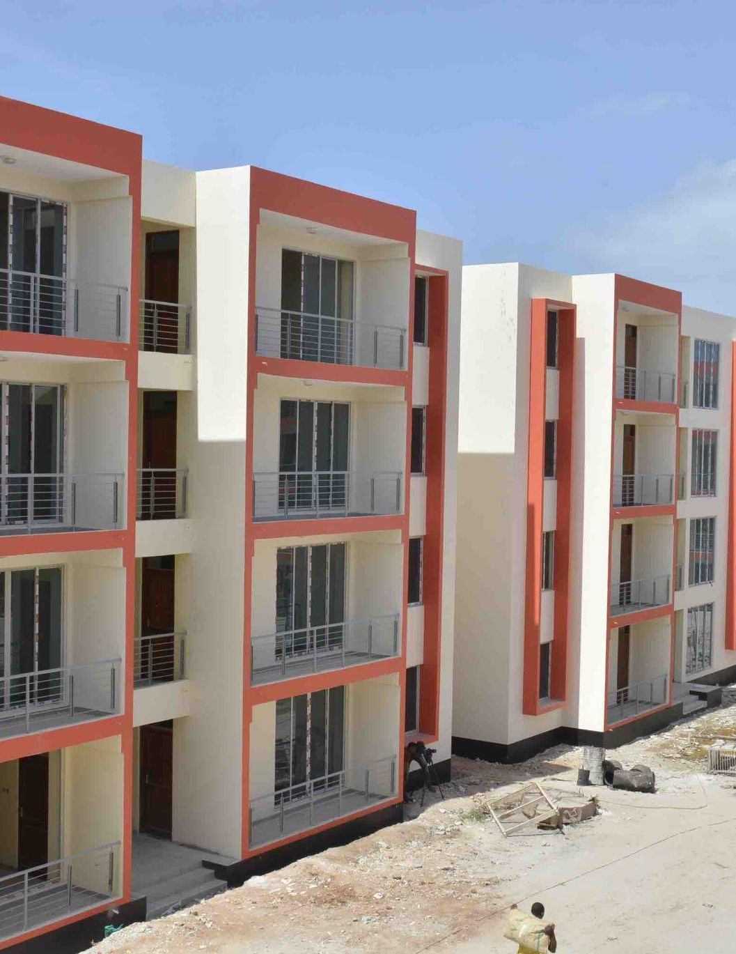
Invest in the Development of Affordable Houses across 16 Counties
Estimated Investment Cost: US$ 851 Million
Implementing Agency: National Housing Corporation (NHC)
Seeking to investors to partner in development of affordable housing in 16 counties in Kenya.
NHC’s contribution = US$ 240 Million (design, land surveying, legal services and project management services)

Slide 14
Tax Incentives for Housing Developers
 | Description | Incentive | Impact on AHP
Value Added Tax | VAT of 16% on construction inputs | 9% reduction in construction costs | 9% reduction in construction costs
Corporate Income Tax | Currently at 30% | 15% for developers of >100 units | 4% reduction in unit price
Import Declaration Fee | Currently at 2% (increased to 3.5% for other imports) | IDF for goods imported for construction in AHP projects to remain at 2% | Reduction in import duties resulting in reduced cost of construction
Railway Development Levy | Railway Development Levy (RDL) currently at 1.5% (increased to 2% for other imports) | RDL for AHP project imports remains at 1.5% | Reduction in import duties resulting in reduced cost of construction
Thin Capitalization | Restriction of interest expense deduction when computing taxable income where a foreign controlled company has a debt to equity ratio exceeding 3:1 | No interest restriction for companies undertaking projects under AHP | Reduction of corporation tax liability resulting in enhanced profit for the developer

Slide 15
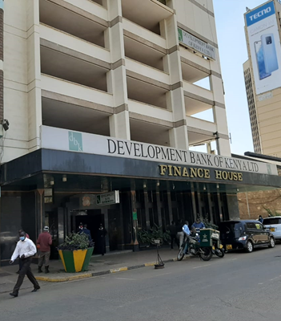
FINANCE HOUSE
Located along Loita street/Koinange street, Nairobi CBD.
18 storey multi-storey business cum office block.
Comprises basements and overhead parking, Banking hall on the ground floor, offices on the upper floors.
The upper floors are served by four lifts, a main staircase and a fire exit staircase.
Built up area covers 172,400 square feet.
The building has a total lettable space of 80,120.20 square feet.
Occupancy – 82%.
Estimated rental receipts per month – USD 77,367.

Slide 16
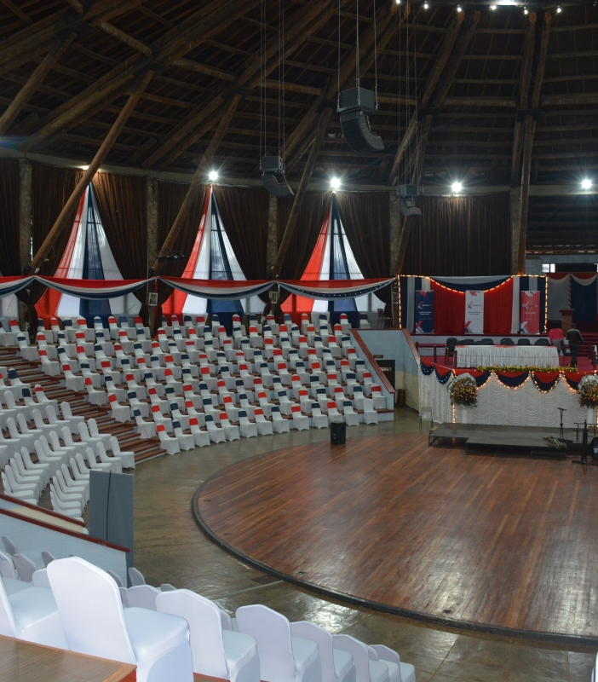
BOMAS OF KENYA - NAIROBI INTERNATIONAL CONVENTION AND EXHIBITION CENTRE
Bomas of Kenya is a tourist village in Langata, Nairobi.
Project - Construction of Nairobi International Convention and Exhibition Centre (NAICEC)
The proposed NAICEC and its components will occupy sixty (60) acres of land of Bomas of Kenya.
Cost - USD 218.22 million

Slide 17
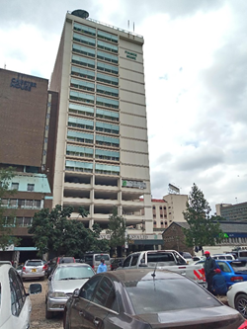
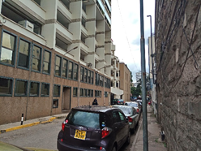
KCB PLAZA
Located at Upper hill
Plot area covers 0.20 hectares
After adjustment for time, analysis yields USD 146 per sq. ft for the land.
L.R. 209/12003
  Located at the junction of Kenyatta Avenue/Kimathi Street
  Plot area covers 0.2176 ha
  Analysis USD 167.23 per sq. ft per for the land.

Slide 18
Financial Ask
✓
An investor to develop affordable housing units on the 43 government lands approved for advertisement.
✓
An investor to purchase Finance House.
✓
An investor to develop Nairobi International Convention and Exhibition Centre (NAICEC) at the Bomas of Kenya.
Notes:
During each phase of the construction period, only interest is paid on outstanding bank debt for that phase, after which payments begin on a declining balance.

Slide 19
Contents
01
Why Kenya
02
Investment Opportunity
03
Get Started

Slide 20

Get started with KenInvest and KDC

Slide 21



