Slide 1




Invest in Kenya’s Energy & Renewable Energy sectors

Slide 2
01
Why Kenya
Contents
02
Investment Opportunity
03
Get Started

Slide 3

Kenya at a Glance
Regional economic hub
Host to over 200 Multinational Corporations with regional & continent-wide HQs in Nairobi
Robust financial system
43 banking institutions
9 representative offices of foreign banks,
13 Microfinance Banks,
3 credit reference bureaus
19 Money Remittance Providers
73 forex bureaus
3rd largest
economy in sub-Saharan Africa.
US$ 110.35 Bn
7.5% growth
Dominant economy in EAC
≈46% of EAC’s GDP.
Africa’s UN HQs (UNON) which is one of four main UN secretariat duty stations globally.
Global headquarters of UNEP and UN-Habitat, together with a joint presence of 23 other UN Agencies.
US$ 2,081.8
+75% growth since 2010
Growing middle-class with an increasing appetite for high-value goods and services.
Communications & Logistics hub of the region
Access to regional transport corridors.
4 international airports
2 sea ports and 2 ICDs
30-freight and 2-passenger rail services daily between Nairobi and Mombasa.

Slide 4
The Investment Environment is Conducive
Guaranteed repatriation of capital and profits
Constitutional protection against expropriation
Investment guarantee against non-commercial risks: ICSID, MIGA and ATIA
Economic liberalization
1
One stop shop facilitation
Periodic Presidential roundtables with private sector
Digitization of government services
Facilitative Industrial zone programs - EPZs & SEZs
2
Investment attractiveness
Investment facilitation
Political and macroeconomic stability.
High labour productivity: a large pool of youthful, trainable and literate workforce
Globally competitive:
56th in the Ease of Doing Business
1st for five years in a row in financial inclusion
1st globally in protection of minority investors
Nairobi – Africa’s leading business travel destination and hub for impact investors.
2nd in Africa in the logistics performance index
3
Source: World Bank, UNCTAD, CBK, KNBS

Slide 5
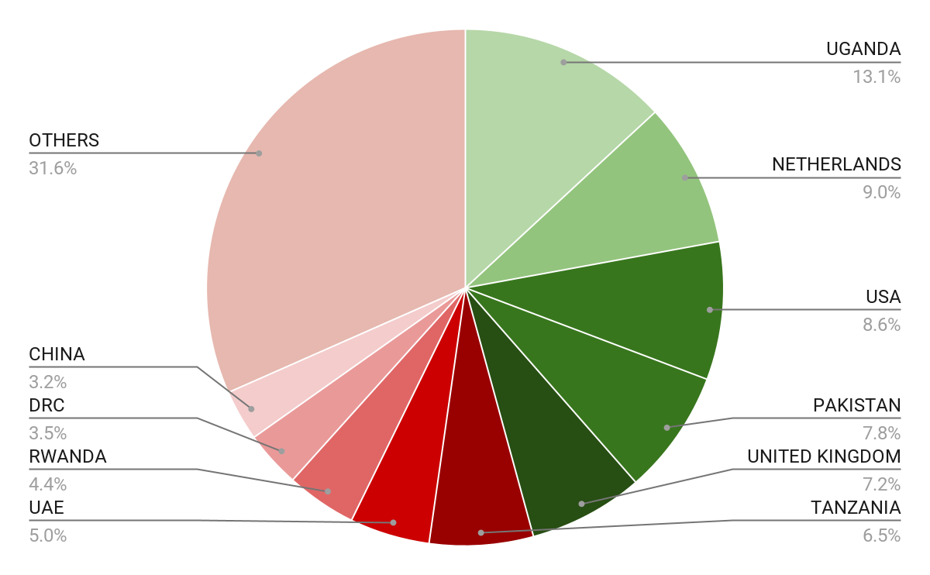





Wide Market Access & Good Trade Relations
US$ 17.43 Bn
Total Imports
US$ 6.09 Bn
Total Exports
Preferential Trade Agreements
1.7Bn
Population
~ US$ 40Tn
Market value
Kenya’s untapped export potential
~ US$ 4.1 Bn (ITC)

Slide 6
Existing Bilateral Trade Treaties with United Kingdom
Economic Partnership Agreement: In 2021, Kenya and the UK signed a trade agreement that seeks to deepen trade and investment ties between the two countries by providing a framework for the elimination of tariffs and non-tariff barriers.
Development Cooperation Agreement: In 2018, Kenya and the UK signed a development cooperation agreement, which aims to strengthen cooperation in areas such as health, education, governance, and security.
Double Taxation Agreement: In 1976, Kenya and the UK signed a double taxation agreement, which seeks to prevent double taxation of income earned by residents of the two countries.
Air Services Agreement: In 1967, Kenya and the UK signed an air services agreement, which allows airlines from the two countries to operate scheduled services between them.

Slide 7
Contents
01
Why Kenya
02
Investment Opportunity
03
Get Started with KenInvest

Slide 8
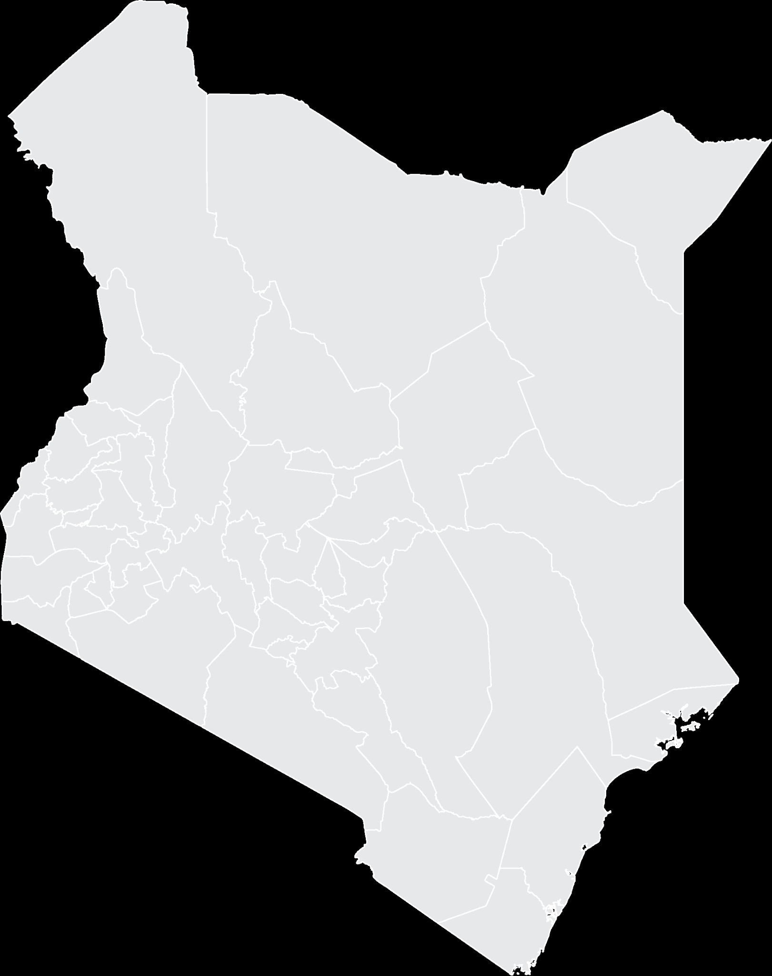


Invest in the proposed Isiolo Dam
Estimated Investment Cost: US$ 136 Million
i
Implementing Agency: National Water Harvesting and Storage Authority
The proposed dam is intended to supply water to Isiolo town, the proposed Isiolo resort city and rural areas of Isiolo, Laikipia and Samburu counties.
Annual water demand for Isiolo and its environs is 113,681 m³ translating to an annual demand for 41,493,565 m³.
Public-private Partnerships (PPP)
Isiolo County
16MW
Hydropower to be generated

Slide 9
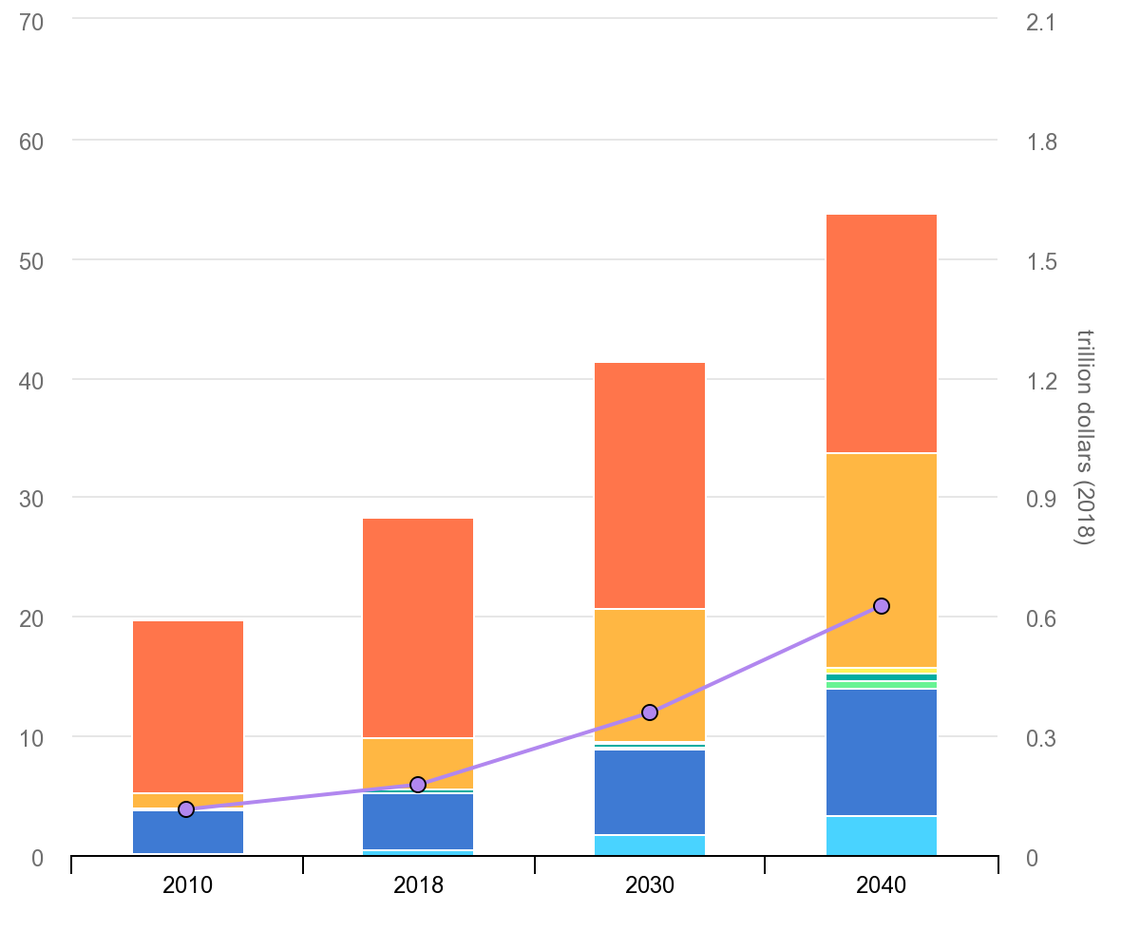
Kenya’s Energy Market
Kenya primary Projected Energy Demand and GDP ($ Trillion)
Generation Capacity: Total Installed Capacity : 2,819 MW Hydro: 826 MW Geothermal: 828 MW Thermal (MSD & GT): 749 MW Wind: 331 MW Solar: 51 MW Biomass: 28 MW
Current Electricity Access Rate: 75% Urban: 100% Rural: 65.7%
Millions of tonnes of oil equivalent (Mtoe)
Source: International Energy Agency

Slide 10

Kenya’s Water Market
The Kenya’s National Water Master Plan 2030 estimates that $14 billion in investment in water supply and $5.4 billion in investment in urban sewerage infrastructure are needed over the next 15 years.
The current estimated water demand for Nairobi is 650,000 m³/day compared to the production of 482,940 m³/day, and the situation is replicated across the country.
Currently, demand for water has been exacerbated by unprecedented drought the country has been facing over the last 40 years.
There exists an opportunity for investment in water infrastructure, water management, and conservation.

Slide 11
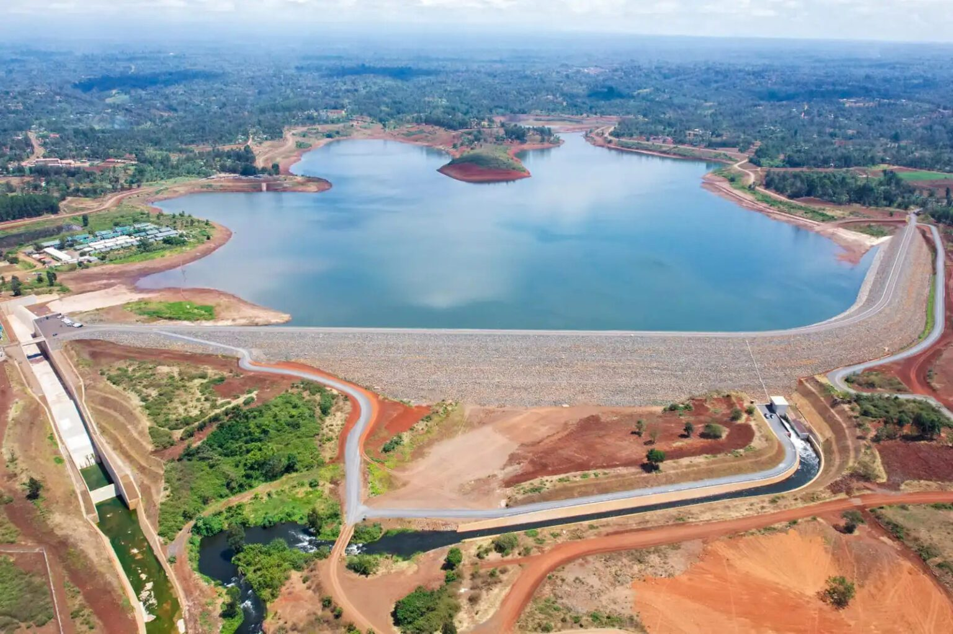
Development of Water Harvesting Dam
The country has 7 large dams with about 3.976 BCM of stored water for hydropower.
Total water storage capacity for hydropower, domestic and irrigation is 5.03 BCM that translates to 107m³ per capita. The recommended global average per capita storage is 1,500m³.
44 dams identified for development. The dams will harvest and store 2.123 BCM to provide domestic water to 11,570,705 people, provide irrigation water for 442,934 acres and can support generation of 341 MW of power.
The total cost is estimated at $ 3.87 Billion.

Slide 12




Invest in the Lower Ewaso Ng'iro South Multipurpose Dam Development
Estimated Investment Cost: US$ 1.4 Billion
Kenya cannot meet the food deﬁcit through rain-fed agriculture alone, hence need for enhanced irrigated agriculture. Water demand is estimated to reach 4,000m³/day for domestic and over 10,000m³/day for industrial use by 2030.
i
3 cascaded dams development
Hydropower with a potential of 180 MW
Irrigation of 4,500Ha
Community Water Supply to 350,000 equivalent inhabitants
Environmental Conservation of 3,000Ha
The project to be implemented on BOT model through the PPP arrangement. Feasibility studies already done
~10.62%
EIRR
~US$ 63.38Mn
NPV
~49.5%
Hydroelectric power generation
~15.3%
Water supply
~14.4%
Water management
~13.7%
Irrigated crop development
~1.07
Beneﬁt Cost Ratio (BCR)

Slide 13
Other Investment Opportunities
Project | Description | Est. Investment cost | Financial projections
High Grand Falls Multi-purpose Dam | One of the Flagship projects in the Kenya Vision 2030. Located about 260 km from Nairobi City and 50 km downstream of Kiambere Dam. The dam will be the last project on the existing Tana River cascade. Project scope: Irrigation scheme; Hydroelectric power generation; A reservoir; Public water supply | US$ 1.849 Billion | EIRR ~16.3%; NPV @ 12% ~US$ 243.3Mn; Benefit/Cost ratio (BCR) ~1.23;
Augmentation of Chebara Pipeline | A water supply project aiming to improve the transmission capacity of Chebara-Kapsoya transmission mainline to evacuate the full design potential of the treatment works of 28,000 m³/day and determine the capability of the treatment plant to treat the 34,000m³/day maximum outflow from the dam. | US4 3.75 Million | BCR: 1.26
Two Rivers Dam and expansion of Sosiani Treatment Plant | The project involves construction of a 38m high Roller compacted dam, construction of a new treatment plant of 60,000m3/day capacity. The project will also involve expansion of distribution network within Eldoret town to serve a population of about 1 Million. | US$ 1.756 Billion | BCR: 1.22
Kamiti 1 Dam project | A proposed water supply project, located along Kamiti River, Kiambu County. The project seeks to supply an additional 16,500m3/day of water to the area serving 250,000 residents. | US$ 32 Million | TBD

Slide 14
Other Investment Opportunities
Project | Description | Est. Investment cost | Financial projections
Keben Dam Water Supply Project | Involves construction of a 12m high concrete dam, construction of a new treatment plant of 8,000m3/day capacity and expansion of distribution network within Kapsabet and Baraton towns of Nandi County. It will serve a population of about 250,000 people and increase supply hours to 24 from the current 12 hours. | US$ 56.1 Million | BCR: 1.2
Gatamaiyu Dam project | A proposed water supply project, located along the Gatamaiyu River about 2.5Km North West of Kambururu Shopping Centre. The project target areas are Ruiru, Juja & Githunguri in Kiambu County which currently experience inadequate water supply due to rapid population growth over the years. | US$ 140 Million | NPV: US$ 20.89 Mn at 5% EIRR: 13% BCR: 1.35
Bonyunyu Dam project | Located along Gucha River. The project will serve Kisii and Nyamira Counties. The Bonyunyu Dam will be designed to allow sufficient storage for the projected water demand (525,000 people) by 2040 | US$ 92.2 Million | IRR: 6.77%
Water Supply Reduction and Associated Management Project | Project designed to increase the efficiency and effectiveness of water distribution networks and related operations. Entails Network Replacement Works, System Expansion Works that might become necessary because of new customers applying for connections, as well as a provision for Emergency works and Unforeseen works. | US$ 60 Million | TBD

Slide 15
Other Investment Opportunities
Project | Description | Est. Investment cost | Financial projections
Pesi Dam Project | Project located 1.5Km upstream of the confluence of rivers Pesi and Gathanji in Nyandarua County. Upon completion, the identified project site will have a gross storage capacity of ~15.5 million Cubic meters. Project scope: Conventional Water Treatment Plant ~50,000m3/day; Augmentation of existing water supply network (Approx. 88 Km) and Mini-hydro power Generation of 262kW. | US$ 108.5 Million | IRR: 14.89%
Rehabilitation and improvement of Eldoret town’s existing water network and installation of automatic meter reading | Project aims at reducing Non-Revenue Water from the current 34% to the recommended value of 25%. It will involve replacement of aging water infrastructure in Eldoret town, expansion and extension of the existing water network and Replacement of aged water meters with AMI-enabled (smart meters) and acquisition of AMI meter management. | US$ 20.8 Million | TBD
Enhancing Food and Water Security for small holders community in the TARDA region | The project aims at enhancing integrated food and water security for small scale holder communities in the TARDA region through promotion of sustainable and effective use of natural resources, enhancing access to water and introduction of improved farming and water management practices. | US$ 44.24 Million | TBD

Slide 16
Other Investment Opportunities
Project | Description | Est. Investment cost | Financial projections
Lower Muranga Smallholder Irrigation Project | Seeking investors and private sector partners to invest in irrigation & hydropower infrastructure as well as dam development spread across 5 clusters representing 5 regions within the larger Muranga catchment area. | US$ 102.5 Million | NPV: US$ 11.76 Mn IRR: 26.67%
Bubisa Integrated Wind Power Generation project | To be located along Marasabit Moyale road. To be implemented as part of the larger Chalbi Desert Integrated Development Programme which has four components: 420MW Wind Power Generation, Water Development, Development of access roads and CSR activities such as construction of schools. | US$ 906 Million | TBD
Lake Chala Water resources Integrated development project | Project is focusing on irrigated Agriculture, forestry and domestic water supply. Targeted acreage is 2,020ha across 6 sites to be developed in a phased approach. The Coast Development Authority proposes a Build Operate and Transfer model. Project development o be implemented in 3 years. | US$ 158.29 Million | IRR: 7.48% NPV: US$ 73.57 Mn Benefit-Cost Ratio: 1.42

Slide 17
Other Investment Opportunities
Project | Description | Est. Investment Cost | Financial Projections
Radat Dam | This project aims to construct the Dam to regulate the flow of the Perkerra River and enhance the development of the Perkerra Irrigation Scheme. Project scope: Construction of a dam with a storage capacity of 124Mm3; Hydropower generation of 1 MW | US$ 38.088 Million | TBD
Lowaat Dam | Lowaat Dam and Irrigation Development project is proposed across the lower reach of Kerio River in Turkana East sub county, and approximately 15 km upstream of Lokori town. Project Scope: Water storage reservoir with a capacity for 383.7 Mm3; Irrigation system covering 43,759 acres; Hydropower plant with capacity for 9.3 MW; Water treatment plant with capacity for 17,280m3/day to serve 253,000 individuals and livestock use. | US$ 29.668 Million | TBD
Kithinu Multipurpose Dam | The Project will provide sustainable access to safe water to the 59% currently unserved population (33,000 households), ultimately irrigate 12,000 acres of high value crops and power the Water Treatment Plant and agro-processing industries. Project Scope: Construction of a 44Mm3 reservoir;25,000m3/day Water Treatment Plant (WTP), Irrigation: Construct Small Hydro Power Plant (SHPP) with capacity for 1 MW together with electricity distribution to the WTP. | US$ 10.744 Million | TBD

Slide 18
Contents
01
Why Kenya
02
Investment Opportunity
03
Get Started

Slide 19

Get started with KenInvest and KDC

Slide 20




