Slide 1

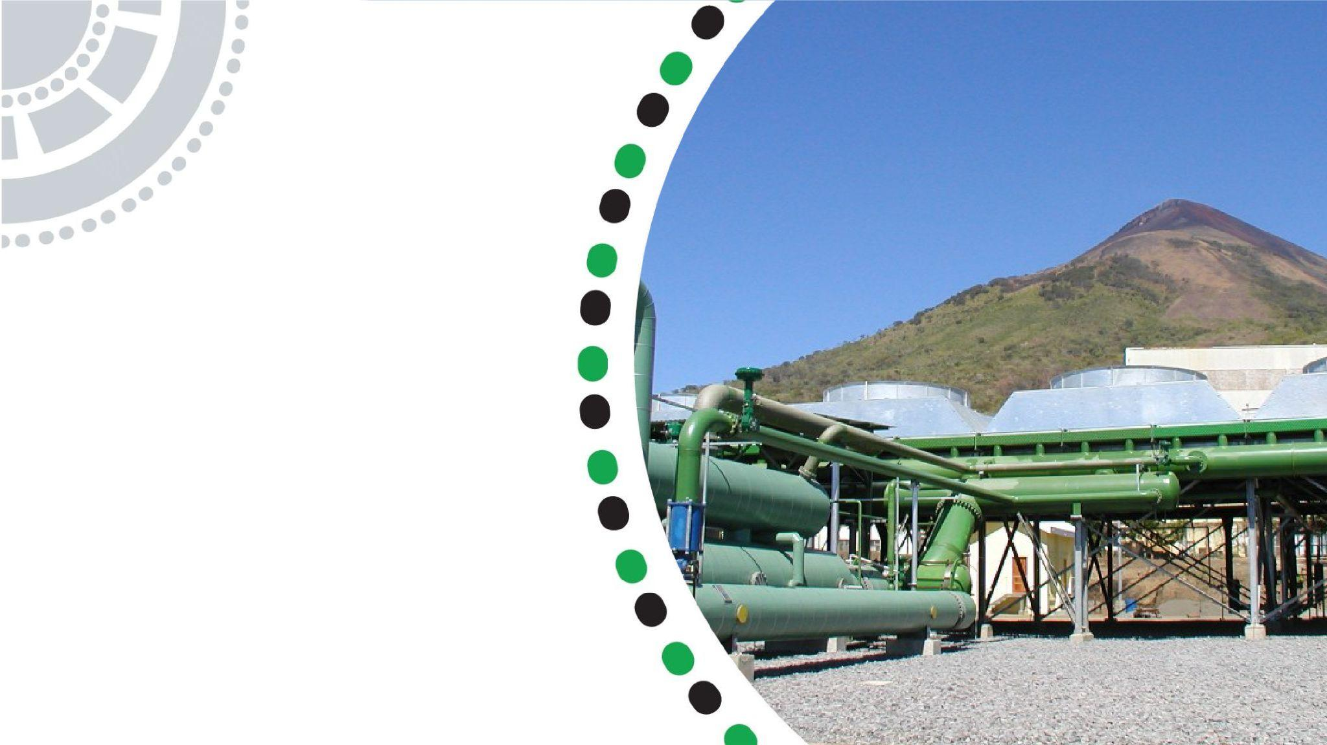




Investment in LPG Infrastructure

Slide 2
01
Why Kenya
Contents
02
Investment Opportunity
03
Get Started

Slide 3

Why Kenya
Regional economic hub
Host to over 200 Multinational Corporations with regional & continent-wide HQs in Nairobi
Robust financial system
  43 banking institutions
  9 representative offices of foreign banks,
  13 Microfinance Banks,
  3 credit reference bureaus
  19 Money Remittance Providers
  73 forex bureaus
3rd largest
economy in sub-Saharan Africa.
US$ 110.35 Bn
7.5% growth
Dominant economy in EAC
≈46% of EAC’s GDP.
Africa’s UN HQs (UNON) which is one of four main UN secretariat duty stations globally.
Global headquarters of UNEP and UN-Habitat, together with a joint presence of 23 other UN Agencies.
Communications & Logistics hub of the region
Access to regional transport corridors.
  4 international airports
  2 sea ports and 2 ICDs
  30-freight and 2-passenger rail services daily between Nairobi and Mombasa.
US$ 2,081.8
+75% growth since 2010
Growing middle-class with an increasing appetite for high-value goods and services.

Slide 4
The Investment Environment is Conducive
Guaranteed repatriation of capital and profits
Constitutional protection against expropriation
Investment guarantee against non-commercial risks: ICSID, MIGA and ATIA
1
Economic liberalization
One stop shop facilitation
Periodic Presidential roundtables with private sector
Digitization of government services
Facilitative Industrial zone programs - EPZs & SEZs
2
3
Political and macroeconomic stability.
High labour productivity: a large pool of youthful, trainable and literate workforce
Globally competitive:
  56th in the Ease of Doing Business
  1st for five years in a row in financial inclusion
  1st globally in protection of minority investors
  Nairobi – Africa’s leading business travel destination and hub for impact investors.
  2nd in Africa in the logistics performance index
Investment attractiveness
Investment facilitation
Source: World Bank, UNCTAD, CBK, KNBS

Slide 5
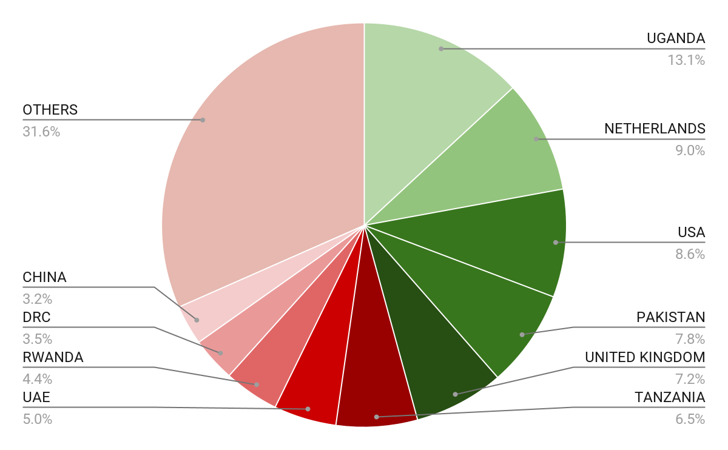





Wide Market Access & Good Trade Relations
US$ 17.43 Bn
Total Imports
US$ 6.09 Bn
Total Exports
Preferential Trade Agreements
1.7Bn
Population
~ US$ 40Tn
Market value
Kenya’s untapped export potential
~ US$ 4.1 Bn (ITC)

Slide 6
Existing Bilateral Trade Treaties with United Kingdom
Economic Partnership Agreement: In 2021, Kenya and the UK signed a trade agreement that seeks to deepen trade and investment ties between the two countries by providing a framework for the elimination of tariffs and non-tariff barriers.
Development Cooperation Agreement: In 2018, Kenya and the UK signed a development cooperation agreement, which aims to strengthen cooperation in areas such as health, education, governance, and security.
Double Taxation Agreement: In 1976, Kenya and the UK signed a double taxation agreement, which seeks to prevent double taxation of income earned by residents of the two countries.
Air Services Agreement: In 1967, Kenya and the UK signed an air services agreement, which allows airlines from the two countries to operate scheduled services between them.

Slide 7
Contents
01
Why Kenya
02
Investment Opportunity
03
Get Started

Slide 8


Outline
4
Q&A
3
Midstream
2
Upstream
1
Background

Slide 9
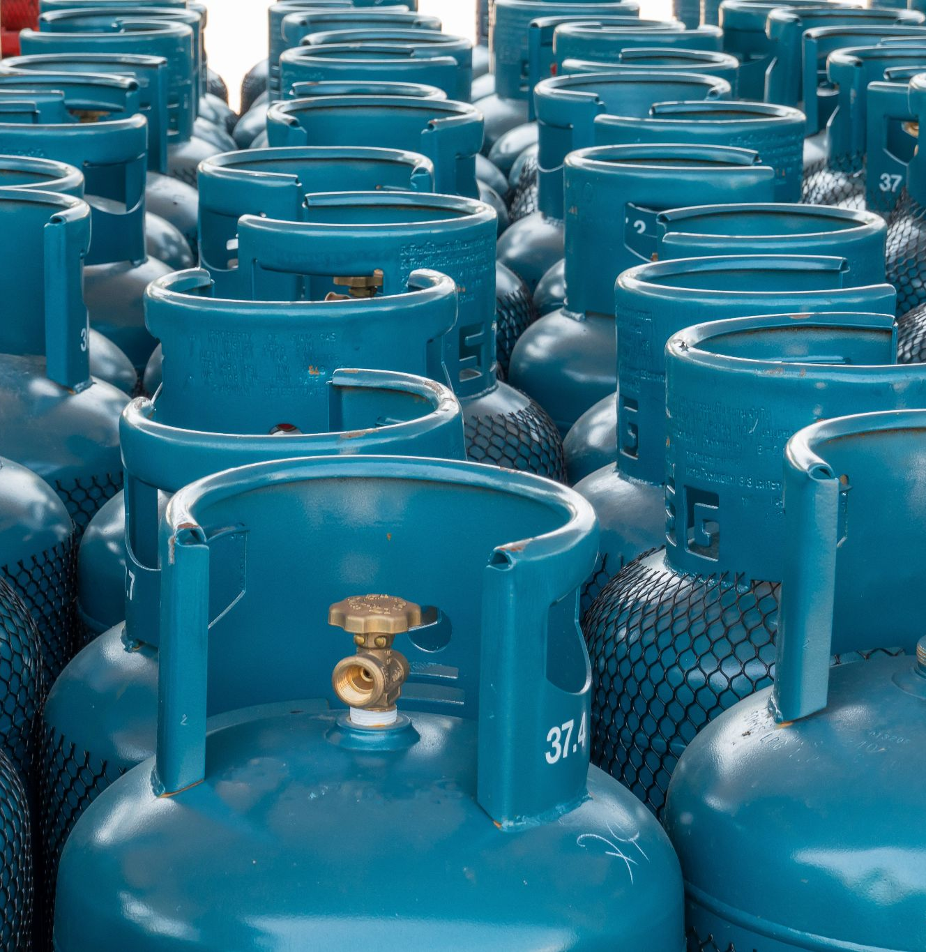
Introduction
The upstream petroleum sector in Kenya offers promising opportunities for the exploration, development, and production of oil and gas.
The midstream petroleum sector in Kenya requires significant investment in the development of petroleum infrastructure.

Slide 10
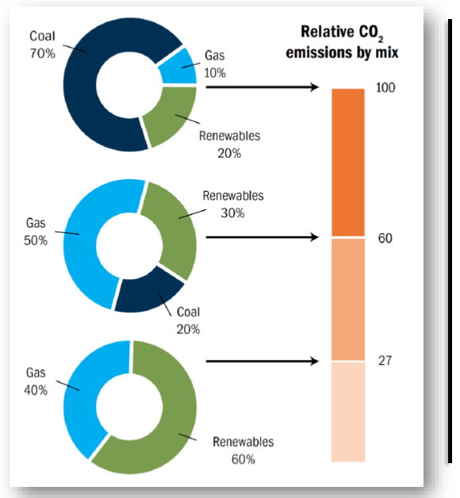
Natural Gas for Power Generation
Make gas an important integral part of our energy mix.
A mix of gas-fired power generation capacity that supports further penetration of renewable energy, provides long duration balancing of resources, and ensures supply is reliable even when renewable energy generation is low or intermittent.
Together, natural gas and renewables offer reliable, flexible and cost-effective access to more and cleaner energy.

Slide 11
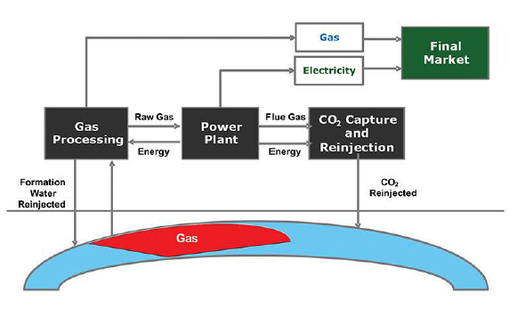
Gas to Power
The reservoir-to-wire or gas-to-wire business model provides an opportunity to monetize the gas in Block-9
An upper gas bearing interval tested dry gas at a maximum rate of 6 mmcf/d with 91 m gas pay (GIIP -362 Bcf) in tight sands (2009/2010)

Slide 12
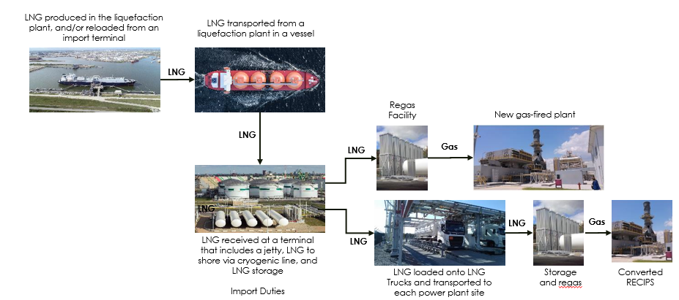
LNG Terminal
Planned LNG Terminal to facilitate importation of LNG for power generation & industrial usage

Slide 13
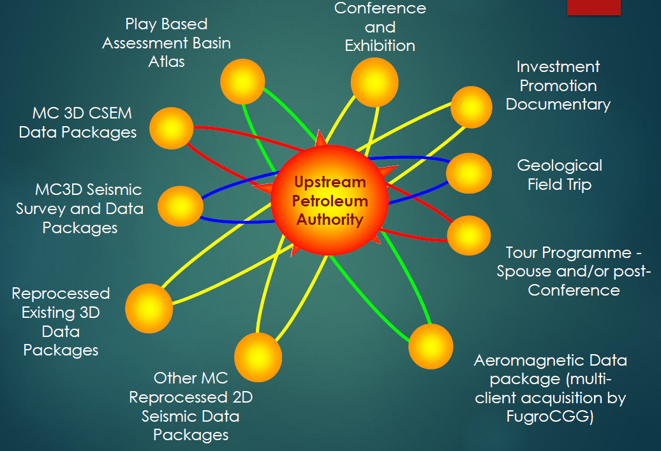
Data Acquisition and Reprocessing of Legacy Data

Slide 14
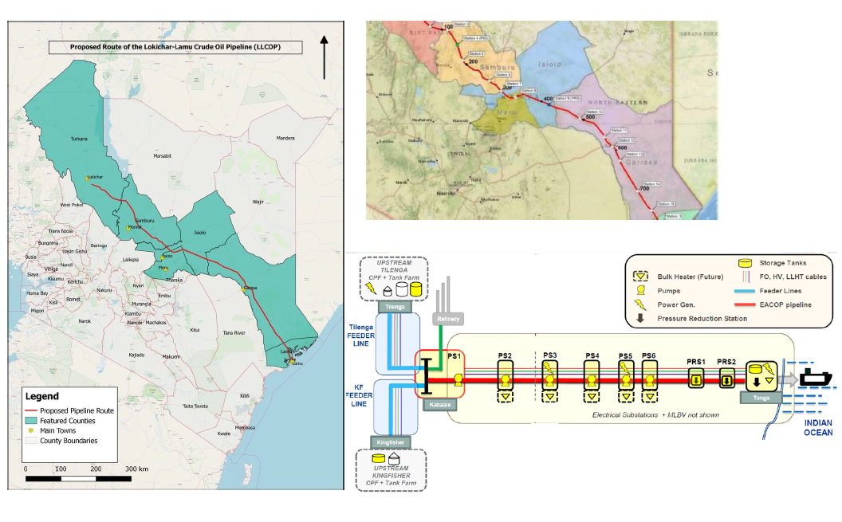
Kenya Crude Oil Pipeline
The pipeline that is projected to be 821 km long and crosses 6 counties provides an excellent opportunity to invest

Slide 15
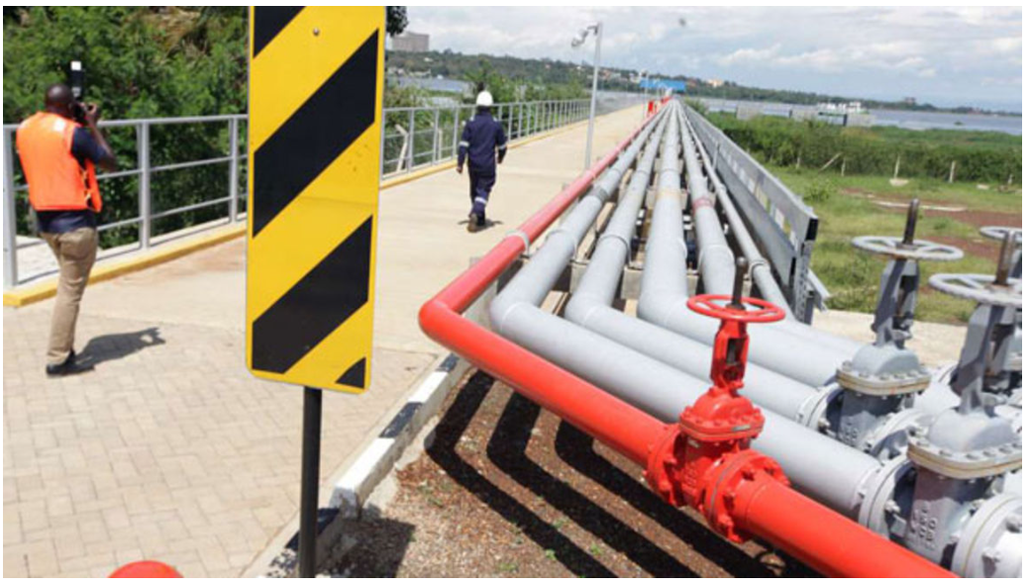
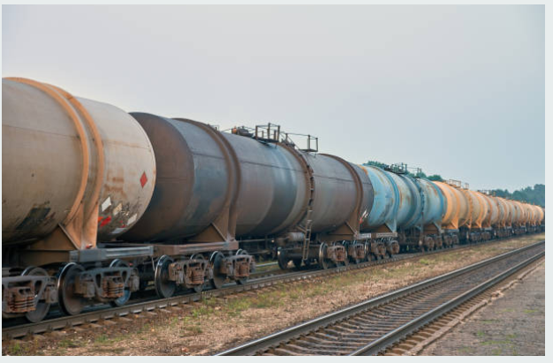
Midstream and Downstream
Commercial cooperation with Kenya’s state-owned agencies through strategic partnerships to develop midstream and downstream infrastructure.

Slide 16
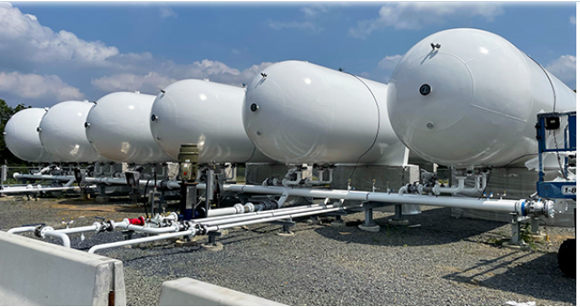
Midstream and Downstream Investment Opportunities
Investment in LPG bulk storage,
Pipeline expansion and storage,
Isotainers for rail transportation of Petroleum products and LPG
Development of the proposed Bomba to Mombasa LPG pipeline

Slide 17
Contents
01
Why Kenya
02
Investment Opportunity
03
Get Started

Slide 18

Get started with KenInvest and KDC

Slide 19



